Slide 1
Review
A quick review of each chapter

Slide 2
Chapter 1
One-Variable Statistics

Slide 3
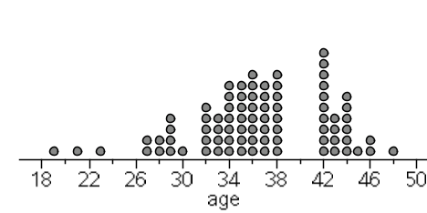
How old is our teacher?
Describe the distribution.
CUSS: Center(mean and median), Unusual features(are there outliers?), Shape(skewed left,symmetric, skewed right), Spread(max to min)
N=82

Slide 4
How old is our teacher?
The distribution of age guesses are slightly skewed to the left, with a mean age guess of 36.4 which slightly larger than the median guess of 36. Guesses of Mr. Pines’ age ranged from 19 to 48 years old.

Slide 5
5# Summary
Definition:
The five-number summary of a distribution consists of the smallest observation, the first quartile, the median, the third quartile, and the largest observation, written in order from smallest to largest.
Minimum Q₁ M Q₃ Maximum

Slide 6
Box Plots
25%
25%
25%
25%
Min Q1 Q2 Q3 MAX

Slide 7
Outliers in a boxplot
1,4,7,12,13,13,21,36
Possible outlier
MIN | Q1 | MEDIAN | Q3 | MAX
1 | 5.5 | 12.5 | 17 | 36
Checking for outliers we use the formulas:
Q1 – 1.5(IQR)…..any number LOWER is an outlier
Q3 + 1.5(IQR)…..any number LARGER is an outlier
IQR = Q3-Q1

Slide 8
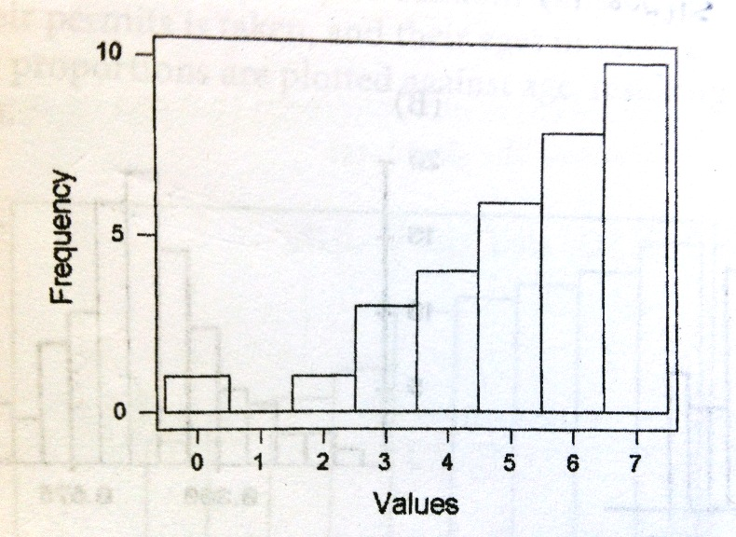
5# Summary of Histogram
10
8
6
4
3
1
1
n=33

Slide 9
Half of 33 is 16.5 so the median falls in the “6” column
Half of 16.5 is 8.25 which makes Q1 in the “4” column
On the other half Q3 falls in the “7” column
10
8
6
4
3
1
1
n=33

Slide 10
Chapter 2
Normal Distribution

Slide 11
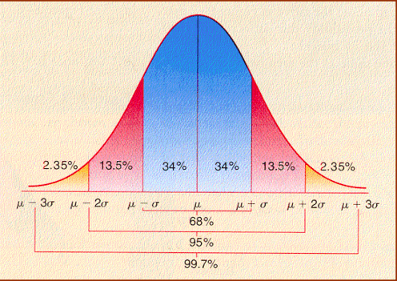
The Empirical Rule
68,95,99.7
68% of the data is within 1 StDev of the mean
95% of the data is within 2 StDev of the mean
99.7% of the data is within 3 StDev of the mean

Slide 12
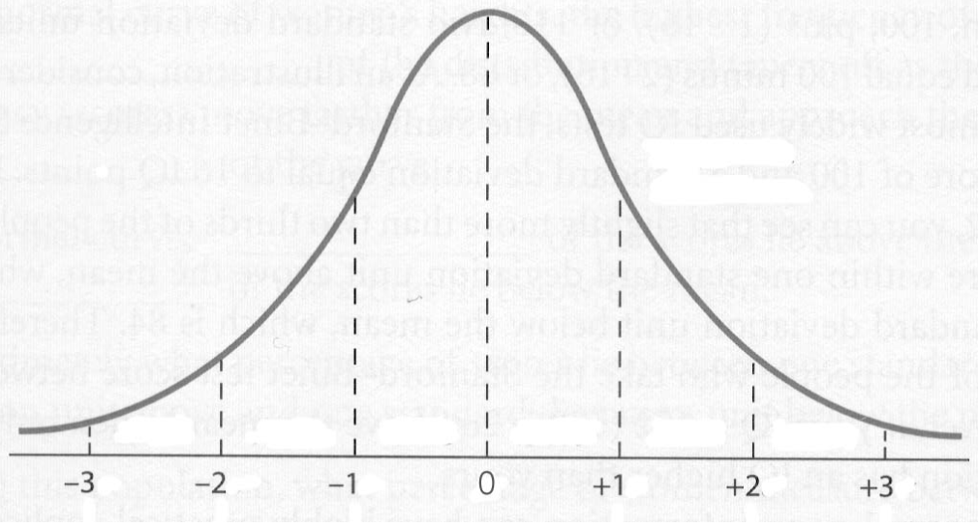
Standard Normal Curve
N(0,1)

Slide 13
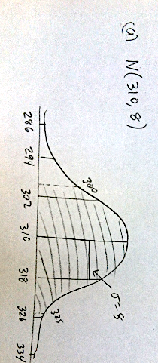

Slide 14
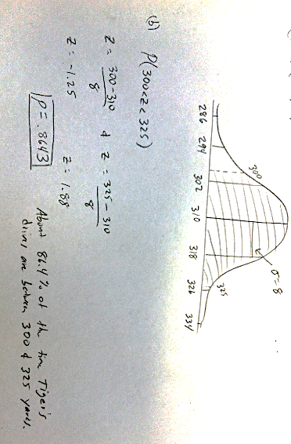

Slide 15
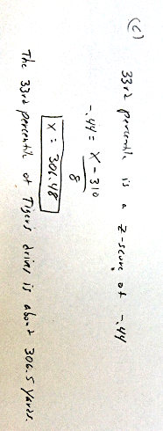

Slide 16
Outliers on a Normal Curve
You need to remember the outlier formulas:
Q1 – 1.5(IQR)
Q3 +1.5(IQR)

Slide 17
Outliers on a Normal Curve
Q1 is the 25th percentile
Q3 is the 75th percentile
Why?

Slide 18
Outliers on a Normal Curve
invNorm(.25) = -.67
invNorm(.75) = .67
IQR = Q3 – Q1
IQR = .67 – (-.67) = 1.34
Q1 – 1.5(IQR)
Q3 +1.5(IQR)
-.67 – 1.5(1.34) =-2.68
.67 + 1.5(1.34) = 2.68

Slide 19
Outliers on a Normal Curve
z = -2.68
z = 2.68

Slide 20
Outliers on a Normal Curve
z = -2.68
z = -.67
z = .67
z = 2.68
Q1
Q3

Slide 21
Outliers on a Normal Curve
IQR = 1.34
Q1
Q3

Slide 22
Chapter 3
Scatterplots and Linear Regression

Slide 23
Study Time and GPA

Slide 24
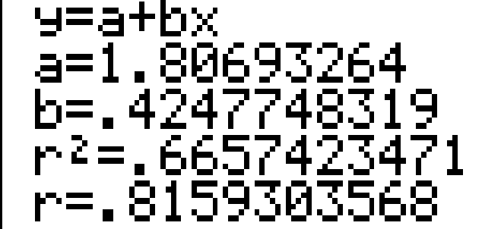
Study Time and GPA

Slide 25
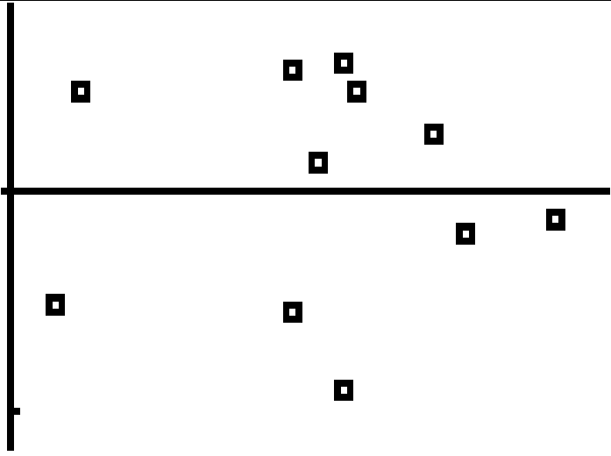
Study Time and GPA
Residual Plot
A randomly scattered residual plot shows that a linear model is appropriate.

Slide 26
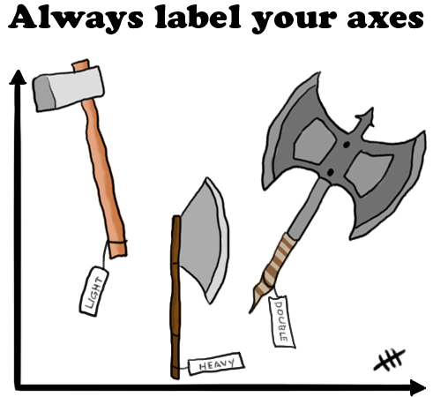

Slide 27
Study Time and GPA
Write the linear equation:
GPA = 1.8069326 + .4247748(Study Time)

Slide 28
Study Time and GPA
Interpret the Slope(b):
For every hour of study our model predicts an avg increase of .4247748319 in GPA.

Slide 29
Study Time and GPA
Interpret the y-intercept(a):
At 0 hours of study our model predicts a GPA of 1.8069326.

Slide 30
Study Time and GPA
Interpret the correlation(r):
There is a strong positive linear association between hours of study and GPA.

Slide 31
Study Time and GPA
Interpret the Coefficient of Determination(r²):
66.6% of the variation in GPA can be explained by the approximate linear relationship with hours of study.

Slide 32
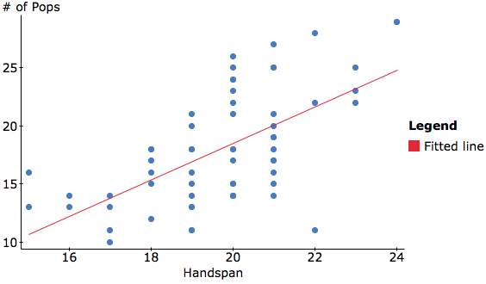
Tootsie Pop Grab
If this point was removed, the slope of the line would increase and the correlation would become stronger.
Are there any outliers or influential points?

Slide 33
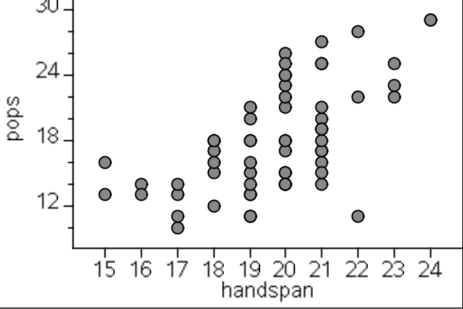
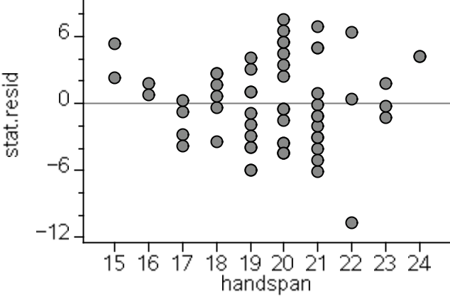
Scatterplot vs Residual Plot
The residual plot uses the same x-axis but the y-axis is the residuals.
The residual plot shows the actual points. It shows whether they were above or below the prediction line.

Slide 34
Scatterplot vs Residual Plot
Prediction line

Slide 35
Tootsie Pop Grab
What was the predicted # of pops for a handspan of 24?
Predicted # of Pops = -12.9362 + 1.57199(Handspan)

Slide 36
Tootsie Pop Grab
What was the predicted # of pops for a handspan of 24?
Predicted # of Pops = -12.9362 + 1.57199(24)
24.79

Slide 37
Tootsie Pop Grab
Check the residual plot for this.
What was the ACTUAL # of pops for a handspan of 24?
It’s predicted +/- residual.
24.79 + 4 = 28.79

Slide 38
Correlation
r = ± .70 to ± .99 Strong Correlation
r = ± .40 to ±.69 Moderate Correlation
r = ± .01 to ± .39 Weak Correlation

Slide 39
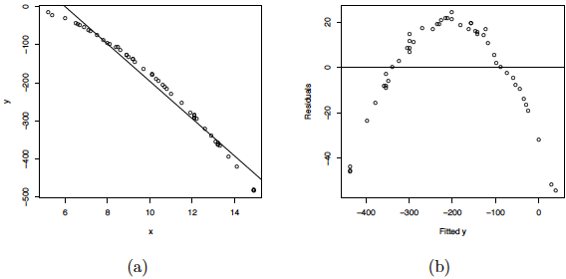
Scatterplot & Residual Plot
Sometimes you can spot a curved residual plot in the scatterplot

Slide 40
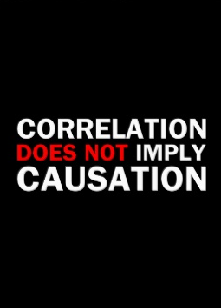
Correlation Does Not Imply Causation

Slide 41
Chapter 12.2
Transformations

Slide 42
Transformations
If your Linear Model x,y is not Appropriate…..
There are a few options to try…..
Exponential Model x ,Log(y)
Power Model Log(x), Log(y)
Try the above options in that order, check r² and the residual plot,……if r² is high and the residual plot looks good then you have found a suitable model
CAUTION…Real data may not have a perfect model….sometimes you have to settle on “good enough”

Slide 43
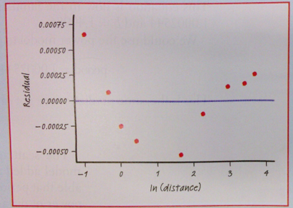
Curved residual plot

Slide 44
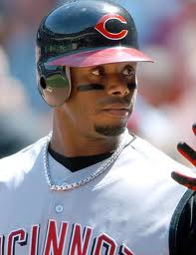
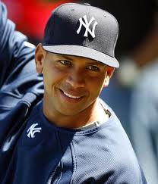
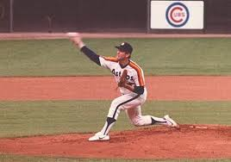
Baseball Salaries
Ballplayers have been signing very large contracts. The highest salaries (in millions of dollars per season) for some notable players are given in the following table.

Slide 45
Player | Year | Salary (millions $)
Nolan Ryan | 1980 | 1.0
George Foster | 1982 | 2.0
Kirby Puckett | 1990 | 3.0
Jose Canseco | 1990 | 4.7
Roger Clemens | 1991 | 5.3
Ken Griffey Jr. | 1996 | 8.5
Albert Belle | 1997 | 11.0
Pedro Martinez | 1998 | 12.5
Mike Piazza | 1999 | 12.5
Mo Vaughn | 1999 | 13.3
Kevin Brown | 1999 | 15.0
Carlos Delgado | 2001 | 17.0
Alex Rodriguez | 2001 | 22.0
Manny Ramirez | 2004 | 22.5
Alex Rodriguez | 2005 | 26.0

Slide 46
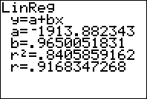
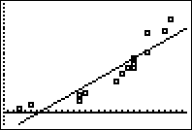
Year VS SALARY
R² is high, however the scatterplot appears to have a curved pattern. A linear model may not be appropriate.

Slide 47
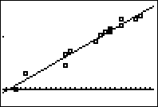
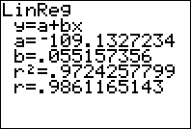
Year vs Log(salary)
This is an exponential model. R² is very high and the scatterplot shows no curvature. This appears to be a good fit for this data. Make sure to check the residual plot to make sure.

Slide 48
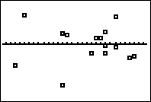
Residual Plot
This residual plot shows no curved pattern and the residuals are randomly scattered above and below the axis…this shows that your model is a good fit.

Slide 49
Exponential model
Use the data from your new model to write the equation.
Make a prediction for the salary in the year 2006
Make a prediction for the salary in the year 2015

Slide 50
Exponential model
Log(salary) = -109.133 + 0.05516YEAR
Make a prediction using your model for a salary in 2006.
About 33 million a year

Slide 51
Life expectancy
The following data is Life Expectancy for white males in the United States every decade during the last century (1 = 1900 to 1910, 2 = 1911 to 1920, etc.). Create a model to predict future increases in life expectancy.
Decade | 1 | 2 | 3 | 4 | 5 | 6 | 7 | 8 | 9 | 10
Life Exp. | 48.6 | 54.4 | 59.7 | 62.1 | 66.5 | 67.4 | 68 | 70.7 | 72.7 | 74.9
Enter the data into your calculator and show evidence that a linear model is not appropriate.
Try using “logs” to find a better model.
Write the equation and sketch the scatterplot and residual plot to show evidence of why your model is a good fit.
Make a prediction for the life expectancy of the decade that we are in now.

Slide 52
Below is a table of data on the intensity of light at various depths in a lake.
Depth(meters) | Light Intensity(lumens)
5 6 7 8 9 10 11 | 168 120.42 86.31 61.87 44.34 31.78 22.78
1. Make a scatterplot of the linear relationship between Depth and Light Intensity.
2. Describe the relationship
3. Use the (natural log) of one or both variables to find a better model.
4. Write the equation of your new model.
5. Sketch the residual plot of your new model. Explain why this is a better model.
6. Make a prediction of a depth of 17 meters.

Slide 53
Chapter 4
Observational Studies & Experimental Design

Slide 54
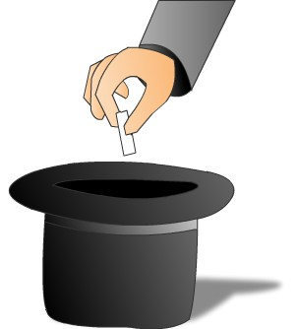
Sampling Design

Slide 55
The entire group of individuals that we want information about is called the population.
A census is an attempt to gather information about every individual member of the population. Problems with census—costs; time needed to complete; sometimes testing can destroy item.
A sample is a part of the population that we actually examine in order to gather information.
The design of a sample refers to the method used to choose the sample from the population.
The design of a study is biased if it systematically favors certain outcomes.

Slide 56
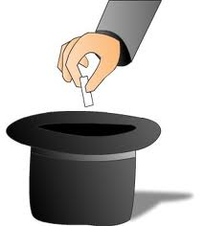
Obtaining a randomly chosen sample refers to the way in which the sample is chosen, not the specific members of the population that happen to end up in the sample.
Simple random sample (SRS)
each member of the population is equally likely to be chosen;
the members of the sample are chosen independently of one other;
every set of n units has an equal chance to be the sample actually selected.
“Classic” method—put names in hat and draw until have desired sample size; more commonly, number names and use random number table or other source of random numbers to select sample.

Slide 57
Systematic sampling—Select every k^{th} element in the population. Easier than random sampling; also guarantees sample is taken from throughout the population—be careful how population is ordered. (i.e. take every 10th student at RAHS; start at randomly selected point—still requires list)
Cluster sampling—divide the population into sections or clusters; randomly select a few of those sections and then choose all members from the selected sections (i.e. randomly select 10 third period classes—survey all students in each class selected—faster way to obtain sample)
Stratified random sampling—select subjects from similar groups called strata (i.e. select SRS from each grade-level at RAHS—9th, 10th, 11th, 12th—in proportion to number of students in each level)
Multi-stage design—uses multiple strata

Slide 58
Sources of bias in probability samples:
Under-coverage occurs when some groups in the population are left out of the process of choosing the sample (i.e. telephone survey excludes those without phones).
Response bias occurs when the method of observation tends to produce values that systematically differ from the true value in some way. BAD DESIGN
Non-response bias occurs when individuals chosen for the sample can’t be contacted or refuse to cooperate.

Slide 59
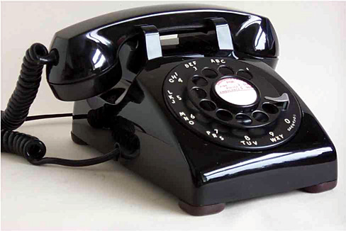
Difficulties with probability sampling—may be no easy way to list all members of a population or to contact some people. Can use: voter registration lists—not everybody is registered; list of all addresses—homeless, multiple people at same address; telephone numbers—unlisted phone numbers, people with multiple numbers are over-represented cell phones

Slide 60
Other sampling techniques (nonprobability—BAD!):
Convenience sampling—easiest way to obtain a sample is to choose it without any random mechanism (Simply uses a sample that is readily available—often biased.
Voluntary sample)—when people participate in a survey by voluntarily responding. People who care enough to respond usually are not representative of the whole population. Not random.
Judgment sampling—a form of convenience sampling where an “expert” selects a sample she/he considers representative. Not random

Slide 61
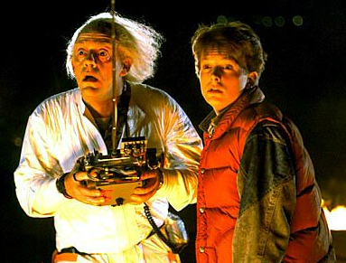
Experimental Design
3 major components of experimental design.
Control
Randomization
Replication

Slide 62
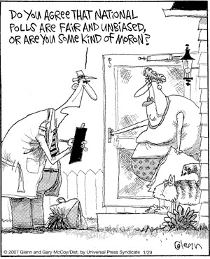
Random sampling is often difficult to do, especially for large populations. (Convenience sampling is easy to do but not very useful—may be representative/ balanced for variables in strata but not for population as a whole.)
The wording of questions is the most important influence on the answers given to a sample survey. Confusing or leading questions can introduce measurement bias. Even minor changes in wording can change the outcome of a survey—pretest survey (often in interview format) to check clarity of questions.

Slide 63
Control--continued
500 subjects
Methods of control.
Blocking: You block to control a known lurking variable.
Example: Headache medicine—gender could be a factor. We will separate men and women into 2 blocks
Then half are given new medicine and half are given the old medicine to compare results.
Men
Women
Randomly
assign half
To new medicine
Randomly
Assign half to old
medicine
Randomly
Half to new
medicine
Randomly
Half to old
medicine

Slide 64
Mr. Pines Surf Wax
Mr. Pines has a brand new surf wax he needs to test out. In order to determine whether his brand of surf wax is worth mass producing he needs to do an experiment comparing it to the current on the market surf wax. In his experiment he has enough money to use 50 subjects. Help Mr. Pines set-up an experiment using a completely randomized design, a block design, and a matched pairs design. He may just choose one of these designs and become a millionaire!

Slide 65
Completely Randomized Design
25 subjects Current Wax
RANDOMIZE
Compare Results
50 subjects
25 subjects Mr. Pines Wax
Place the 50 subjects names in a hat and draw 25 names randomly and place these in the current wax group, the remaining names in the hat will be in Mr. Pines Wax group

Slide 66
Block Design
Some may say the there may be a difference between the effect of wax on short boards and on longboards. This should be accounted for in a block design.
Current Wax
25 Short Board
RANDOMIZE
Mr. Pines Wax
50 subjects
Compare Results
Current Wax
25 Longboard
RANDOMIZE
Mr. Pines Wax
Each board group will randomly take the first 13 peoples names drawn out of a hat and will be placed in the current wax group, the remaining 12 will be in Mr. Pines wax group.

Slide 67
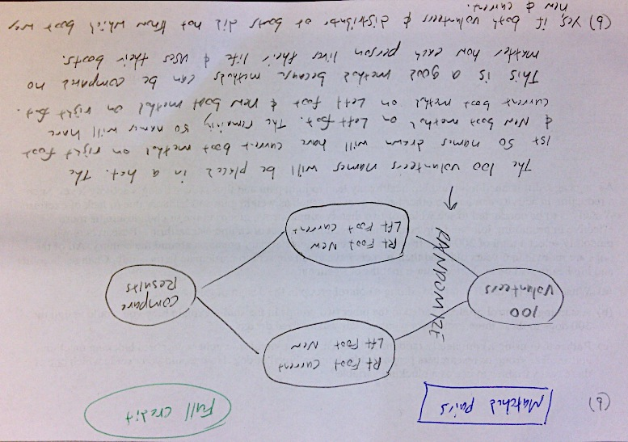

Slide 68
Chapter 6
PROBABILITY
Simulation
Venn Diagrams
Tree Diagrams
Two-Way Tables

Slide 69
Simulation
You must clearly explain your method.
Remember D.A.R.E.
D: Determine the number of digits to be taken at a time
A: Assign your digits.
R: Repeats? Do you allow them or ignore them?
E: Ending rule, when do you stop taking digits?

Slide 70
SURF
BREAKFAST
SURFED
BREAKFAST
.63
.08
.16
SURF ONLY
BOTH
BREAKFAST ONLY
.13
Venn Diagrams
NEITHER

Slide 71
Conditional Probability Formulas

Slide 72
Conditional Probability Formulas

Slide 73
Independent Events
If 2 events A and B have no effect on each other then they are independent.
If A and B are independent then:

Slide 74
Mutually Exclusive
Mutually Exclusive events mean that A and B cannot both happen.
Events cannot be Independent and Mutually Exclusive

Slide 75
THE HIV PROBLEM
It has been estimated that in the United States, 1 out of 250 people are infected with HIV.
Currently the test for determining if someone is infected with HIV is 99.5% accurate.
What is the probability that a randomly selected person tests positive for HIV?
If a randomly selected person tests positive for HIV what is the probability that they are really infected?

Slide 76
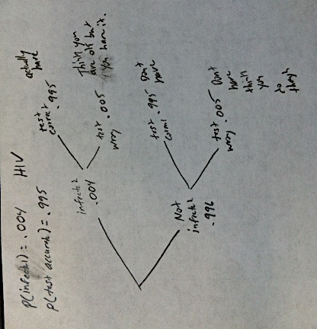

Slide 77
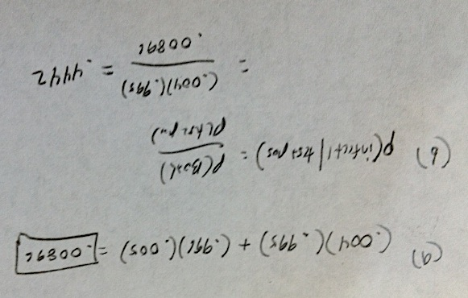

Slide 78
Chapter 7
Sampling distributions

Slide 79
Parameter vs Statistic
In each of the following determine which bold face # is a parameter or a statistic.
During the first quarter, Mr. Pines was planning on giving out on average about 20 baseball cards per student. After surveying 25 students at random there were actually about 32 cards per student given out.
A Parameter is the number that goes with the population,the number that we are expecting from prior studies or given information.
A Statistic is the number obtained from a sample.

Slide 80
Parameter vs Statistic
In each of the following determine which bold face # is a parameter or a statistic.
On a certain airline flight last week, 7% of the 195 passengers were selected for random security screening. Typically this same flight randomly selects 11% of its passengers.
A Parameter is the number that goes with the population,the number that we are expecting from prior studies or given information.
A Statistic is the number obtained from a sample.

Slide 81
Ch2 Vs Ch7
The Chapter 2 Test scores had a mean of 73 and a standard deviation of 9
Ch2 Question: What is the probability that a randomly chosen test score was greater than 88?
Ch7 Question: What is the probability that 5 randomly chosen test scores have a mean greater than 88?
Do you see the difference?

Slide 82
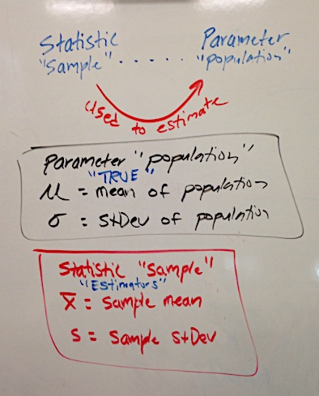
Symbols

Slide 83
Means
The mean of the sample means should be close to μ.
The standard deviation of the distribution of sample means is

Slide 84
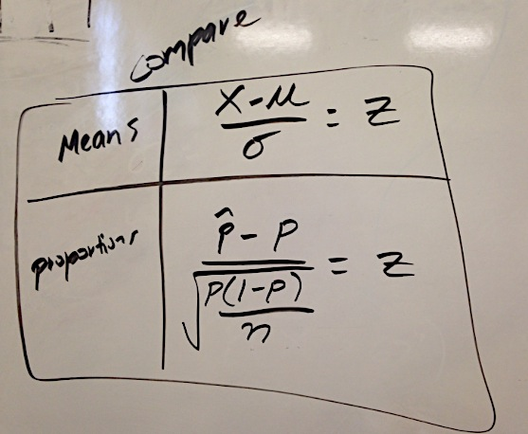
Means vs Proportions

Slide 85
Means vs Proportions
These problems require the following:
Z-score formula
The Z-Score
The Normal Curve
Shading
The probability answer
A conclusion sentence

Slide 86
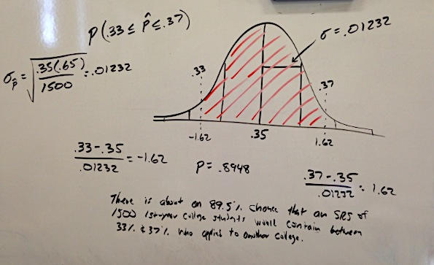
Example of a completed proportion problem.

Slide 87
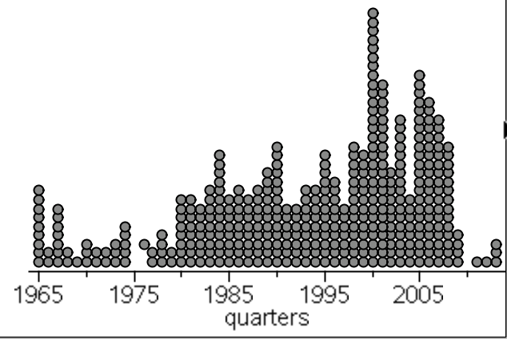
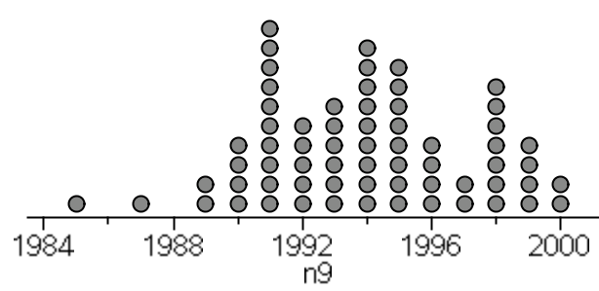
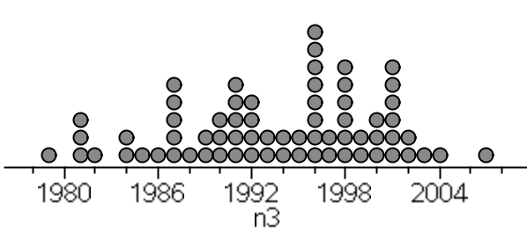
POPULATION
Mean = 1994
StDev = 11.53
Mean = 1993.6
StDev = 6.43343
Mean = 1994
StDev = 3.27263
Sampling Distribution of 67 samples of size 3
Sampling Distribution of 67 samples of size 9

Slide 88
Chapter 8
Z confidence interval (means)
t confidence interval (means)
Z confidence interval (proportions)

Slide 89
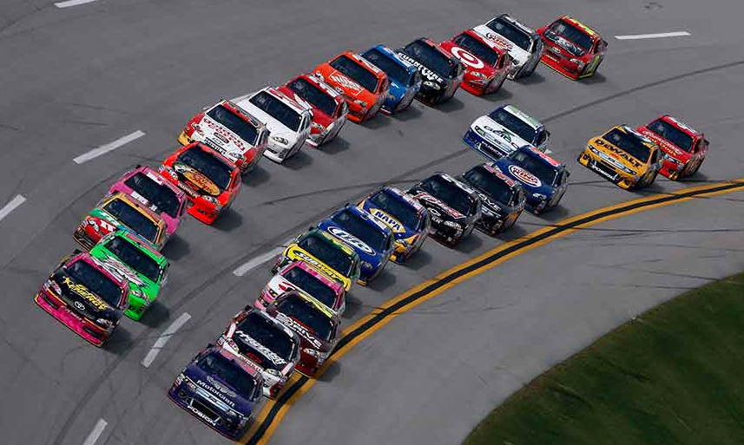
N: Name the Interval
A: Assumptions/Conditions
S: Stats from calculator
C: Confidence Interval
A: And
R: Result in Context

Slide 90
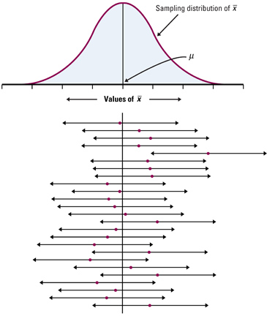
What is the meaning of these intervals?

Slide 91
What are some ways to shrink your interval?
Lower confidence.
Higher sample size.

Slide 92
Margin of Error vs Standard Error
Standard Error
With any of the margin of error formulas the standard deviation part is called the standard error

Slide 93
Cutting the margin of error
A very common question is how much does your sample size have to increase in order to cut the margin of error in half?
The sample needs to be 4x as large.

Slide 94
Reducing the margin of error
Making the margin of error ½ as large we had to multiply the sample size by 4.
It follows that…..
If the desired the margin of error is to be 1/n as big, then the sample size needs to be multiplied by n²

Slide 95
Back to the REAL Die.
How many times do we need to roll the die to have our CI accurate to within ± .10 at 90% confidence?
Use this formula
After solving, n = 789.26
So we would need at least 790 rolls.

Slide 96
Interpret the Interval
I am 90% confident that the true _____ is between ________ & ________ because I used a method that captures the true ________ in 90 out of every 100 attempts in repeated sampling.

Slide 97
Chapter 9
Z Tests
Type I and II errors
Power

Slide 98
Let’s use the following Hypothesis
H_{o}: μ = 73 vs H_{a}: μ ≠ 73, where μ is the true mean pulse rate for our class today.
We will also use the standard deviation from the previous study σ=11

Slide 99
H_{o}: μ = 73 vs H_{a}: μ ≠ 73, where μ is the true mean pulse rate for students at Rancho.
Assumptions: We have an independent random sample of 39 pulse rates taken during fourth period in class. The population of all students at school is more than 10x our sample. Our normal condition is met by the CLT.
1-sample Z Test
Mean = 69.6
n = 39
Z = -1.92
P-value = .0547
This p-value is low enough to reject Ho at the 10% level.
Based on this sample, there is evidence to suggest the the pulse rates for Rancho students may be different than 73.

Slide 100
Type 1 and 2 errors
Type 1 error — Rejecting Ho when it’s true.
Type 2 error — Failing to reject Ho when it’s false.

Slide 101
Power
STUDY THIS PAGE
What is power?
Power = 1 - β
It is the probability of correctly rejecting H_{o} when it is false.
Ways to increase power
Increase sample size
Increase alpha level.....ex.(use α = .10 instead of α = .05 or α = .01)

Slide 102
Conjecture
Mr. Pines got stung by a sting ray over the break. He is trying to decide whether he should go to the doctor.
Ho: It will heal on its own.
Ha: It needs to be looked at by a doctor.
Fill out your type I and II error template completely.

Slide 103
Type I Error: Reject Ho, when it’s true
Decide that it needs to be looked at by a doctor when it would have healed on its own.
Consequence: Wasted time,money, and the inconvenience of going to the doctor.
Type II Error: Fail to reject Ho, when it’s false
Assume that it would heal on its own when it needed to be looked at by a doctor
Consequence: It takes a long time to heal, could get infected, and may possibly result in loss of a limb.

Slide 104
Type II error is worse because you’re putting your body in serious risk
Because you want to protect against the type II error, you need to make Ho easy to reject. Choose a high alpha level .10.
The power is correctly rejecting Ho when it’s false.
So in this situation the power is the probability of correctly choosing to go to the doctor when you need to go.

Slide 105
Chapter 9 continued
INFERENCE
T Tests
1-Proportion Z Test

Slide 106
1-sample t-test
Ho: u = 3.5 vs Ha: u ≠ 3.5 where u is the true mean of this fake die.
Assumptions: We have an independent random sample of 50 rolls of a fake die. Our normal condition is met by the CLT.

Slide 107
t = -2.32
X-bar = 3
s = 1.52530
p=.0247
This p-value is low enough to reject Ho at the 5% alpha level.
This is evidence to suggest that the mean of this die might be different than 3.5

Slide 108
1-Proportion Z-Test

Slide 109
Find the p-value
A one sided t-test of sample size 16 gives t = 2.13.
What is the p-value?
tcdf(LB,UB,df)

Slide 110
Tic Tac Toe per. 1
Ho: p = .67 vs Ha: p > .67 where p is the true proportion of time that the player who goes first will win for games that are not ties.
ASSUMPTIONS: We have an independent random sample of 184 games of tic tac toe. Our Normal condition is met np > 10 and n(1-p) > 10
184(.67) = 123 184(.33) = 61
✓ ✓
p-hat = 144/184 = .783
z = 3.25
p = .0006
1-proportion z test
This p-value is low enough to reject Ho at any alpha level
This evidence suggests that the true proportion of time that the first player will win(for games that are not ties) might be greater than .67.

Slide 111
Chapter 10
INFERENCE
2-Sample T Tests
2 - Sample T Intervals
2 – Prop Z Tests
2 – Prop Z Intervals
Paired T Test

Slide 112
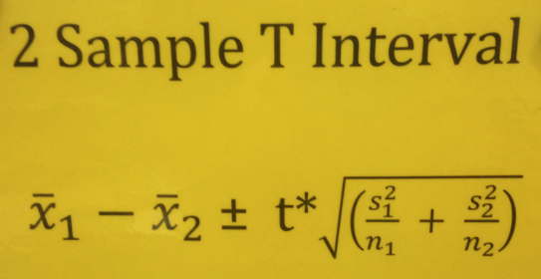
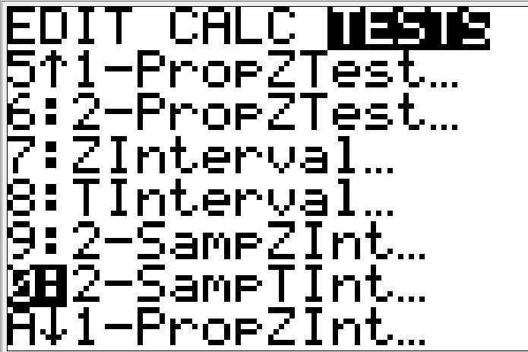
Formulas for ch13
Remember……. these will be used in MC situations not on an FRQ.
Formula Sheet
Gives Standard Error

Slide 113
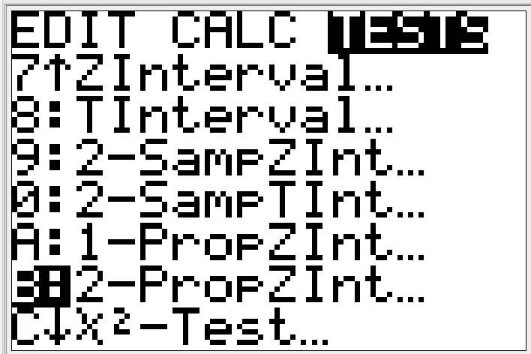
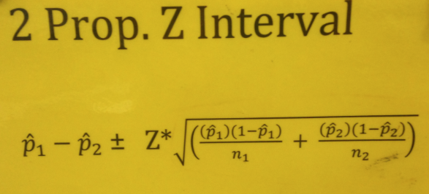
Formulas for ch13
Formula Sheet
Gives Standard Error

Slide 114
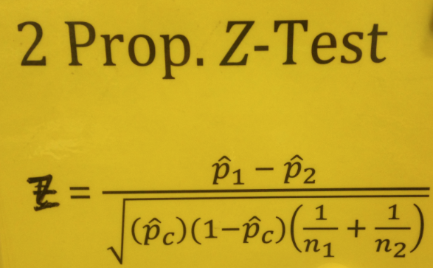
Formulas for ch13
The only one that uses combined p-hat
Formula Sheet
Gives Standard Error

Slide 115
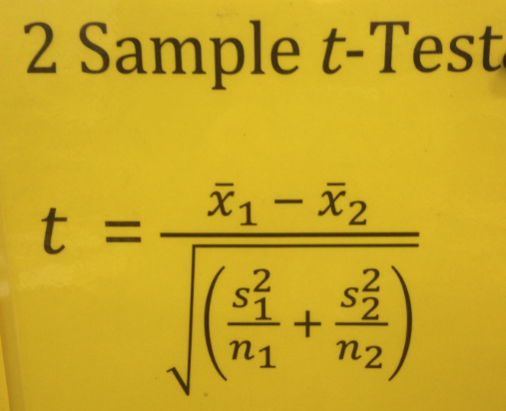
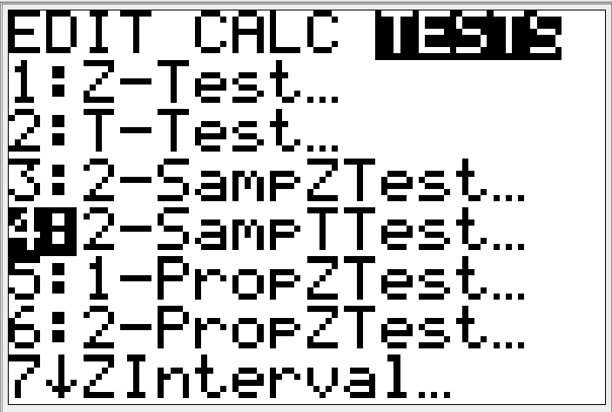
Formulas for ch13
Formula Sheet
Gives Standard Error

Slide 116
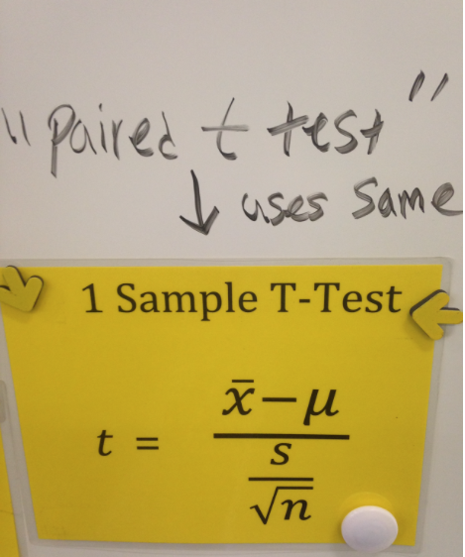
Formulas for ch13
Formula Sheet
Gives Standard Error

Slide 117
Ho: P_{A} = P_{J} vs Ha: P_{A} ≠ P_{J} where P is the true proportion of of 3’s that will appear on their dice. (P_{A} = Arturo’s die……P_{J} = Jennifer’s die)
ASSUMPTIONS: We have two random samples of 60 rolls from Arturo’s die and Jennifer’s die. Their individual rolls are independent and their samples are independent from each other. Our normal condition for both samples has been checked below and is
NOT met. PROCEED WITH CAUTION
Stats
Arturo’s Die
Jennifer’s Die
z = 1.14
P-value = .2553
P-hat A = .15
P-hat J = .08
60(.15) & 60(.85)
9 51
X ok
60(.08) & 60(.92)
5 55
X ok

Slide 118
This p-value is too high to reject Ho at any level of alpha.
There is NOT enough evidence to suggest that Arturo’s and Jennifer’s dice are different in the proportion of 3’s that appear .
Show how the results of a 95% confidence interval can help obtain the same conclusion that we arrived at with the significance test.
(-.0476, .1809)
ZERO means not different
Is ZERO contained in this interval?
Since ZERO is contained in my interval, this is evidence to suggest that there is no difference between Arturo’s and Jennifer’s dice in the proportion of 3’s that occur.

Slide 119
Group 3 vs Group 5 per1
H_{o}: u₃ = u₅ vs H_{a}: u₃ ≠ u₅ where u is the true mean flight time(seconds) for group 3 and group 5’s plane.
Assumptions: We have two independent random samples of flight times for paper airplanes. 13 throws from group 3’s plane and 15 throws from group 5’s plane. Each groups samples are independent from each other. Each groups flight times have met the normal condition by a boxplot which show no outliers or extreme skew.
Group 3
Group 5

Slide 120
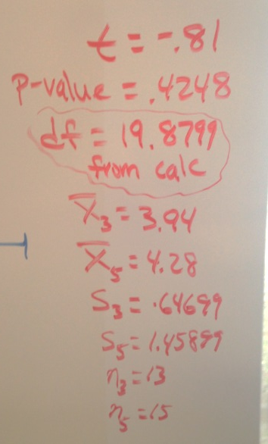
Group 3 vs Group 5 per1
Stats from Calc
This p-value is too high to reject H_{o} at any alpha level.
Based on these samples, there is NOT enough evidence to suggest that these groups mean flight times of their planes are different.

Slide 121
Matched Pairs Test
“AKA” Paired T Test
This is a test that looks like you are given 2 samples but is actually done on the calculator as a 1-sample t test.
You have to be careful reading the problem, usually there it is a situation where there is a before and after.

Slide 122
H_{o}: u_{d} = 0 vs H_{a}: u_{d} > 0 where u_{d} is the true mean difference(strong – weak) between students strong hands and weak hands in bouncing qtr’s into a cup
Assumptions: We have an independent random sample of 42 student differences between strong and weak hands in bouncing coins into a cup. The population of all students is more than 10 times our sample size. Our normal condition is met by the CLT.
Paired t Test
Stats
t = 2.79
P-value = .0039
df = 41
x-bar = .81
s = 1.87718
n = 42
This p-value is low enough to reject H_{o} at the 1% alpha level.
Based on this sample, there is very strong evidence to suggest that students strong hands may be better than their weak hands in bouncing coins into a cup.

Slide 123
Chapter 11
INFERENCE
Chi-Square GOF Test
Chi-Square Test for Independence/Association
Chi-Square Test for Homogeneity

Slide 124
What’s the difference?
Goodness of Fit…..how well does the observed data match the expected….2 rows or 2 columns
Homogeneity…..More than one sample is taken with one categorical variable in mind (2+ Samples, 1 category)
Independence/Association…..Only one sample is taken and there are two or more categories. (1 sample, 2+ categories)

Slide 125
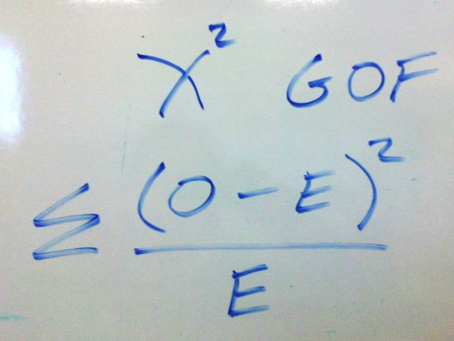
Formula

Slide 126
Normal condition for χ²
80% of the expected cells are greater than or equal to 5.
(not observed cells—expected cells!)

Slide 127
Degrees of Freedom (df)
For all chi-square tests use the following:
df = (r – 1)(c – 1)
r is the row and c is the column

Slide 129
Calculator steps
TI-83+ Calculator
Put your observed counts in L1 and Expected in L2
Then hit 2nd and Stat
Tyoe the observed in L1 and expected in L2. Then click on the L3 heading and type the formula(then click enter), then quit out to the main screen
Find the sum of L3, your answer is the chi-square statistic

Slide 130
H_{o}: There is no difference between gender and social media preference
H_{a}: There is a difference between gender and social media preference
Assumptions: We have two independent random samples of students social media preferences(83 girls and 74 boys). There are obviously more than 830 girls and 740 boys in the population sampled from who use social media. 100% of our expected cells are 5 or more.
Chi-square test of homogeneity
This p-value is low enough to reject Ho at the 5% level
This is evidence to suggest that there may be a difference between gender and social media preference.
X² = 6.96
P-value =.0307
df = 2

Slide 131
Hypotheses
This is a chi-square test for Independence/Association, you have a few options for writing the hypotheses
H_{o}: There is no association between students’ residence type and drinking habits.
H_{a} There is an association between students’ residence type and drinking habits.
OR
H_{o}: Student drinking habits and residence type are independent
H_{a} Student drinking habits and residence type are not independent

Slide 132
Chapter 15
INFERENCE
Linear Regression T Test
Linear Regression T Interval

Slide 133
H_{o}: B = 0 vs Ha: B < 0, where B is the true slope of the linear relationship between alcohol consumption from wine and heart disease
Conditions: We have an independent random sample of 19 countries wine consumption and heart disease death results. The population of all countries is more than 10x our sample. We have a linear relationship between wine consumption and heart disease. The boxplot and histogram of the residuals show no outliers or extreme skew we can assume that they are approximately normal and the residuals are randomly scattered about the regression line.

Slide 135
Linear Regression T Test
t = -6.46 df = 17
p = .000003
This p-value is low enough to reject Ho at any level.
This is very strong evidence to suggest that there may be a negative linear relationship between wine consumption by alcohol and heart disease.

Slide 136
A 95% Confidence interval for this situation……

Slide 137
Make sure you can read computer output!

Slide 138
ALWAYS GIVES FOR A TWO-Sided TEST!

Slide 139
Make sure you understand the difference between the Standard Error & the Margin of Error

