Slide 1
Bad Graph Mini Project

Slide 2
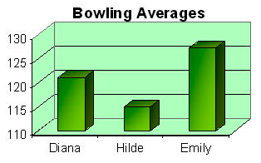
Bad Scale

Slide 3
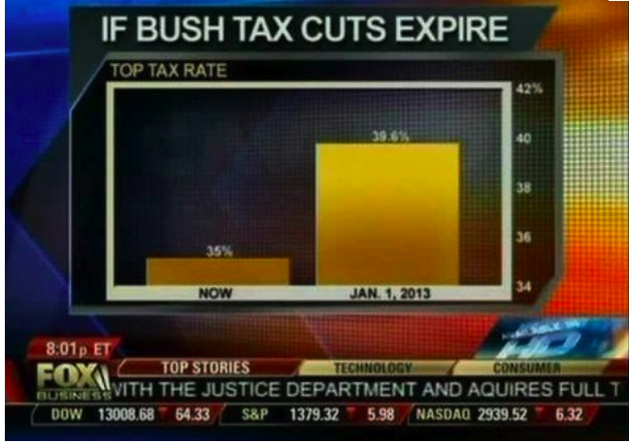
Bad Scale

Slide 4
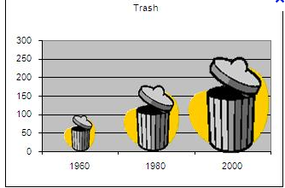
Misleading Size of trash cans

Slide 5
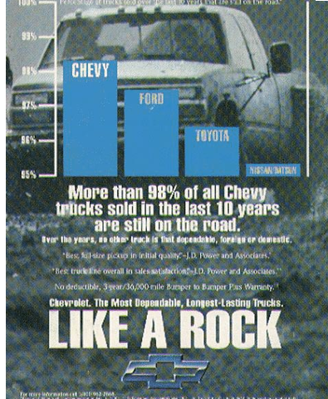
Bad Scale

Slide 6
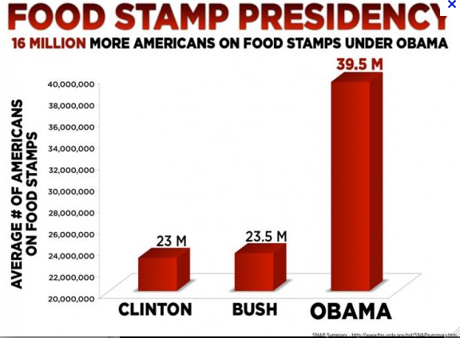
Bad Scale

Slide 7
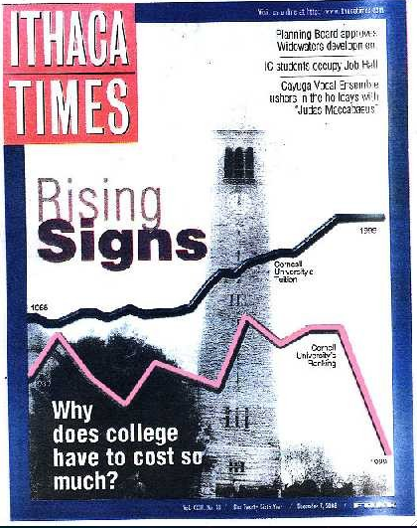
No Scale

Slide 8
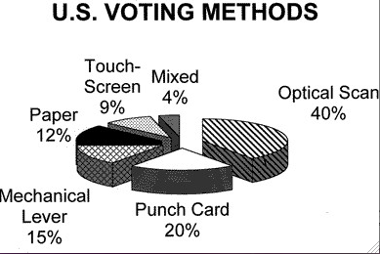
How was the data collected?

