Slide 1
Chapter 2
The Normal Distribution

Slide 2
The Normal Distribution
The assumption that something is “Normal” is one of the most important things in Statistics.
Think of a list of numbers that has low values, high values, and values in the middle. If you have LOTS of these types of numbers then they MIGHT follow a “Normal Distribution”
A good example might be the height of ALL women in the United States. This would be a list of millions of numbers. They would all average to a certain height(the mean). There would be some very tall women and some very short women, because there are SO MANY women in the United States, this data would follow a Normal Distribution.
Other things that might follow a Normal Distribution: test scores for ALL of tests in AP Stats, the time it takes you to get to school for all of the school days this year, shoes sizes for men, IQ scores, the number of times that you blink each day,…..etc.

Slide 3
CAUTION!!
Not all data follows a Normal Distribution
Data with outliers or skewness may not be Normally distributed
Large samples will be closer to a Normal distribution than small samples
Real life data is almost NEVER EXACTLY NORMAL.

Slide 4
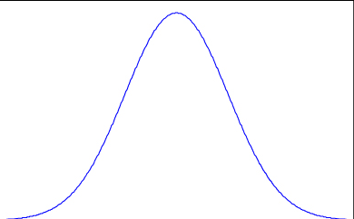
The Normal Distribution
The area under the curve represents 100% of the observations/data.

Slide 5
The Normal Distribution
The center of the curve is the mean,median, and the 50th percentile.

Slide 6
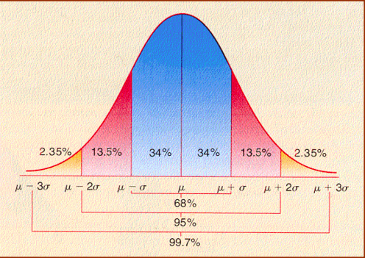
The Empirical Rule
68,95,99.7
68% of the data is within 1 StDev of the mean
95% of the data is within 2 StDev of the mean
99.7% of the data is within 3 StDev of the mean

Slide 7
Describing a Normal Distribution
The mean and standard deviation describe a Normal Distribution.
We write it like this:

Slide 8
Describing a Normal Distribution
Let’s say that the mean height for all men in Garden Grove is 68 inches with a standard deviation of 4 inches.
We would need to write our description like this:

Slide 9
Describing a Normal Distribution
Let’s say that the mean time it takes Mr. Pines to walk to the office each day is 242 seconds with a standard deviation of 11 seconds.
We would need to write our description like this:

Slide 10
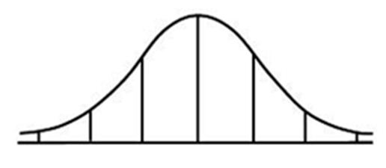
Sample Test Scores for a typical math class.
Draw a Normal Curve with Mean μ = 70 and Standard Deviation σ = 10.
What percent of the data was less than 80?
What percent of the data was between 50 and 90?
What score was at the 50th percentile?
What score would be the 16th percentile?
σ = 10
μ
40 50 60 70 80 90 100

Slide 11
Draw a Normal Curve with Mean μ = 70 and Standard Deviation σ = 10.
What percent of the data was less than 80? about 84%
What percent of the data was between 50 and 90? about 95%
What score was at the 50th percentile? 70
What score would be the 16th percentile? 60
σ = 10
μ
40 50 60 70 80 90 100

Slide 12
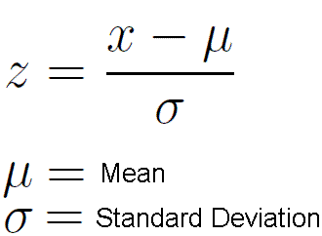
Z - Scores
A Z-score is the number of Standard Deviations above or below the mean
You can be asked to find any of the 4 pieces in the above equation. If given a percentage you need to use the invNorm function on your calculator to get the Z-score.

Slide 13
Assume a Normal Distribution with a Mean μ = 70 and Standard Deviation σ = 10.
Calculate the Z-score a score of 83.
Z = 1.3 which means that a score of 83 is 1.3 standard deviations above the mean.

Slide 14
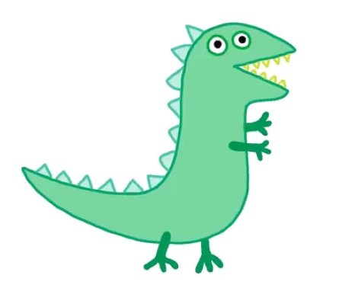
Scores from Miss Turrys quiz on Dinosaurs.
0 | 012
1 | 2248
2 | 1134599
3 | 00036
4 | 457
5 | 0
1) Calculate the mean and standard deviation.
2) Interpret the meaning of the standard deviation in this context.

Slide 15
Scores from Miss Turrys quiz on Dinosaurs.
0 | 012
1 | 2248
2 | 1134599
3 | 00036
4 | 457
5 | 0
3) Peppa earned a 45. Calculate and interpret her z-score.
4) George earned a 2. Calculate and interpret his z-score.

Slide 16
Scores from Miss Turry’s quiz on Dinosaurs.
0 | 012
1 | 2248
2 | 1134599
3 | 00036
4 | 457
5 | 0
5) The scores on Miss Turry’s next quiz had a mean of 32 and a standard deviation of 6.5. Peppa earned a 47 on this quiz. On which quiz did she perform better relative to the rest of the class? Explain

Slide 17
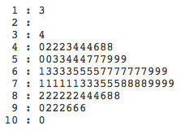
Ch 5 Test Scores
n = 85

Slide 18
n = 85
Based on the mean and median, it appears that the distribution of test scores are approximately Normal.

Slide 19
n = 85

Slide 20
Sketch a Normal Curve using the mean and standard deviation above.
Compare the distribution of Ch5 test scores to the Empirical Rule.

Slide 21
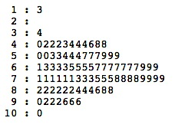

Slide 22
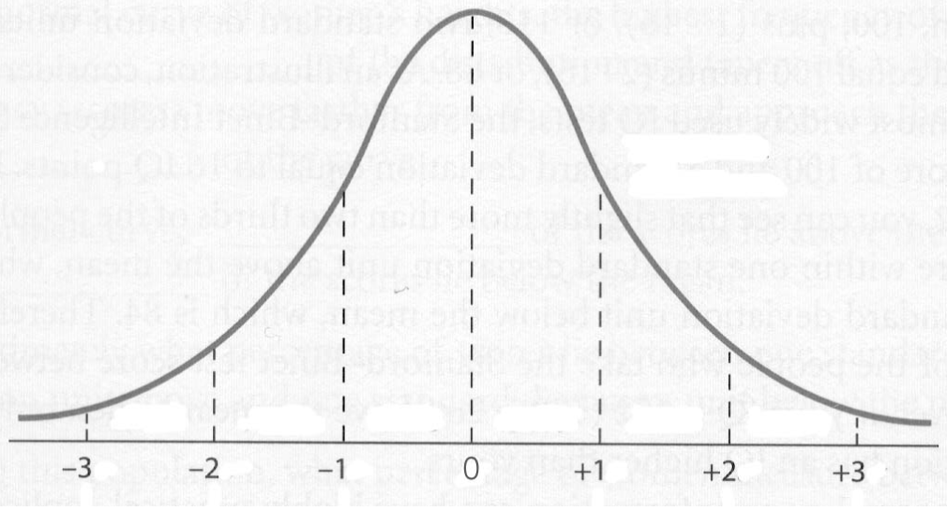
Standard Normal Curve
N(0,1)

Slide 23
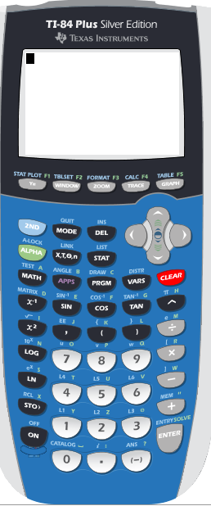
Find the percentile for the following Z-scores
z = 2.34
z = -.34
z = -.27
Use the the Yellow Table.
4. z = -1.25
5. z = 1.89
6. z = 0
Use your

Slide 24
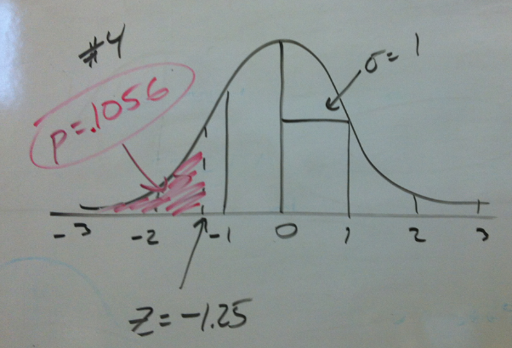
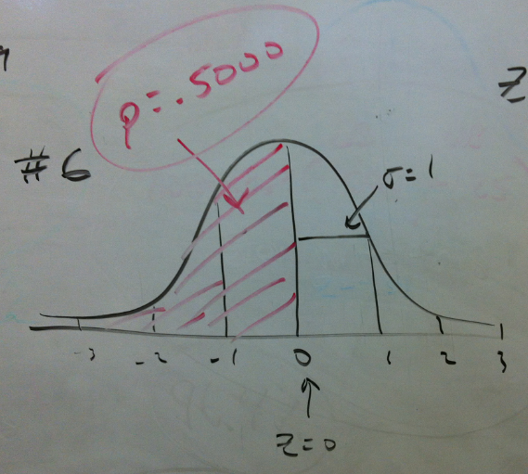
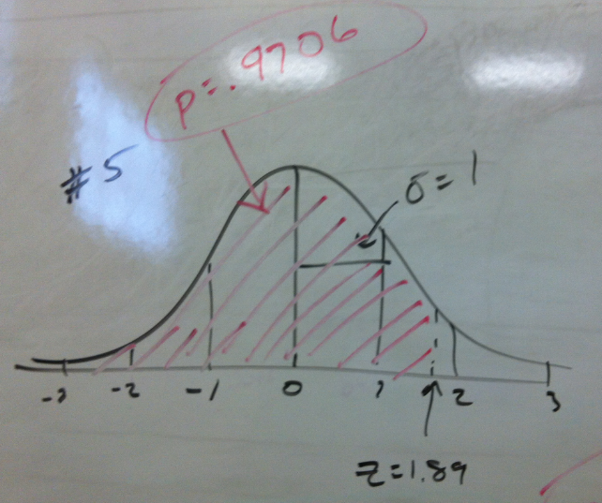

Slide 25
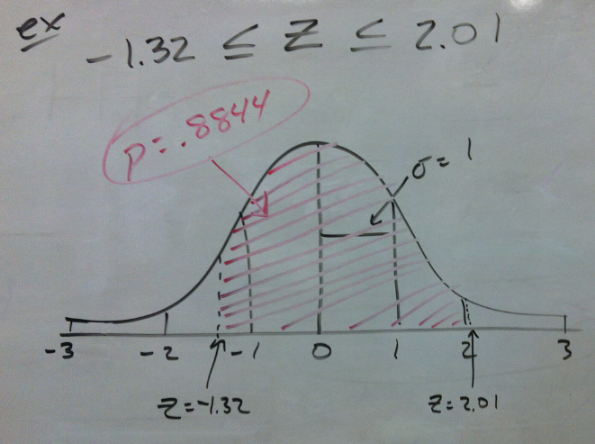

Slide 26
Given the percentile, find the Z-score
p = .2673
p = .1238
p = .9472
Use the the Yellow Table.
4. p = .5632
5. p = .2167
6. p = .7654
Use your

Slide 27
Sketch the curve, find the percent/probability and shade.
z > 1.34
z < 2.15
z < -2.34
Use the the Yellow Table.
4. z > 2.90
5. z < 1.34
6. z > -.28
Use your
normalcdf(

Slide 28
Sketch the curve, find the z-score.
p = .6348
p = .22
75th percentile
Top 10 percentile
Use the the Yellow Table.
or
Use your
invNorm

Slide 29
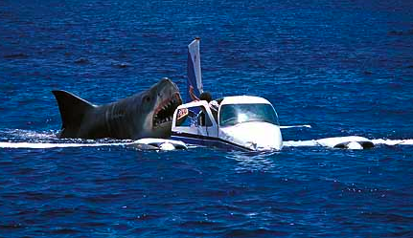
Great White Sharks

Slide 30
Lengths of 44 Great White Sharks
Find the Mean and Standard Deviation
18.7 | 12.3 | 18.6 | 16.4 | 15.7 | 18.3 | 14.6 | 15.8 | 14.9 | 17.6 | 12.1
16.4 | 16.7 | 17.8 | 16.2 | 12.6 | 17.8 | 13.8 | 12.2 | 15.2 | 14.7 | 12.4
13.2 | 15.8 | 14.3 | 16.6 | 9.4 | 18.2 | 13.2 | 13.6 | 15.3 | 16.1 | 13.5
19.1 | 16.2 | 22.8 | 16.8 | 13.6 | 13.2 | 15.7 | 19.7 | 18.7 | 13.2 | 16.8

Slide 31
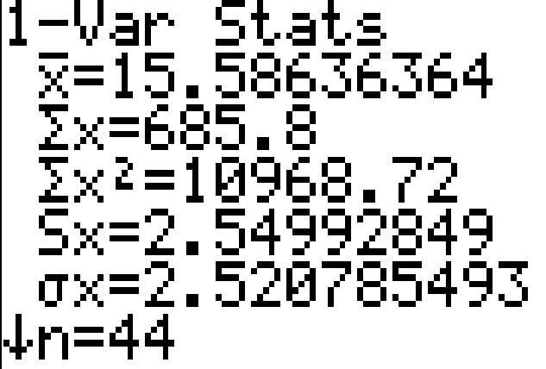
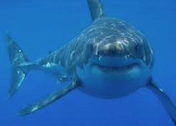
This is a sample, so we will use the x-bar for the mean and the “s” for the standard deviation.
N(16,3)

Slide 32
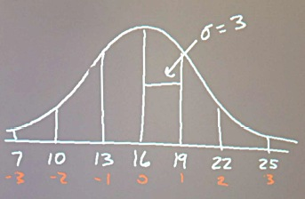
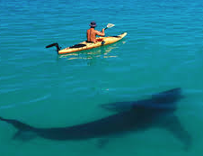
Sketch a Normal curve using the following as the mean and standard deviation for Great White Shark lengths.
N(16,3)

Slide 33
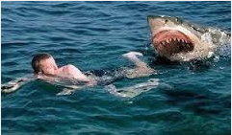
What proportion of Great White Sharks are over 18 feet in length?
N(16,3)

Slide 35
What proportion of Great White Sharks are between 11 and 20 feet?
N(16,3)

Slide 37
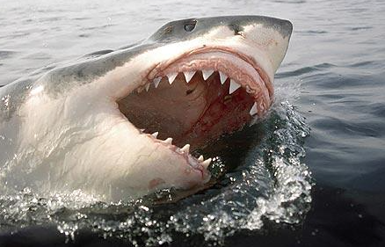
90% of Great White Sharks are above what length?
N(16,3)

Slide 39
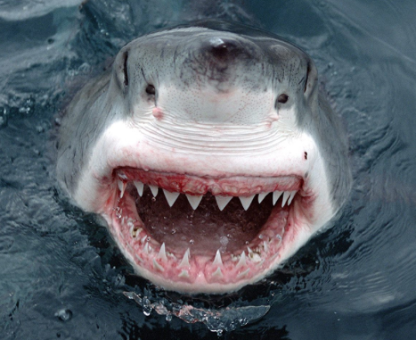
What is the interquartile range for Great White Shark Lengths?
N(16,3)

Slide 41
What lengths of Great Sharks would be considered outliers?
N(16,3)

Slide 43
COFFEE

Slide 44
The amount of coffee that Mr. Pines drinks on a school day follows a Normal Distribution with a mean of 23.4 ounces and a standard deviation of 7.2 ounces.

Slide 45
N(23.4,7.2)
Mr. Pines coffee drinking
1) Sketch a Normal curve labeling all important information for this situation
2) How often does Mr. Pines drink less than 20 ounces of coffee in a day?
3) How often does he drink between 15 and 30 ounces of coffee in a day?
4) 60% of the time he drinks more than ____ ounces of coffee in a day?
5) How many ounces of coffee would be considered outliers for Mr. Pines?

Slide 46
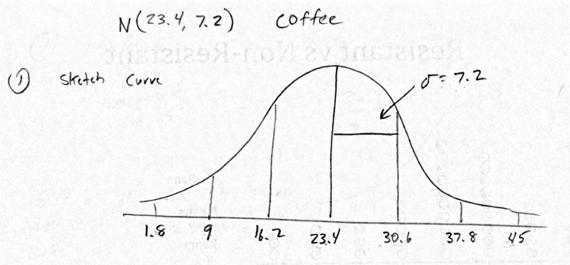
N(23.4,7.2)
Mr. Pines coffee drinking
1) Sketch a Normal curve labeling all important information for this situation

Slide 47
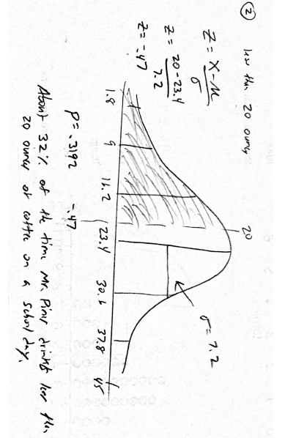
N(23.4,7.2)
Mr. Pines coffee drinking
2) How often does Mr. Pines drink less than 20 ounces of coffee in a day?

Slide 48
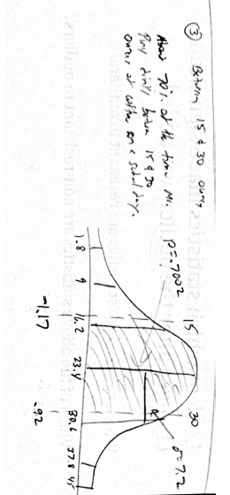
N(23.4,7.2)
Mr. Pines coffee drinking
3) How often does he drink between 15 and 30 ounces of coffee in a day?

Slide 49
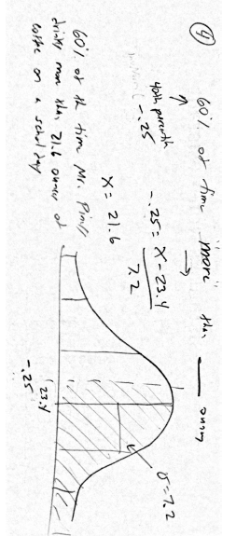
N(23.4,7.2)
Mr. Pines coffee drinking
4) 60% of the time he drinks more than ____ ounces of coffee in a day?

Slide 50
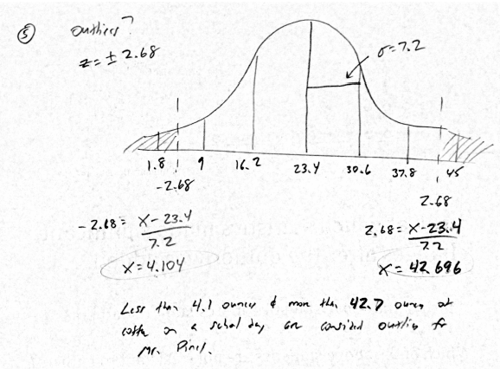
N(23.4,7.2)
Mr. Pines coffee drinking
5) How many ounces of coffee would be considered outliers for Mr. Pines?

Slide 51
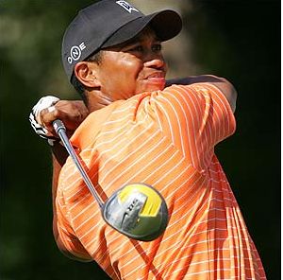
Tiger Woods

Slide 52
When Tiger Woods is on the driving range, the distance that golf balls travel when he hits them with a driver follows a Normal distribution with mean 310 yards and a standard deviation of 8 yards.
Sketch the distribution of Tiger Wood’s drive distances. Label the points one, two, and three standard deviations from the mean.
What proportion of Tiger’s drives travel between 300 and 325 yards? Shade the appropriate area under the curve you drew in (a). Then show your work.
Find the 33rd percentile of Tiger’s drive distance distribution. Show your method.
What driving distances would be considered outliers for Tiger?

Slide 53
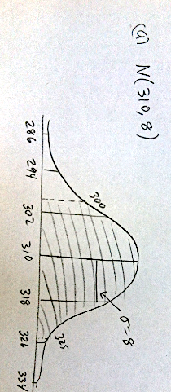

Slide 54
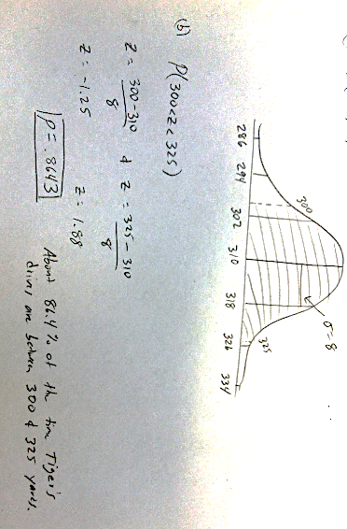

Slide 55
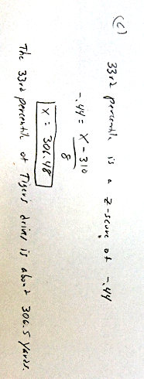

Slide 56
Outliers on a Normal Curve
You need to remember the outlier formulas:
Q1 – 1.5(IQR)
Q3 + 1.5(IQR)

Slide 57
Outliers on a Normal Curve
Q1 is the 25th percentile
Q3 is the 75th percentile
Why?

Slide 58
Outliers on a Normal Curve
invNorm(.25) = -.67
invNorm(.75) = .67
IQR = Q3 – Q1
IQR = .67 – (-.67) = 1.34
Q1 – 1.5(IQR)
Q3 + 1.5(IQR)
-.67 – 1.5(1.34) = -2.68
.67 + 1.5(1.34) = 2.68

Slide 59
Outliers on a Normal Curve
z = -2.68
z = 2.68

Slide 60
Outliers on a Normal Curve
z = -2.68
z = -.67
z = .67
z = 2.68
Q1
Q3

Slide 61
Outliers on a Normal Curve
IQR = 1.34
Q1
Q3

Slide 62
Brushing Teeth
Mr. Pines typically brushes his teeth during break after he has finished his second cup of coffee.
The amount of time he spends brushing his teeth follows a normal distribution with unknown mean and standard deviation. Mr. Pines spends less than one minute brushing his teeth about 40% of the time. He spends more than two minutes brushing his teeth 2% of the time.
Use this information to determine the mean and standard deviation of this distribution.
After you find the mean and standard deviation, sketch a normal curve labeling all the important information.(If your part “a” is correct then your normal curve will match the given percentages)

Slide 63
Brushing Teeth
Use invNorm to get your Z-scores.
invNorm(.40) = -.25
invNorm(.98) = 2.05
Set them equal to each other
Plug the Stdev into any equation above to get a mean of 1.11

