Slide 1
Chapter 6
Random Variables
Binomial and Geometric Distributions

Slide 2
(A)
X | Red Card | Spade | Club | Ace of Clubs
P(X) | 26/52 =.50 | 13/52 = .25 | 12/52 = .25 | 1/52 = .0192
$ | 0 | 5 | 10 | 30
(C) I would be willing to pay less than $4.13
(B) E($) = (.50)(0) + (.25)(5) + (.25)(10) + (.0192)(20)
E($) = $4.13

Slide 4
Difference between two random variables with…

Slide 5
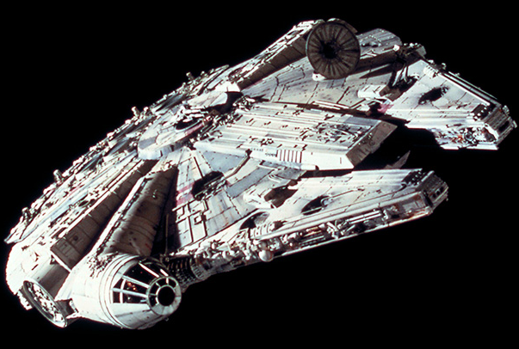
Luke Skywalker and Han Solo are meeting up at the planet Endor for a special type of mission.
Han Solos ship the Millennium Falcon is the fastest ship in the galaxy which can get to Endor with a mean time of 35 minutes and a standard deviation of 3 minutes.

Slide 6
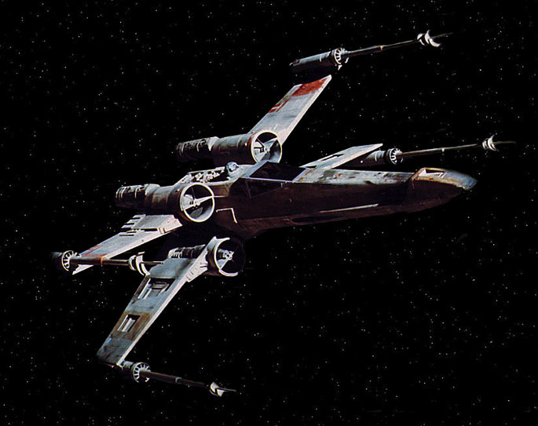
Luke Skywalker and Han Solo are meeting up at the planet Endor for a special type of mission.
Luke Skywalker flies an X-Wing Fighter which can get to Endor with a mean time of 42 minutes and a standard deviation of 5 minutes.

Slide 7
We will assume that both their distributions follow a Normal Distribution, Let X = the Luke’s X-Wing Fighter and Y = Han’s Millennium Falcon
(A) What is the distribution for the difference X – Y between their times getting to Endor?
The difference between their times also follow a Normal Distribution
μ_{X-Y} = 42-35 = 7 minutes
σ_{X-Y} = √ 3² + 5² = 5.83095 minutes
N(7, 5.83095)

Slide 8
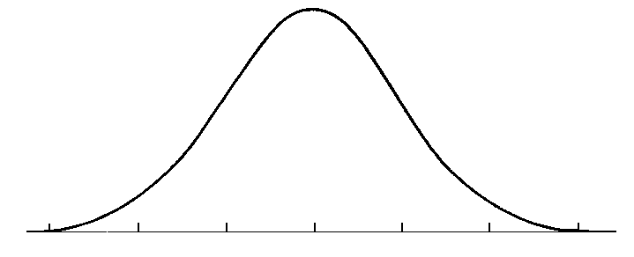
(B) What % of the time does Han Solo arrive to Endor before Luke Skywalker?
P(Z < -1.20)
Normalcdf(-1.20,1000) = .8849
Luke Skywalker
Han Solo
P(Z < -.50)

Slide 9
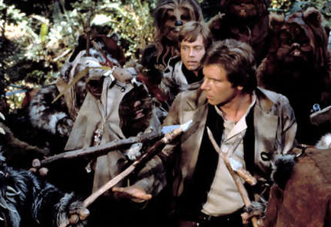
(C) Han Solo does not like to arrive to Endor before Luke because he is not a Jedi and he doesn’t like Ewoks. If he tells Luke to leave before him, how many minutes early should Luke leave so that Han arrives early only 2% of the time?
Use invNorm(.98) to get your Z-score of 2.05
X = 18.95 minutes

Slide 10
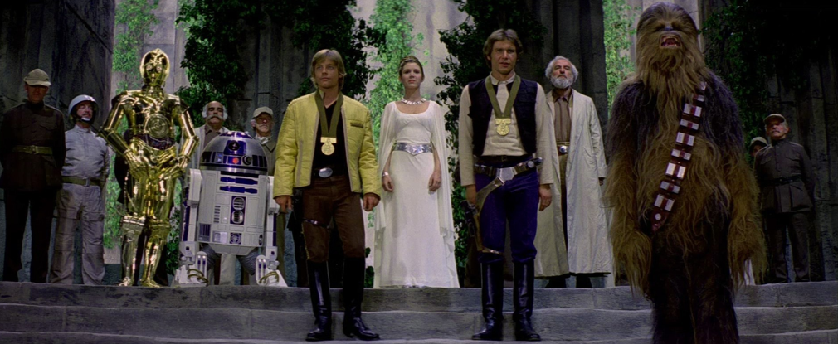
Good Job, You are Ready for the Test!
….and may the Force be with you.

Slide 11
Team Type Problem
Seinfeld Racing Team

Slide 12
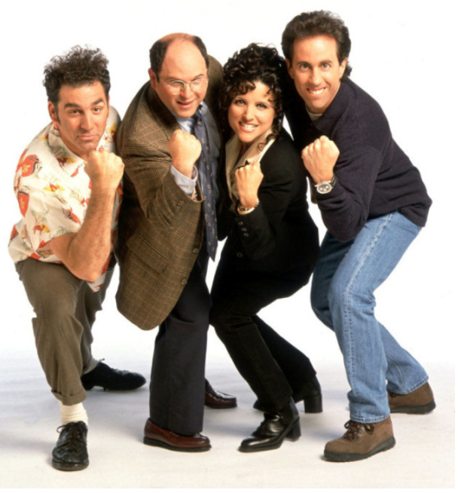
The Seinfeld Four are going to run a relay race.

Slide 13
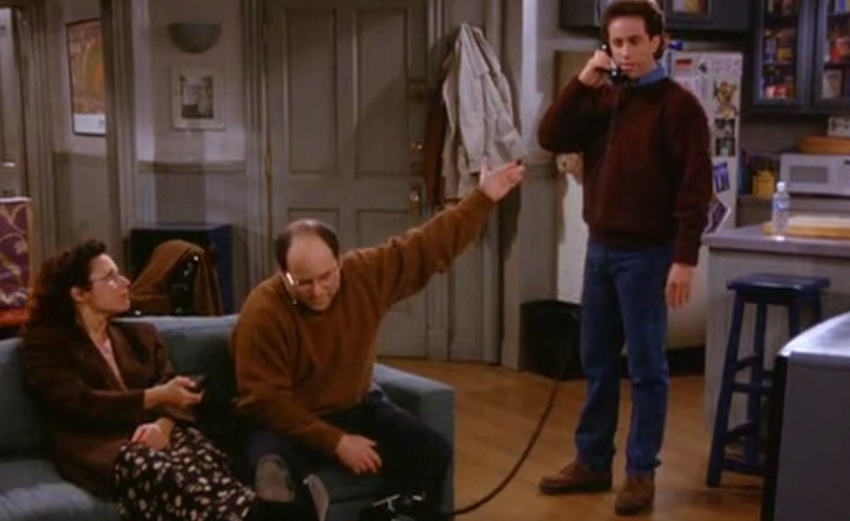
The only problem with their running team is………
I choose not to run!

Slide 14
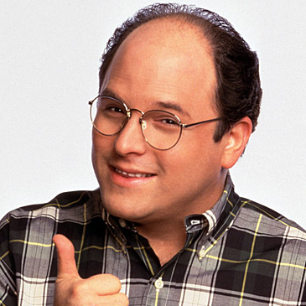
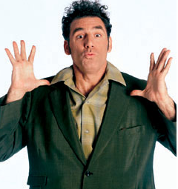
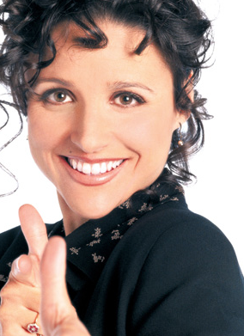
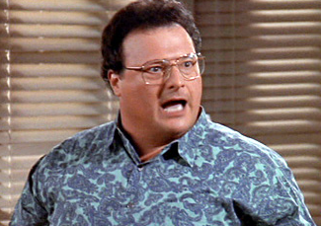
Their individual times follow a Normal Distribution.
GEORGE
KRAMER
N(12.3, 2.9)
N(11.2, 4.2)
And our alternate
ELAINE
NEWMAN
N(10.2, 2.6)
N(17.3, 1.8)

Slide 15
The combined times of our racers also follow a Normal Distribution
This statement must be on your papers on an FRQ.
Team Combined Mean
μ_{team} = 12.3 + 11.2 + 10.2 + 17.3 = 51 seconds
Team Standard Deviation
σ_{team} = √ 2.9² + 4.2² + 2.6² + 1.8² = 6.00417 seconds
Team Time N(51, 6.00417)

Slide 16
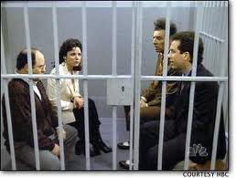
What is the probability that the Seinfeld Racing Team can beat their goal of 48 seconds?

Slide 17
What is the probability that the Seinfeld Racing Team can beat their goal of 48 seconds?
P( X < 48)?
Use the most interesting formula in the world!
P(Z < -.50)

Slide 18
What is the probability that the Seinfeld Racing Team can beat their goal of 48 seconds?
P(Z<-.50)
Use normalcdf(-1000, -.50)
μ
P = .3085
The probability of the Seinfeld Racing Team beating their goal of 48 seconds is about .3085

Slide 19
Coach Enright, Coach Pines, Coach Patterson, and Coach Than were at the river last spring on a boat. They were somewhat concerned that they may be exceeding the acceptable weight limit on their boat. Since none of them could give an accurate answer on their current weight we will assume that the weight of a Rancho coach is normal with a mean of 195 pounds and a standard deviation of 13 pounds.
Assuming that the weights are independent, what is the probability that they are too heavy and sink their boat if the boat can only hold 800 pounds?

Slide 21
The Rock & Stone Cold
Combining Random Variables

Slide 22
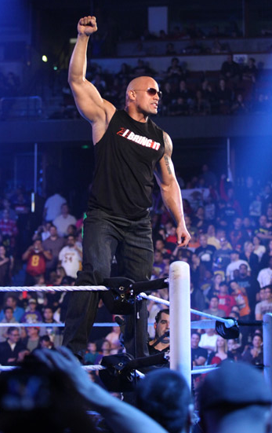
The Rock

Slide 23
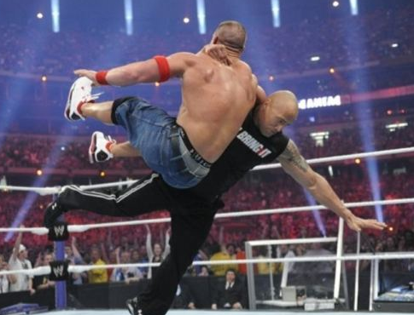
The Rock
The time it takes the Rock to pin his opponent follows a Normal Distribution with mean 9 minutes and standard deviation 4 minutes.

Slide 24
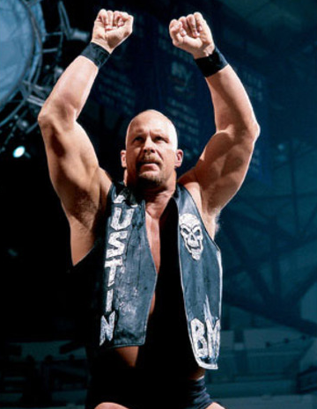
Stone Cold Steve Austin

Slide 25
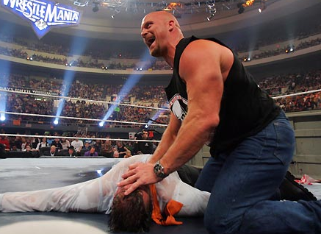
Stone Cold Steve Austin
The time it takes Stone Cold to pin an opponent follows a Normal Distribution with mean 12 minutes and standard deviation 3 minutes.

Slide 26
What is the distribution of their combined times? S + R
What is the difference between their times? S - R
Combined Mean
Difference Between their Means
μ_{S+R} = 12 + 9 = 21 Minutes
μ_{S-R} = 12 - 9 = 3 Minutes
Combined Standard Deviation
Difference Standard Deviation
σ_{S+R} = √ 3² + 4² = 5 Minutes
σ_{S-R} = √ 3² + 4² = 5 Minutes
Combined Time N(21,5)
Difference Between Them N(3,5)

Slide 27
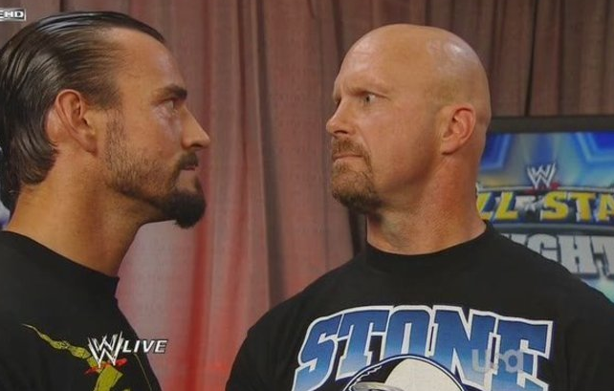
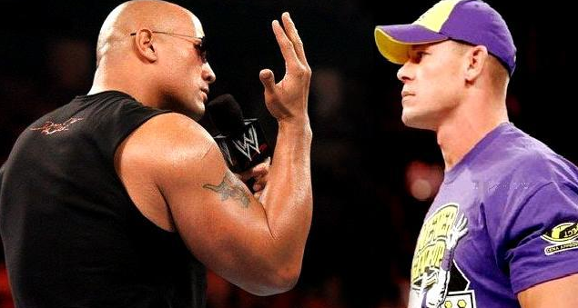
Team Type Problem
Let’s say that The Rock and Stone Cold are going to each compete in a match against other opponents. What is the probability that their combined pin times will be less than 17 minutes?

Slide 28
Let’s say that The Rock and Stone Cold are going to each compete in a match against other opponents. What is the probability that their combined pin times will be less than 17 minutes?
Use their combined time information to solve this.
Combined Time N(21,5)
-.80
Normalcdf(-1000,-.80)
P = .2119
The probabiliy that their combined time is less than 17 minutes is about .2119

Slide 29
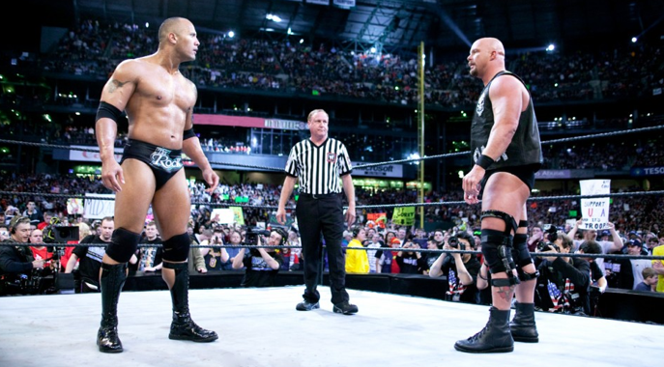
The Rock vs Stone Cold

Slide 30
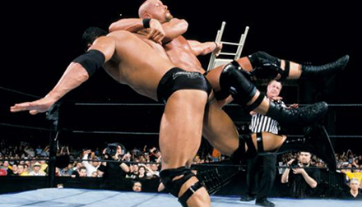
The Rock vs Stone Cold
From looking at their individual pin times it appears that The Rock has the advantage and should win a Head-To-Head match the majority of the time.
THE ROCK N(9,4)
STONE COLD N(12,3)
Assuming Independence what % of time should Stone Cold win?
In a Versus type problem you will want to use the differences between their pin times.
Difference Between Them N(3,5)

Slide 31
The Rock vs Stone Cold
Difference Between Them N(3,5)
Use the most interesting formula in the world.
X = 0 in these versus type problems
-.60

Slide 32
Which Side of the Curve?
Remember we are interested in the % of the time that Stone Cold wins?
The Rock was favored to win because of his better individual time. So the Rock should have the larger portion of the curve and Stone Cold the smaller portion of the curve.
Stone Cold
The Rock
Normalcdf(-1000,-.60)
-.60
P = .2742

Slide 33
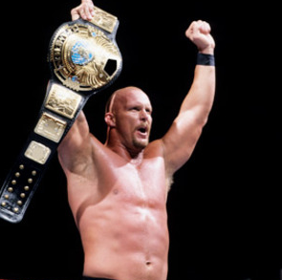
Answer in Context
27.42% of the time Stone Cold would beat the Rock in a Head-To-Head match.

Slide 34
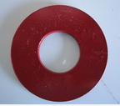
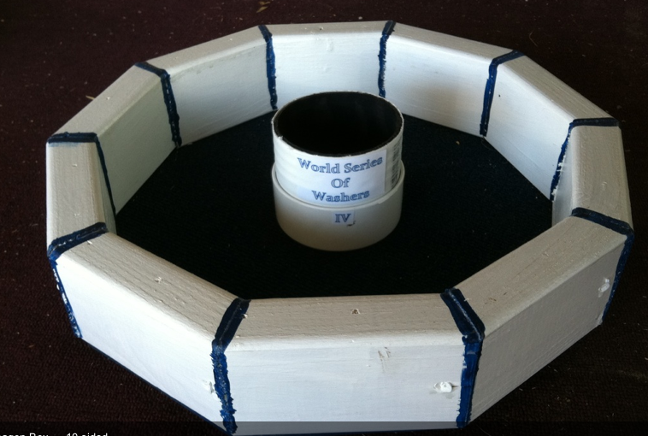
Austin Powers Vs. Dr. Evil
World Series of Washers Championship XXXI

Slide 35
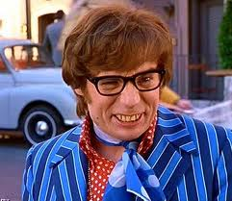
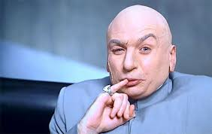
Who Will Win?
I demand a little respect!
Groovy Baby!

Slide 36
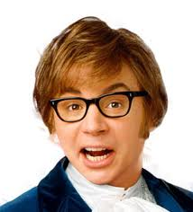
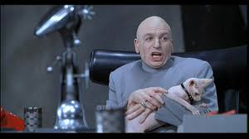
We need to know about their previous skills before we can predict who will win?
Austin Powers washers scores follow a Normal Distribution N(12.8, 3.2)
Dr. Evil’s washers scores follow a Normal Distribution N(11.3, 3.9)
Is it an evil washers tournament?!

Slide 37
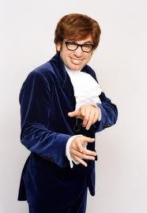
Austin Powers has been better based on previous scores?
That’s Right Baby!
Dr. Evil is the underdog!

Slide 38
What proportion of the time will Dr. Evil win?
We must find the differences(A – D) between their means and standard deviations.
This statement must ALWAYS be written on your paper: Their differences will also follow a Normal Distribution
μ_{A-D} = 12.8 – 11.3 = 1.5
Means can add or subtract
StDev’s cannot be added or subtracted. You ALWAYS square them, then ALWAYS add, then ALWAYS take square root

Slide 39
This will be solved using the Normal Distribution
We are looking for the probability that Dr. Evil beats Austin Powers.
P( D – A) > 0
X is the number of interest, which means where Dr. Evil and Austin Powers are the same which is ALWAYS 0 in these problems
P(Z > -.30)

Slide 40
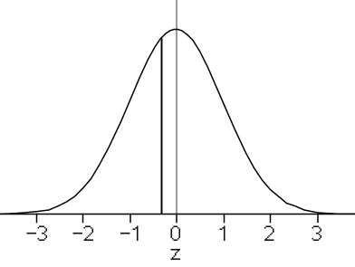
Draw the curve and label your Z-score.
Z = -.30

Slide 41
Austin usually wins,so his side of the curve should be the biggest.
Austin Wins
Dr. Evil Wins

Slide 42
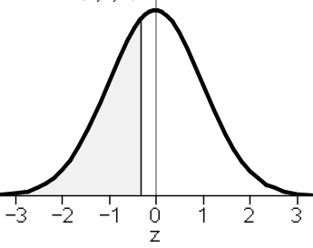
Dr. Evil’ side is on the left.
We want Dr. Evil’s chances so we use normalcdf(-1000,-.30) = .3821

Slide 43
Answer in context
WRITE YOUR ANSWER AS IF YOU WERE GOING TO TELL YOUR FRIEND
There is about a 38.2% chance that Dr. Evil will beat Austin Powers in washers.
OR
About 38.2% of the time Dr. Evil will beat Austin Powers in washers.

Slide 44
Binomial Setting
We use the acronym POTI
P: Probability “p” same for every trial
O: Outcome is either “success” or “failure”
T: Trials are a fixed number “n”
I: Each trial is independent of other trials

Slide 45
Binomial Formulas
Mean of a binomial, or expected value of a binomial
μ=np
Standard Deviation of a binomial

Slide 46
Binomial Formulas
Answering binomial questions about the # of successes of an event
n^{C}r function
on calculator
OR
binomialpdf(n,p,x) for exactly questions, ex. P(X = 2)
binomialcdf(n,p,x) for continuous interval questions, ex P(X<2)

Slide 47
Is it binomial?
The number of fives rolled in 30 rolls of a fair die.
YES
P: p = 1/6
O: outcomes are success(rolling a 5) and failure(not rolling a 5)
T: fixed # of trials n = 30
I: each roll is independent

Slide 48
Is it binomial?
b) The number of heads that occur in 10 flips of a fair coin
YES
P: p = 1/2
O: outcomes are success(heads) and failure(tails)
T: fixed # of trials n = 10
I: each flip is independent

Slide 49
Is it binomial?
c) The number of hearts after drawing 15 consecutive cards from a standard deck without replacement
NO
P: p = ??? Changes each card
O: outcomes are success(heart) and failure(not a heart)
T: fixed # of trials n = 15
I: probability is based on previous draws(NOT independent)

Slide 50
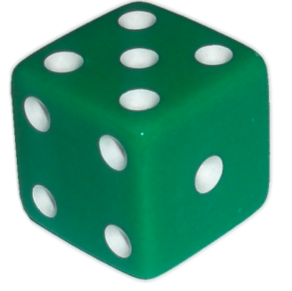
Rolling Dice
1. What is the expected number of fours rolled in 30 rolls of a fair die?
2. What is the standard deviation for the number of fours rolled in 30 rolls of a fair die?

Slide 51
Rolling Dice
1. What is the probability of rolling exactly four 5’s in 30 rolls.
P(X = 4)
Symbols must be written, if you are going to use your calc
OR
n p X
binompdf(30,⅙,4) = .1847

Slide 52
Rolling Dice
1. What is the probability of rolling four 5’s or less in 30 rolls.
P(X ≤ 4)
We will now stop using this method,
You may only need to remember this for a MC type question.
OR
n p X
binomcdf(30,⅙,4) = .4243
Adds up to 4 successes

Slide 53
Rolling Dice
1. What is the probability of rolling at least four 5’s in 30 rolls.
P(X ≥ 4) = 1 – P(X ≤ 3)
At least 4 is the opposite of 3 or less
n p X
1- binomcdf(30,⅙,3)=.7604

Slide 54
Albert Pujols
In his career he has hit 475 homeruns in 6,919 at-bats.

Slide 55
Albert Pujols
Let’s consider his next 50 at-bats of next season.
Assuming that each at-bat is independent, explain how Pujols hitting a homerun follows the binomial setting.

Slide 56
Albert Pujols
P: p = .0687 is the same for each at-bat
O: outcome is success(hitting a homerun) or failure(not hitting a homerun
T: trials are fixed. n = 50
I: independent trials(each at-bat is independent)

Slide 57
Albert Pujols
What is the mean and standard deviation for the number of homeruns in his next 50-at-bats?

Slide 58
In his next 50 At-Bats….
What is the probability he hits exactly 4 homeruns?
What is the probability he hits at most 8 homeruns?
What is the probability he hits at least 1 homerun?
What is the probability he hits at least 3 homeruns?
What is the probability he hits no more than 4 homeruns?
What is the probability he hits exactly 2 homeruns?
What is the probability he hits at least 4 homeruns?
What is the probability he hits less than 1 homeruns?
What is the probability he hits exactly 6 homeruns?

Slide 59
In his next 50 At-Bats….
.1942
.9935
.9715
.6767
.7416
.1898
.4526
.0285
.0729

Slide 60
Albert Pujols
What is the probability that he hits exactly 4 homeruns?
P(X = 4)

Slide 61
Albert Pujols
What is the probability that he hits at most 8 homeruns?
P(X ≤ 8)

Slide 62
Albert Pujols
What is the probability that he hits at least 1 homerun?
P(X ≥ 1) = 1 – P(X=0)

Slide 63
Albert Pujols
What is the probability that he hits at least 3 homeruns?
P(X ≥ 3) = 1 – P(X≤ 2)

Slide 64
Albert Pujols
What is the expected number of at-bats until he hits his first homerun?
Explain why this is not binomial.
There is not a fixed number of at-bats, this is a Geometric situation.

Slide 65
What is the probability he hits a homerun on his 10th at-bat?
What is the probability he hits a homerun after his 7th at-bat?
What is the probability he hits a homerun before his 13th at-bat?
What is the probability he hits a homerun on his 8th at-bat?
What is the probability he hits a homerun after his 4th at-bat?
.0362
.6076
.5743
.0417
.7522

Slide 66
Albert Pujols
What is the probability that he hits a homerun on his 10th at-bat?
OR

Slide 67
Albert Pujols
What is the probability that he hits a homerun after his 7th at-bat?
OR

Slide 68
Albert Pujols
What is the probability that he hits a homerun before his 13th at-bat?
OR

Slide 69
Normal Approximation
All binomial problems can be solved using a Normal Distribution.
The binomial is the EXACT answer.
Answers for these two methods will be similar.
The larger the sample size, the closer the Normal approximation answer will be to the binomial.

Slide 70
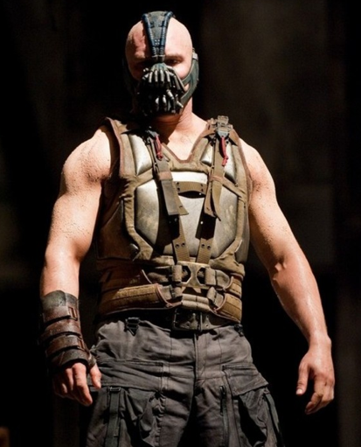
Binomial
After watching the latest Batman movie “The Dark Knight Rises”, Mr. Pines figured he can understand about 37% of the words that Bane says.

Slide 71
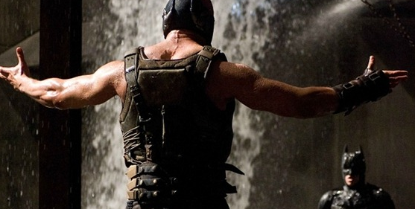
What is the probability that Mr. Pines can understand 257 or less of the next 700 words spoken by Bane?
P(X ≤ 257)

Slide 72
Normal Approximation
We can solve the same problem using the Normal Approximation.
P(X ≤ 257)
We have to use the binomial formulas to get μ & σ

Slide 73
Normal Approximation
Z < -.16
P = .4364
-.16

Slide 74
Compare Answers
Binomial Answer p = .4546
Normal Approximation p = .4364
They are very close, the Binomial is the exact answer.
There is about a 45% chance that Mr. Pines can understand 257 words or less of Bane’s 700 words.

Slide 75
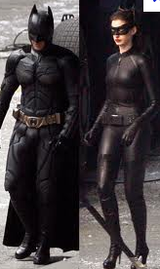
It’s a cool movie, now on DVD & Blue Ray.
Hey adldj, asdfasfldj
What did he say?
I have no clue

