Slide 1
CHAPTER 10
2-Sample T Tests
2 - Sample T Intervals
2 – Prop Z Tests
2 – Prop Z Intervals
Paired T Test

Slide 2
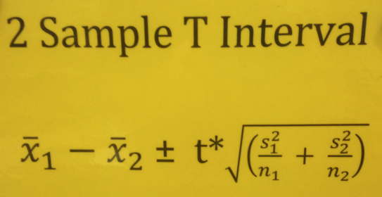
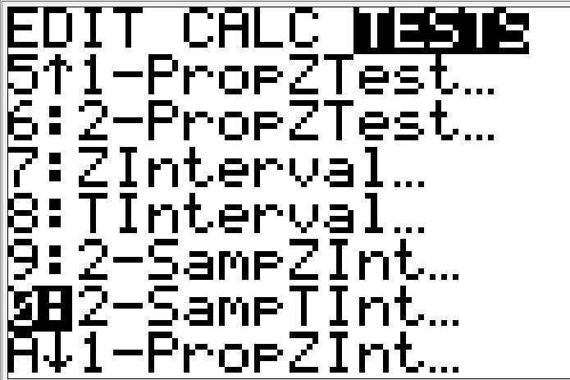
Formulas for ch13
Remember……. these will be used in MC situations not on an FRQ.
Formula Sheet
Gives Standard Error

Slide 3
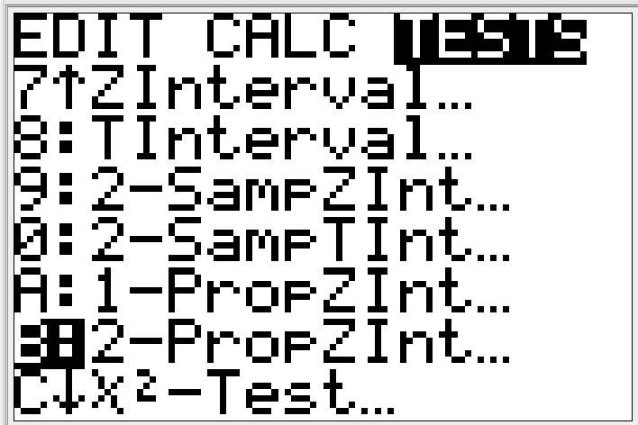
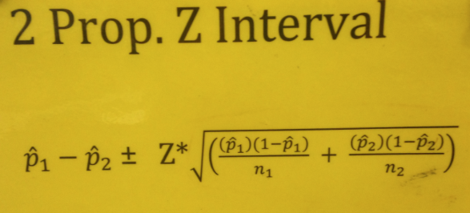
Formulas for ch13
Formula Sheet
Gives Standard Error

Slide 4
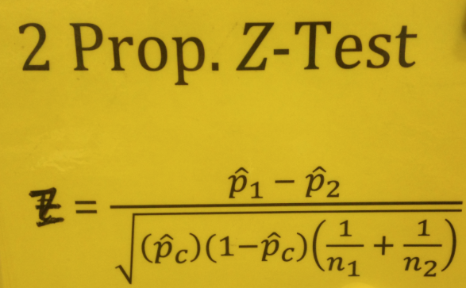
Formulas for ch13
The only one that uses combined p-hat
Formula Sheet
Gives Standard Error

Slide 5
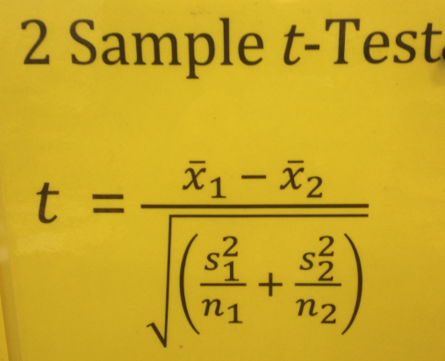
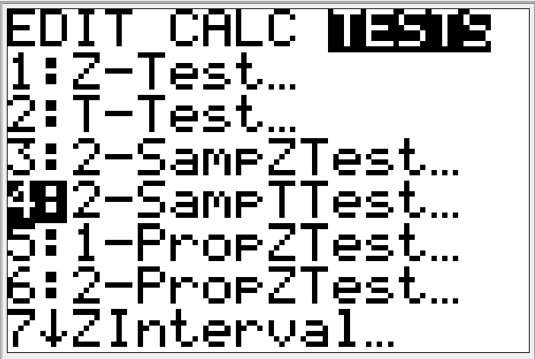
Formulas for ch13
Formula Sheet
Gives Standard Error

Slide 6
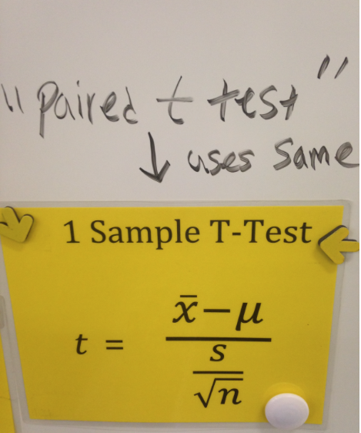
Formulas for ch13
Formula Sheet
Gives Standard Error

Slide 7
Second Semester Changes
New baseball card incentives(see wall)
Mr. Pines will give out baseball cards to first team that gets Warm-up correct(5 to individual student(no help) or 1 per person in group(help))
If you have a stamp on every HW assignment for a chapter you will receive 10 baseball cards
Classwork/Activities will be collected at times and go into your quiz grade
Low test scores will go in as is(no 40% minimum this semester, you should be used to format by now)

Slide 8
Two-Proportion Z Test
We are going to compare your fake die to another students fake die
We will compare by calculating the proportion of times a 3 comes up.
Roll your die 60 times and record the number of times the number 3 shows up.

Slide 9
Hypothesis
Ho: P1 – P2 = 0 vs Ha: P1 – P2 ≠ 0
Or
Ho: P1 = P2 vs Ha P1 ≠ P2
EASIER

Slide 10
2-Proportion Z Test
Ho: P_{A} = P_{J} vs Ha: P_{A} ≠ P_{J} where P is the true proportion of of 3’s that will appear on their dice. (P_{A} = Arturo’s die……P_{J} = Jennifer’s die)
ASSUMPTIONS: We have two random samples of 60 rolls from Arturo’s die and Jennifer’s die. Their individual rolls are independent and their samples are independent from each other. Our normal condition for both samples has been checked below and is
______________________
Stats
Arturo’s Die
Jennifer’s Die
z =
P-value =
P-hat_{A} =
P-hat_{J} =
P-hat_{C}
60( ) & 60( )
60( ) & 60( )

Slide 11
This p-value is _______________ to reject Ho at __________.
There is ________________evidence to suggest that Arturo’s and Jennifer’s dice are different in the proportion of 3’s that appear .
Show how the results of a 95% confidence interval can help obtain the same conclusion that we arrived at with the significance test.
(-.0476, .1809)
ZERO means not different
Is ZERO contained in this interval?
Since ZERO is contained in my interval, this is evidence to suggest that there is no difference between Arturo’s and Jennifer’s dice in the proportion of 3’s that occur.

Slide 12
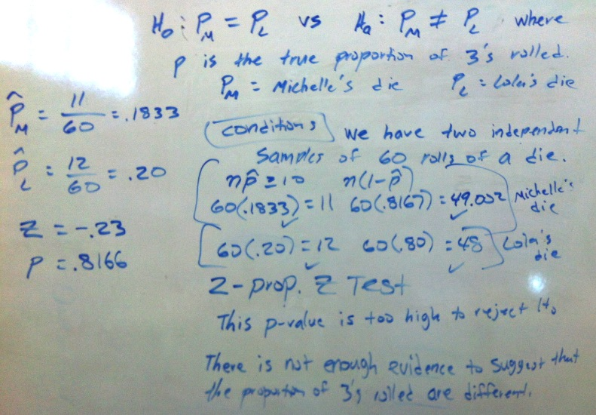
Ex. Michelle’s and Lola’s dice.

Slide 13
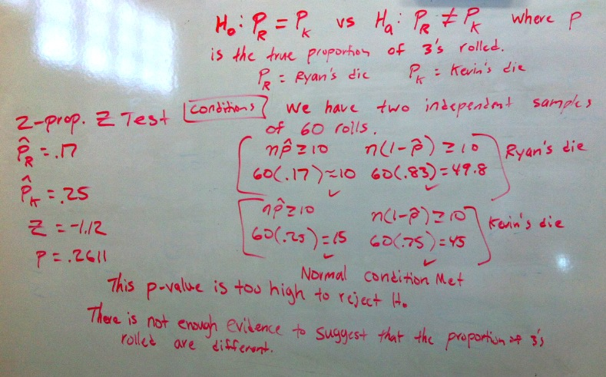
Ex. Ryan’s and Kevin’s dice

Slide 14
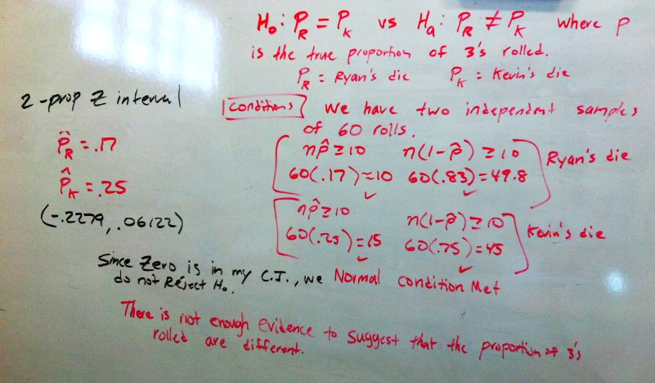
Use a CI to make a decision
This strategy should only be done if they “TELL YOU” to do a CI to test a hypothesis

Slide 15
Calculator Practice
Have graduation rates increased……..?
2008
200 seniors graduated out of 345 total seniors
2014
209 seniors graduated out 341 total seniors
1. Write out the proper hypothesis for this situation.
H_{o}: p₂₀₀₈ = p₂₀₁₄ vs H_{a}: p₂₀₀₈ < p₂₀₁₄ where p is the true proportion of seniors that have graduated in 2008 and 2014
2. What is the p-value and conclusion in context?
P-value = .1878…There is NOT enough evidence to suggest that the graduation rate has increased.

Slide 16
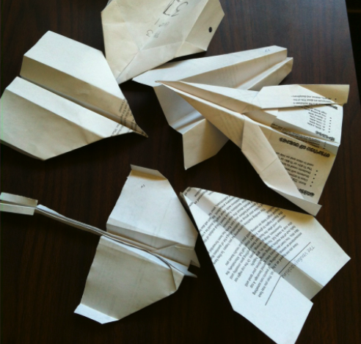
Paper Airplane Competition

Slide 17
PAPER AIRPLANE “TWO Sample t-Test”
Your group needs to create a paper airplane that can fly well.
Your group will get 25 minutes to make your plane. You may only use one 8.5x11 sheet of paper to build your plane. No tape or added material are allowed on your plane.
One person may take them outside for 1 minute to practice throwing them, you may NOT throw them in the room. At the end of 25 minutes your plane must be on my desk with your period and group number on it.
We will test them tomorrow in the gym. The longer your plane stays in the air the better.

Slide 18
Rules
Each group must time all throws of their airplane
Start timer when it leaves the hand and stop when it hits the ground
No cheating on your times
High outliers will be a disqualification, there should be no outliers unless your plane falls apart and you get low outliers.
Try for 30 throws, if you have less you will need to show a boxplot of your times to meet your normal condition.(this could happen if your plane gets lost or starts to fly poorly)
You may choose to stop throwing anytime after 10 throws.

Slide 19
Airplane Data
Put ALL your times into a list on your calculator
Use 1-var stats(write down your mean and Stdev(S))
Do a boxplot of your data
TURN in to ME:
Mean,StDev, and Boxplot, and sample size(how many throws)

Slide 20
Group 3 vs Group 5 per1
H_{o}: u₃ = u₅ vs H_{a}: u₃ ≠ u₅ where u is the true mean flight time(seconds) for group 3 and group 5’s plane.
Assumptions: We have two independent random samples of flight times for paper airplanes. 13 throws from group 3’s plane and 15 throws from group 5’s plane. Each groups samples are independent from each other. Each groups flight times have met the normal condition by a boxplot which show no outliers or extreme skew.
Group 3
Group 5

Slide 21
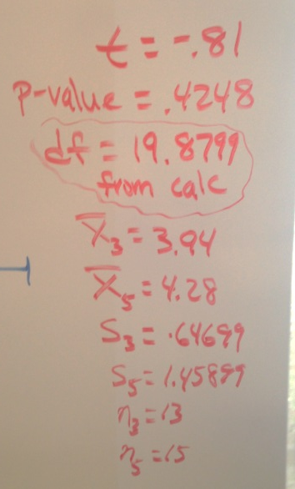
Group 3 vs Group 5 per1
Stats from Calc
This p-value is too high to reject H_{o} at any alpha level.
Based on these samples, there is NOT enough evidence to suggest that these groups mean flight times of their planes are different.

Slide 22
Period 1 Results
Group 2’s plane had the highest mean flying time followed by group 6’s plane.
Is group 2’s plane significantly better than group 6’s plane?
We can run a 2 sample t test to determine this.

Slide 23
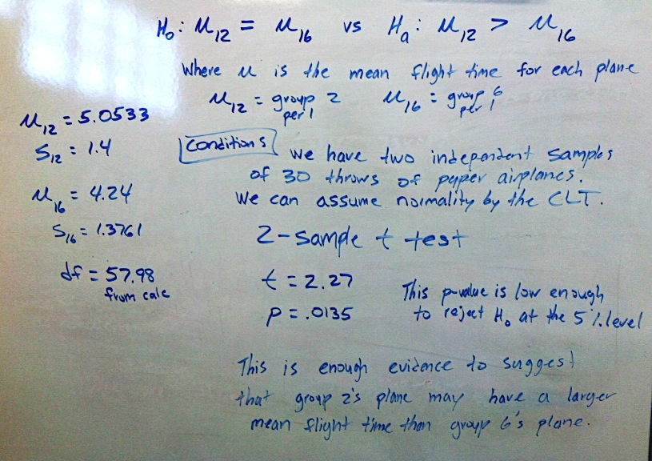

Slide 24
Period 3 Results
Group 5’s plane had the highest mean flying time followed by group 7’s plane.
Is group 5’s plane significantly better than group 7’s plane?
We can run a 2 sample t test to determine this.

Slide 25
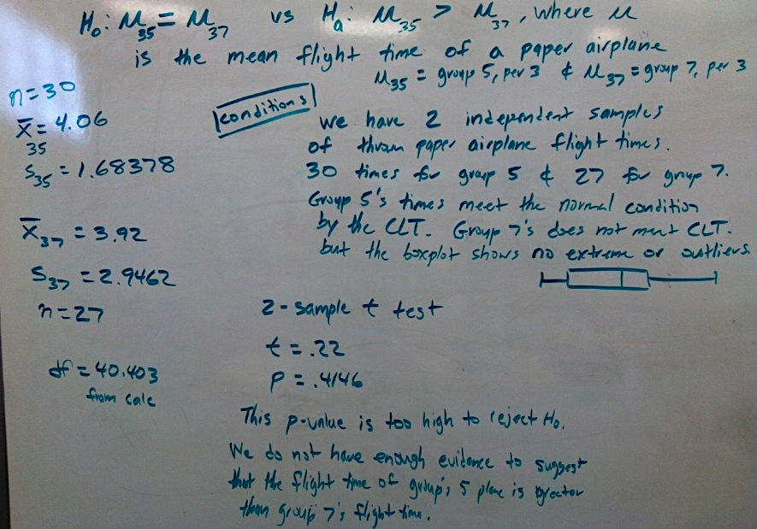

Slide 26
Paper Airplane Champions
Plane 12 had a significantly greater mean flight time than 16’s plane.
Plane 16 had a greater mean than any of the planes in period 3.
Therefore there is no other tests that need to be done. Plane 12 is the winner.

Slide 27
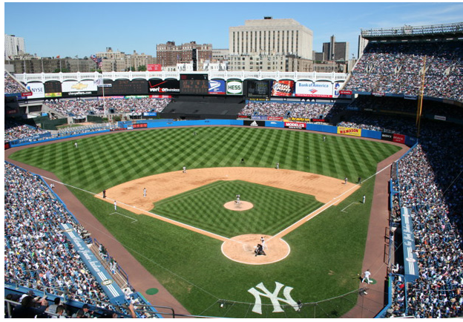
Home Field Advantage
In the 2000 regular baseball season, the World Series Champion New York Yankees played 80 games at home and 81 games away. They won 44 of their home games and 43 of the games played away.
Was there a significant Home field advantage for the Yankees in 2000?

Slide 28
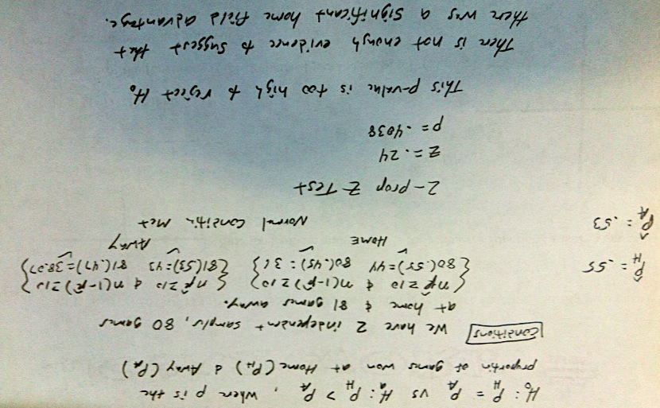

Slide 29
Matched Pairs Test
“AKA” Paired T Test
This is a test that looks like you are given 2 samples but is actually done on the calculator as a 1-sample t test.
You have to be careful reading the problem, usually there it is a situation where there is a before and after.

Slide 30
Bouncing Coins in a Cup
How many quarters can you bounce in a cup? Is your strong hand better than your weak?
RULES
Groups 1,3,5,7 will start with your strong hand…..Groups 2,4,6,8 will start with your weak hand.
Every 2 minutes we will switch hands.(I will tell you when to switch)
Make sure to keep track of which hand you make them with.
We will run a paired-t Test as a class.

Slide 31
S | 2 | 2 | 3 | 6 | 4 | 6 | 0 | 0 | 2
W | 2 | 1 | 2 | 3 | 4 | 1 | 3 | 2 | 3
Diff
S | 3 | 3 | 1 | 2 | 8 | 2 | 0 | 0 | 3
W | 2 | 1 | 2 | 0 | 2 | 1 | 0 | 0 | 2
Diff
S | 0 | 0 | 0 | 0 | 0 | 2 | 7 | 5 | 0
W | 0 | 0 | 0 | 0 | 0 | 0 | 3 | 5 | 0
Diff
S | 0 | 1 | 3 | 1 | 3 | 1 | 2 | 5 | 1
W | 0 | 3 | 0 | 1 | 1 | 0 | 0 | 1 | 0
Diff
S | 3 | 3 | 0 | 5 | 1 | 1
W | 4 | 5 | 0 | 2 | 1 | 0
Diff
Fill in the differences(Strong Hand – Weak Hand)

Slide 32
S | 2 | 2 | 3 | 6 | 4 | 6 | 0 | 0 | 2
W | 2 | 1 | 2 | 3 | 4 | 1 | 3 | 2 | 3
Diff | 0 | 1 | 1 | 3 | 0 | 5 | -3 | -2 | -1
S | 3 | 3 | 1 | 2 | 8 | 2 | 0 | 0 | 3
W | 2 | 1 | 2 | 0 | 2 | 1 | 0 | 0 | 2
Diff | 1 | 2 | -1 | 2 | 6 | 1 | 0 | 0 | 1
S | 0 | 0 | 0 | 0 | 0 | 2 | 7 | 5 | 0
W | 0 | 0 | 0 | 0 | 0 | 0 | 3 | 5 | 0
Diff | 0 | 0 | 0 | 0 | 0 | 2 | 4 | 0 | 0
S | 0 | 1 | 3 | 1 | 3 | 1 | 2 | 5 | 1
W | 0 | 3 | 0 | 1 | 1 | 0 | 0 | 1 | 0
Diff | 0 | -2 | 3 | 0 | 2 | 1 | 2 | 4 | 1
S | 3 | 3 | 0 | 5 | 1 | 1
W | 4 | 5 | 0 | 2 | 1 | 0
Diff | -1 | -2 | 0 | 3 | 0 | 1
Fill in the differences(Strong Hand – Weak Hand)

Slide 33
H_{o}: u_{d} = 0 vs H_{a}: u_{d} > 0 where u_{d} is the true mean difference(strong – weak) between students strong hands and weak hands in bouncing qtr’s into a cup
Assumptions: We have an independent random sample of 42 student differences between strong and weak hands in bouncing coins into a cup. The population of all students is more than 10 times our sample size. Our normal condition is met by the CLT.
Paired t Test
Stats
t = 2.79
P-value = .0039
df = 41
x-bar = .81
s = 1.87718
n = 42
This p-value is low enough to reject H_{o} at the 1% alpha level.
Based on this sample, there is very strong evidence to suggest that students strong hands may be better than their weak hands in bouncing coins into a cup.

Slide 34
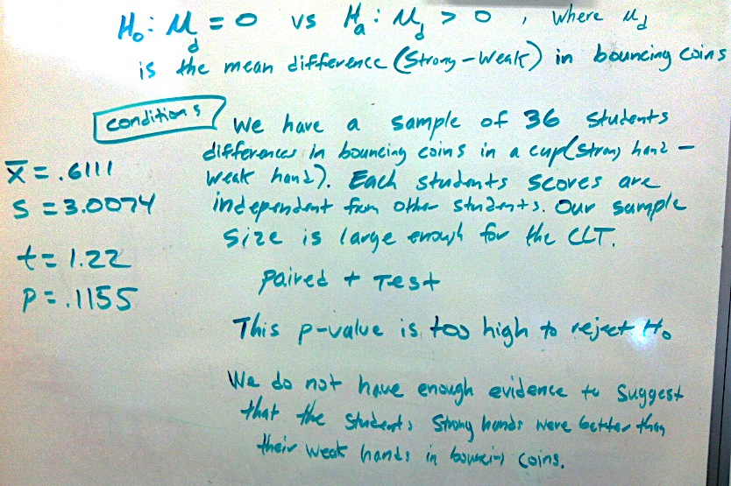
C/O 2014

Slide 35
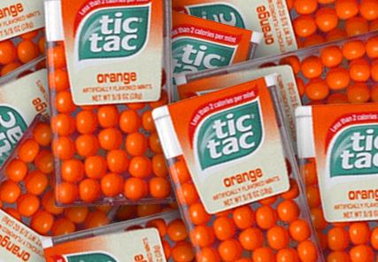
Catching Tic Tacs
Due to choking hazard we will use a cup
With Your Mouth

Slide 36
Paired T Test
You will throw EXACTLY 10 Tic Tacs in the air(one at a time) and attempt to catch them with your mouth/cup.
Then you will have a partner toss you 10 Tic Tacs(one at at time) and you will attempt to catch them in the air.
No Practice throws.

Slide 37
Paired T Test
Is there a difference between you tossing them to yourself or someone tossing them to you?
As a class we will run this test.

Slide 38
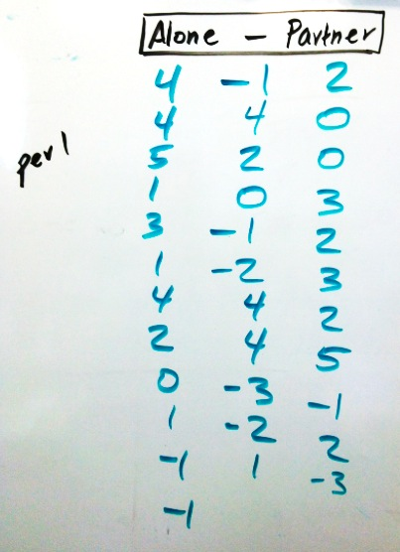
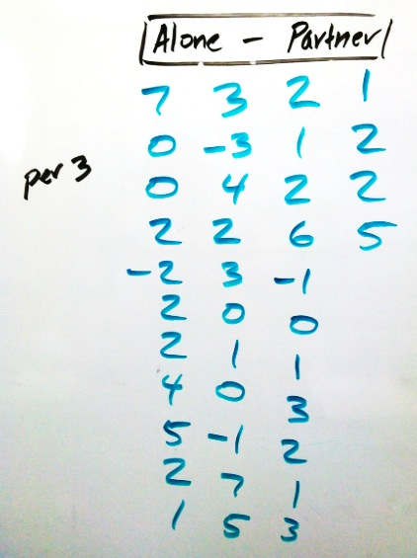
Paired t Test

Slide 39
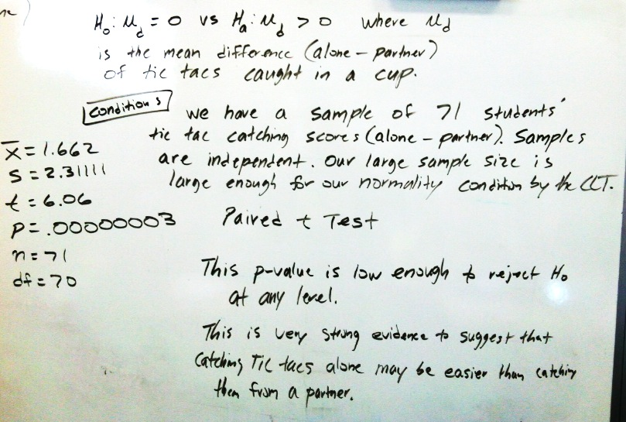

Slide 40
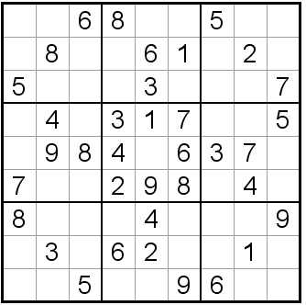
Sudoku Times
Is there a difference between the boys and girls when it comes to finishing Sudoku puzzles?

Slide 41
Let’s perform a 2-sample t test for the difference between the boys and girls Sudoku times in seconds.
Tony | 955
Randy | 945
Lawrence | 846
Kevin | 493
Miguel | 1442
Adolpho | 1390
Josue | 1307
Phi | 782
Thomas | 740
David | 585
Marlon | 448
Joseph | 701
Mohammed | 1691
Jorge | 1052
Gema | 868
Jenna | 471
Vanessa | 710
Bryanna | 595
Tuan | 799
Karen | 1245
Danielle | 1376
Kayla | 1768
Enter the girls into L₁ and boys in L₂

Slide 42
2 sample T Test
Ho: u_{g} = u_{b} vs Ha: u_{g} ≠ u_{b} where u is the true mean number of seconds it takes high school boys and girls to to finish a Sudoku puzzle
ASSUMPTIONS: We have two independent random samples of Sudoku times, 8 for girls and 14 boys. Their individual times are independent and their samples are independent from each other. The population of high school students is well over 10x out sample sizes. Our samples are small but the boxplots show no outliers or extreme skew. Ok for T procedures.
Stats
t =
X-bar_{g} =
S_{g} =
X-bar_{b} =
S_{b} =
P-Values =
This p-value is _______________ to reject Ho at __________.
There is ________________evidence to suggest that the true mean number of seconds it takes to finish a Sudoku puzzle is __________ for girls and boys.

Slide 43
Use the Sudoku data to construct a 90% confidence interval.
How can you use this interval to make a decision on H_{o}?
What is the standard error for this confidence interval?
What is the margin of error for this confidence interval?

Slide 44
Bouncing Coins
Paired t Test
There should be a hint in the problem of a before and after situation or a right hand left hand.
Sometimes called a Matched Pairs Test
It’s #2 on the calculator like a t-test

Slide 45
Paired T Test
Ho: u_{d} = 0 vs Ha: u_{d} > 0 where u_{d} is the true mean number of quarters made in the cup before and after instructions were given. u_{d} is the difference in means(after – before)
ASSUMPTIONS: We have an independent of sample of ____ differences in the number of coins bounced in a cup. The population of high school students is well over 10x out sample sizes. Our normal condition is met by the CLT.
Stats
t =
X-bar_{d} =
S_{g} =
P-Value =
This p-value is _______________ to reject Ho at __________.
There is ________________evidence to suggest that there was an improvement in the mean number of coins that went into the cup after instructions were given.

Slide 46
Did students get better playing the chimp game the second time around. A SRS of 12 students scores were taken from December and January. Is there significant evidence that students scores improved?
Dec | .29 | .23 | .29 | .34 | .29 | .29 | .25 | .29 | .23 | .20 | .21 | .34
Jan | .26 | .21 | .25 | .22 | .25 | .35 | .34 | .23 | .32 | .26 | .20 | .26
diff
Write the Hypothesis, run the test, write your conclusion.
Ho: u_{d} = 0 vs Ha: u_{d} > 0 where u_{d} is the true mean difference(Dec-Jan) in scores from the chimp game from December to January.
This p-value is _______________ to reject Ho at __________.
There is ________________evidence to suggest that

Slide 47
Were the girls better than the chimp significantly more than the boys? 33 out of 63 girls were better than the chimp while only 12 out of 36 boys finished better than the chip. Is this significant evidence that the girls were better?
Write the Hypothesis, run the test, write your conclusion.
Ho: P_{G} = P_{B} vs Ha: P_{G} > P_{B} where P is the true proportion of girls and boys who were better than the chimp.
This p-value is _______________ to reject Ho at __________.
There is ________________evidence to suggest that

Slide 48
Were the 10 heaviest cars significantly faster than the 10 lightest cars? The heavier cars had a mean of 2.77 with a standard deviation of .29694 and the lighter cars had a mean of 3.14 with a standard deviation of .32762.
Write the Hypothesis, run the test, write your conclusion.
H_{o}: u_{H} = u_{L} vs H_{a}: u_{H} < u_{L} where u is the true mean time for the heaviest and lightest cars.
This p-value is _______________ to reject Ho at __________.
There is ________________evidence to suggest that

