Slide 1
Chapter 1
Descriptive Statistics
Mean
Median
Mode
Standard Deviation
Shape
Skew
Outliers
Stemplots
Dot Plots
Histograms
Boxplots

Slide 2
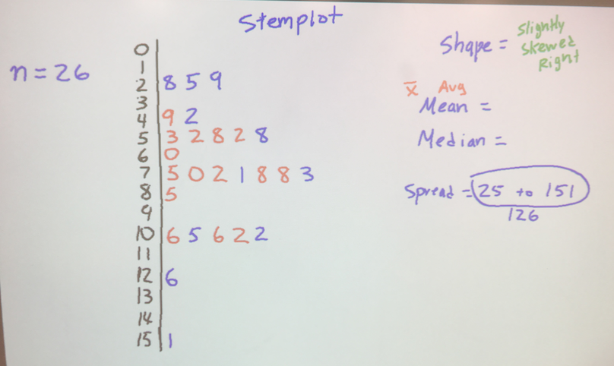
The Game of Greed

Slide 3
The Game of Greed
PER 1
The distribution of Greed scores were slightly skewed to the right. The distribution had a mean score of 73.3 which is slightly more than the median score of 71.5. Out of the 26 students who played there were no outliers . Scored ranged from 25 up to 151.

Slide 4
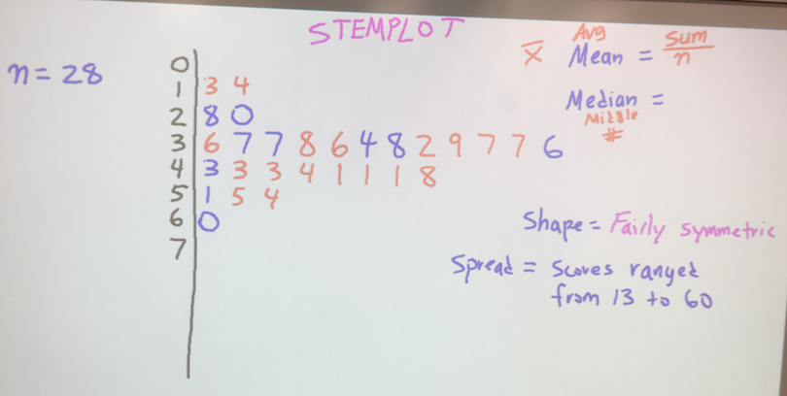
The Game of Greed

Slide 5
The Game of Greed
PER 2
The distribution of Greed scores had a fairly symmetric shape. The distribution had a mean score of 38.4 which is just a tiny bit more than the median score of 38. Out of the 28 students who played there were no outliers . Scored ranged from 13 up to 60.

Slide 6
Quantitative vs Categorical
Basically something that cannot be counted is categorical
Something that can be counted is quantitative

Slide 7
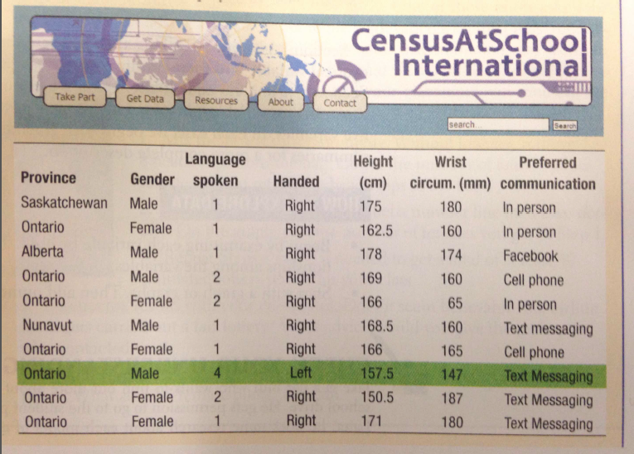
Quantitative vs Categorical

Slide 8
Texting
Check your phone for the # of text messages you have sent since noon yesterday
Not Texts Received
Not Tweets
Just Texts Messages sent
If you have sent none, write zero
If you do not have a phone or its off or not with you, write N/A
Make sure to write down if you are a boy or girl

Slide 9
Texting
We will make a back-to-back stemplot comparing the boys and girls
We will calculate the summary statistics using 1-variable stats on the calculator
We will check for outliers by constructing a boxplot on our calculator
We will compare the distributions(C.U.S.S.)

Slide 11
NFL CHALLENGE

Slide 12
NFL CHALLENGE
As a group answer all questions on the NFL questionnaire
You do not need to write the city name, just the mascot
Example: Los Angeles Rams…...just write RAMS
Use your cell phones
Use Google, Find an NFL site, search for predictions, etc
After the SUPER BOWL in Febuary, we will see who wins,.....baseball cards awarded to best group.....we will use this data in class later
You have 15 minutes.....GO

Slide 13
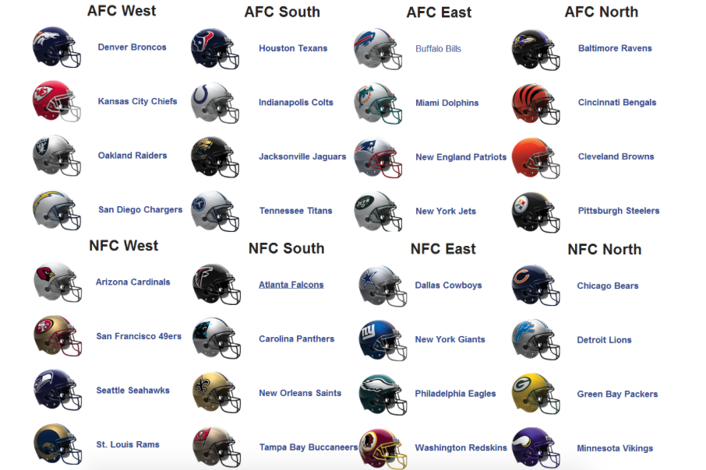
NFL CHALLENGE

Slide 14
The Game of Greed
The object of this game is to get the Highest Score you can after 5 rounds.
I will roll a 12-sided die to give you points to start with.
After my initial roll, I will start rolling a 6-sided die. You will add these points to your score.
BEWARE! If I roll a 2 you will lose all the points you have counted for that round.
You may sit down anytime and take the points you have earned for that round.

Slide 15
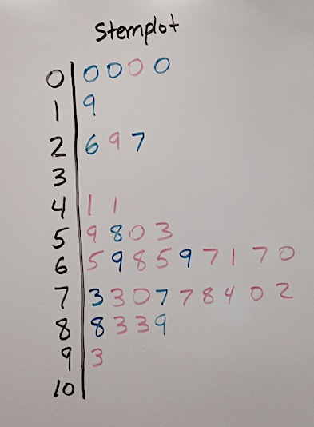
The Game of Greed
Per 2

Slide 16
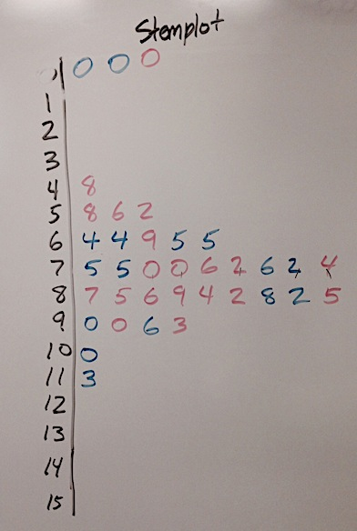
The Game of Greed
Per 3

Slide 17
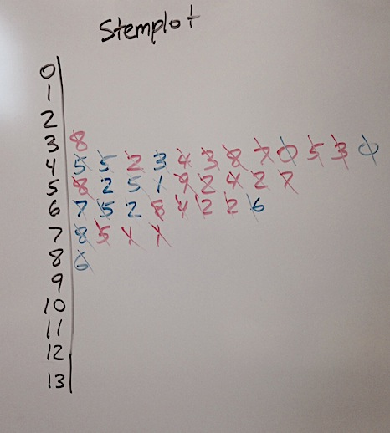
The Game of Greed
Per 4

Slide 18
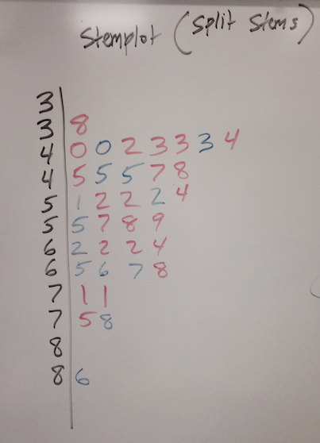
The Game of Greed
Per 4

Slide 19
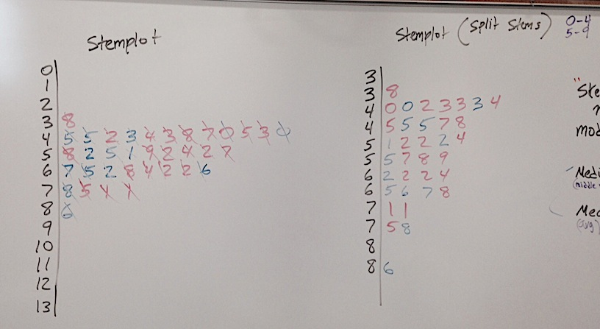
The Game of Greed
Per 4

Slide 20
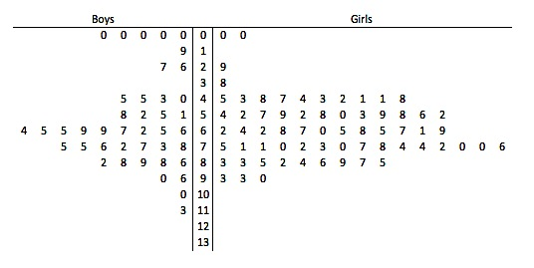
The Game of Greed
Back-To-Back Stemplot

Slide 21
How old is our teacher?
Write down on a piece of paper the age you think Mr. Pines is.
Don’t ask anyone else, hide your answer, we will use this data in a few minutes.

Slide 22
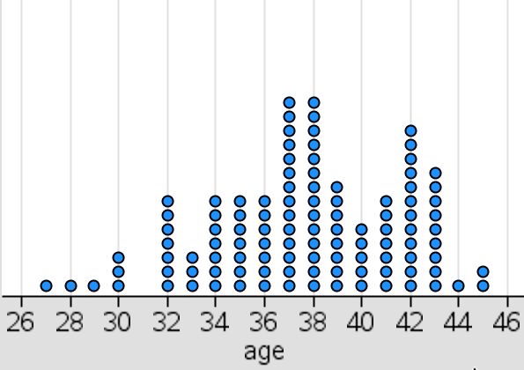
How old is our teacher?

Slide 23
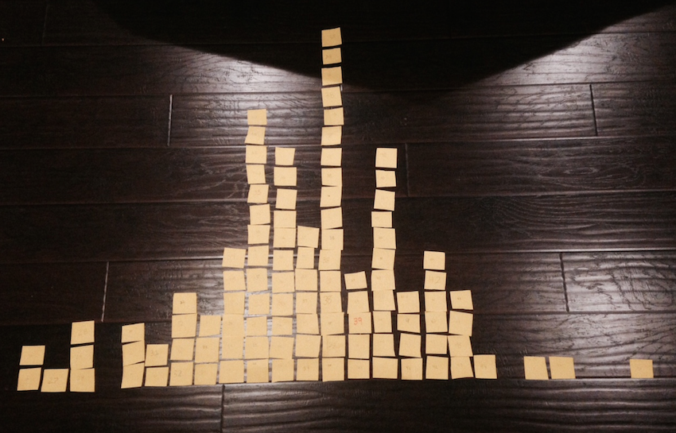
How old is our teacher?

Slide 24
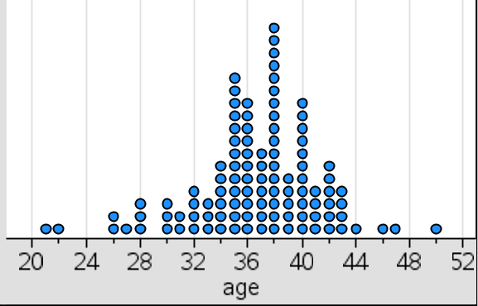
How old is our teacher?
Dot plot here
Student Age Estimation for Mr. Pines
n=108

Slide 25
How old is our teacher?
Can you estimate the mean and median from the shape of the distribution?
Mean = 36.6 Median = 37
n=108

Slide 26
How old is our teacher?
n=108
37
Mr. Pines actual age is…………………

Slide 27
How old is our teacher?
Describe the distribution.
CUSS: Center(mean and median), Unusual features(are there outliers?), Shape(skewed left,symmetric, skewed right), Spread(max to min)
n=108

Slide 28
How old is our teacher?
The distribution of age guesses are fairly symmetric, with a mean age guess of 36.6 which slightly less than the median guess of 37. Students made six guesses that were considered outliers, they were 21,22,26,26,27, and one at 50 years old. Guesses of Mr. Pines’ age ranged from 21 to 50 years old.

Slide 29
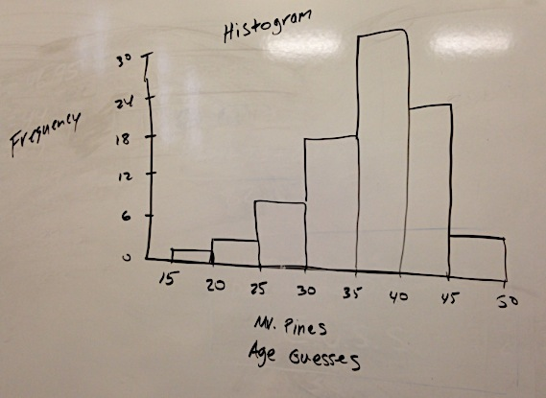
Histogram
Mr. Pines Age Guesses

Slide 30
Histogram
Skewed Right Skewed Left Symmetric
Where do the mean and median lie in each histogram?
Mean is greater than the Median
Mean is less than the Median
Mean and Median are the same

Slide 31
5# Summary
Definition:
The five-number summary of a distribution consists of the smallest observation, the first quartile, the median, the third quartile, and the largest observation, written in order from smallest to largest.
Minimum Q₁ M Q₃ Maximum

Slide 32
Find the 5# Summary
1,1,6,9,13,21,35
n = 7
Find the min,Q1,Med,Q3,Max

Slide 33
Find the 5# Summary
2,6,22,41,15,19
n =6
Find the min,Q1,Med,Q3,Max
Let the Calculator do it!

Slide 34
This is the 5# Summary
WE CANNOT USE THE CALCULATOR
Min | Q1 | Med | Q3 | Max
3 | 4 | 14 | 22 | 51
n =?
Check for outliers and construct a boxplot.
Checking for outliers we use the formulas:
Q1 – 1.5(IQR)…..any number LOWER is an outlier
Q3 + 1.5(IQR)…..any number LARGER is an outlier
IQR = Q3-Q1

Slide 35
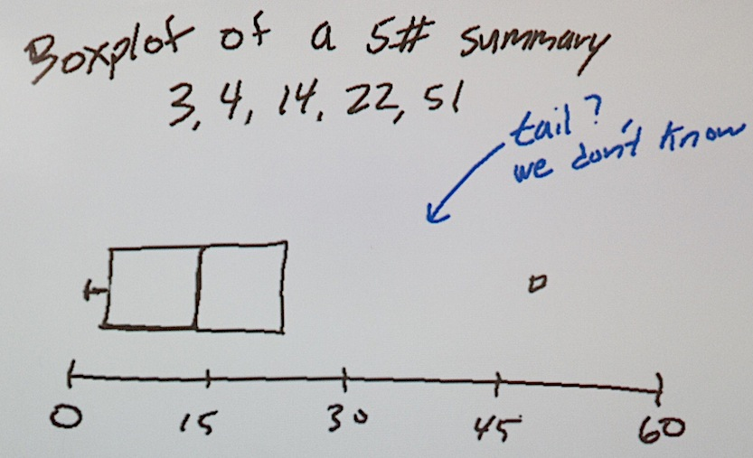
This is the 5# Summary
WE CANNOT USE THE CALCULATOR
Min | Q1 | Med | Q3 | Max
3 | 4 | 14 | 22 | 51
n =?
Check for outliers and construct a boxplot.

Slide 36
This is the 5# Summary
WE CANNOT USE THE CALCULATOR
Min | Q1 | Med | Q3 | Max
3 | 4 | 14 | 22 | 51
Lets say that n = 20, tell me how many outliers there are? Give me the perfect answer.

Slide 37
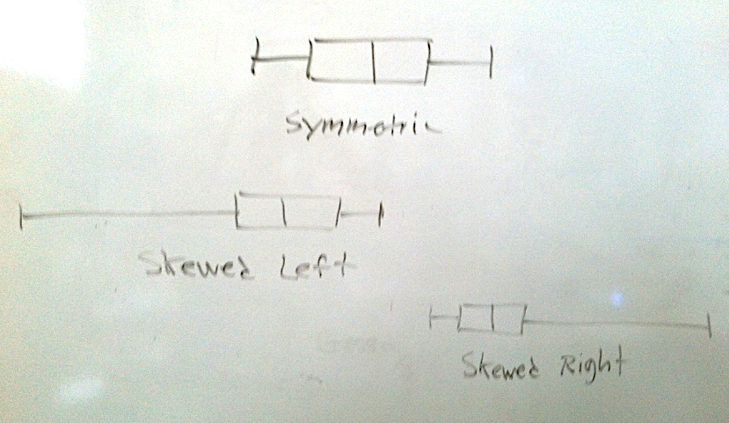
Box Plot Shapes

Slide 38
Box Plots
25%
25%
25%
25%
Min Q1 Q2 Q3 MAX

Slide 39
25%
25%
25%
25%
Lets make up a 5#-summary
Min | Q1 | Med | Q3 | Max
3 | 9 | 20 | 30 | 56
20
50% of the values are greater than __________
75
_____% of the values are less than 30
50
_____% of the values are between 9 and 30
9
75% of the values are greater than _______

Slide 40
5# Summary
Find the 5# summary for the following set of numbers
1,4,7,12,13,13,21
First find the median(it is the one in the middle)

Slide 41
5# Summary
Find the 5# summary for the following set of numbers
1,4,7,12,13,13,21
Now Q1 and Q3 are the numbers in the middle below and above the Median
The median cuts the set of numbers into two equal groups

Slide 42
5# Summary
Find the 5# summary for the following set of numbers
1,4,7,12,13,13,21
The Min and Max are the smallest and largest numbers.

Slide 43
5# Summary
Find the 5# summary for the following set of numbers
1,4,7,12,13,13,21
MIN | Q1 | MEDIAN | Q3 | MAX
1 | 4 | 12 | 13 | 21
This is the method for an ODD set of numbers

Slide 44
5# Summary
Find the 5# summary for the following set of numbers
1,4,7,12,13,13,21,24
In an EVEN set of numbers there is no exact middle.
The MEDIAN is the average of the two numbers in the middle.
Q1 and Q3 are also found by taking the avg of the two numbers in the middle
MIN | Q1 | MEDIAN | Q3 | MAX
1 | 5.5 | 12.5 | 17 | 24
This is the method for an EVEN set of numbers

Slide 45
Construct a Boxplot
MIN | Q1 | MEDIAN | Q3 | MAX
1 | 5.5 | 12.5 | 17 | 24
First draw a number line that contains the numbers in your 5# summary
0 5 10 15 20 25

Slide 46
Construct a Boxplot
MIN | Q1 | MEDIAN | Q3 | MAX
1 | 5.5 | 12.5 | 17 | 24
Next draw a rectangular box connecting Q1 and Q3
0 5 10 15 20 25

Slide 47
Construct a Boxplot
MIN | Q1 | MEDIAN | Q3 | MAX
1 | 5.5 | 12.5 | 17 | 24
Place a vertical line for the MEDIAN
0 5 10 15 20 25

Slide 48
Construct a Boxplot
MIN | Q1 | MEDIAN | Q3 | MAX
1 | 5.5 | 12.5 | 17 | 24
The MIN and MAX get small tic marks and connect to the box
0 5 10 15 20 25

Slide 49
Outliers in a boxplot
MIN | Q1 | MEDIAN | Q3 | MAX
1 | 5.5 | 12.5 | 17 | 24
There are no outliers in this set of numbers, but what if the MAX was a bigger number like 36………how would this change our boxplot?
0 5 10 15 20 25

Slide 50
Outliers in a boxplot
Do the following with the following numbers:
Find the 5#-Summary
Check for outliers
Create a boxplot
1,4,7,12,13,13,21,36

Slide 51
Outliers in a boxplot
1,4,7,12,13,13,21,36
Possible outlier
MIN | Q1 | MEDIAN | Q3 | MAX
1 | 5.5 | 12.5 | 17 | 36
Checking for outliers we use the formulas:
Q1 – 1.5(IQR)…..any number LOWER is an outlier
Q3 + 1.5(IQR)…..any number LARGER is an outlier
IQR = Q3-Q1

Slide 52
Outliers in a boxplot
1,4,7,12,13,13,21,36
36 is an outlier
The Outlier 36 is now considered the MAX but it is displayed with a circle.
0 5 10 15 20 25 30 35 40

Slide 53
Outliers in a boxplot
1,4,7,12,13,13,21,36
36 is an outlier
The tail is now extended to the next highest number in the set which is 21.
0 5 10 15 20 25 30 35 40

Slide 54
Check for outliers
2,5,1,3,7,8,10,12,6,8,41
Checking for outliers we use the formulas:
Q1 – 1.5(IQR)…..any number LOWER is an outlier
Q3 + 1.5(IQR)…..any number LARGER is an outlier
IQR = Q3-Q1

Slide 55
Check for Outliers on calculator
2,5,1,3,7,8,10,12,6,8,41
Put the numbers in a list(L1) and do a boxplot

Slide 56
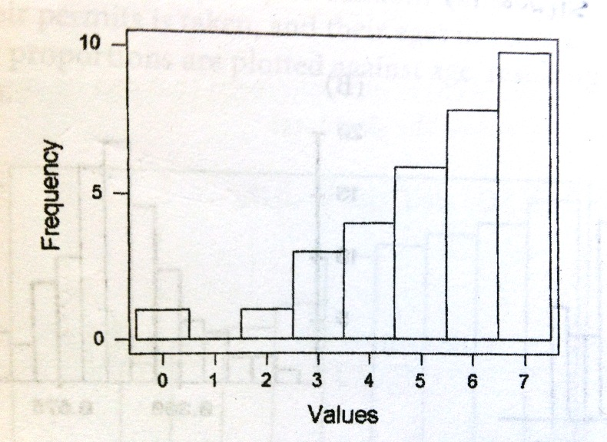
5# Summary of Histogram

Slide 57
5# Summary of Histogram
10
8
6
4
3
1
1
n=33

Slide 58
Half of 33 is 16.5 so the median falls in the “6” column
Half of 16.5 is 8.25 which makes Q1 in the “4” column
On the other half Q3 falls in the “7” column
10
8
6
4
3
1
1
n=33

Slide 59
The 5#-Summary becomes 0,4,6,7,7
10
8
6
4
3
1
1
n=33

Slide 60
This can be done on the calculator by putting the column numbers in L1 and the frequency counts in L2.
10
8
6
4
3
1
1
n=33

Slide 61
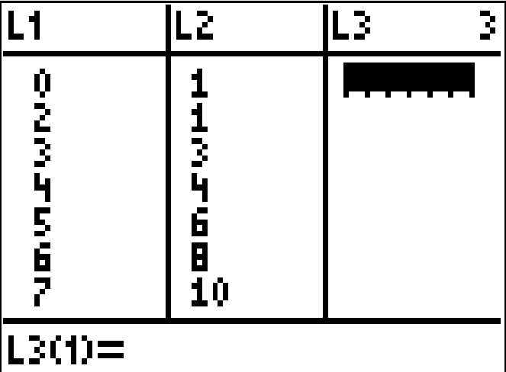
This can be done on the calculator by putting the column numbers in L1 and the frequency counts in L2.
Next hit the “STAT” button, right arrow to “CALC”, select 1:1-Var Stats

Slide 62
This can be done on the calculator by putting the column numbers in L1 and the frequency counts in L2.
Typel L1,L2
It should look like this:
1-Var Stats L1,L2

Slide 63
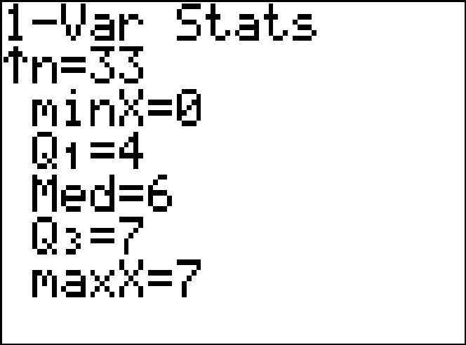
This can be done on the calculator by putting the column numbers in L1 and the frequency counts in L2.
5#-Summary

Slide 64
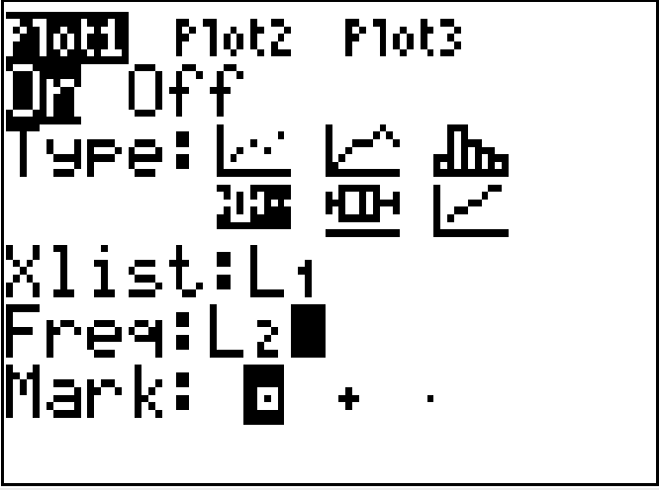
This can be done on the calculator by putting the column numbers in L1 and the frequency counts in L2.
You can also do a boxplot to get the 5#-summary
Because our data is in two columns you need to change the frequency to L2

Slide 65
This can be done on the calculator by putting the column numbers in L1 and the frequency counts in L2.

Slide 66
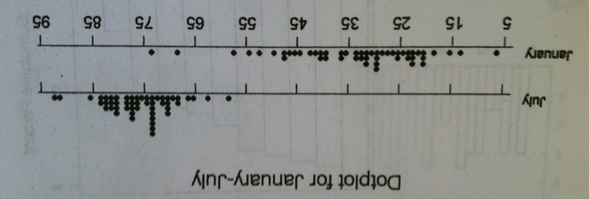
Variability and Spread
Which dotplot has the highest variability(spread)?
Which dotplot has the lowest variability(spread)?
Jan
July

Slide 67
Variability and Spread
Which dotplot has the largest Standard Deviation?
Which dotplot has the smallest Standard Deviation?
Jan
July

Slide 68
Percentiles
86 is the 49th dot out of 51 dots
In the July dotplot, estimate the percentile for the dot at 86.
49/51 = .9608 so 86 is at the 96th percentile.

Slide 69
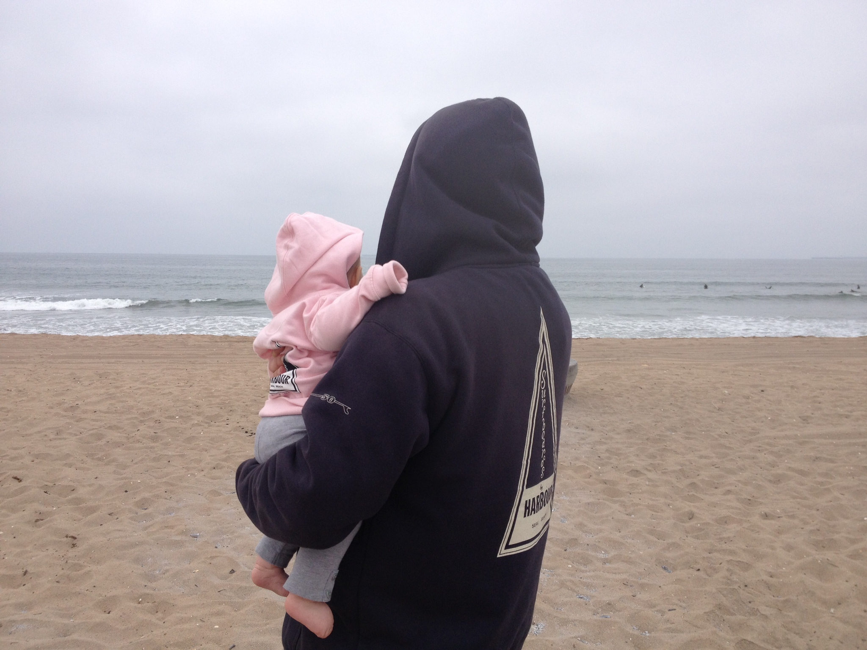
Box Plots
Mr. Pines caught lots of waves this past summer, such a bummer school had to start. But the good news is, now his AP Statistics students can calculate his surf stats for him.

Slide 70
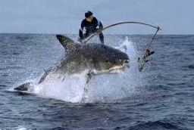
Box Plots
Mr. Pines caught lots of waves this past summer, such a bummer school had to start. But the good news is, now his AP Statistics students can calculate his surf stats for him.

Slide 71
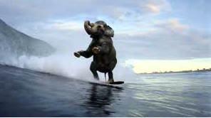
Box Plots
Mr. Pines caught lots of waves this past summer, such a bummer school had to start. But the good news is, now his AP Statistics students can calculate his surf stats for him.

Slide 72
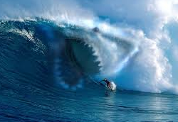
Box Plots
Mr. Pines caught lots of waves this past summer, such a bummer school had to start. But the good news is, now his AP Statistics students can calculate his surf stats for him.

Slide 73
Create a Box Plot
Here are the number of waves Mr. Pines caught for 40 surfing sessions this past summer.
4 | 3 | 35 | 16 | 20 | 15 | 17 | 13 | 18 | 12
20 | 10 | 20 | 11 | 7 | 16 | 13 | 9 | 21 | 17
9 | 15 | 1 | 9 | 2 | 3 | 5 | 8 | 3 | 5
6 | 7 | 8 | 6 | 5 | 21 | 12 | 24 | 2 | 10

Slide 74
Create a Box Plot
Here are the number of waves Mr. Pines caught for 40 surfing sessions this past summer.
4 | 3 | 35 | 16 | 20 | 15 | 17 | 13 | 18 | 12
20 | 10 | 20 | 11 | 7 | 16 | 13 | 9 | 21 | 17
9 | 15 | 1 | 9 | 2 | 3 | 5 | 8 | 3 | 5
6 | 7 | 8 | 6 | 5 | 21 | 12 | 24 | 2 | 10
Find the 5# Summary
Min,Q1,Median(Q2),Q3,Max

Slide 75
Create a Box Plot
Here are the number of waves Mr. Pines caught for 40 surfing sessions this past summer.
4 | 3 | 35 | 16 | 20 | 15 | 17 | 13 | 18 | 12
20 | 10 | 20 | 11 | 7 | 16 | 13 | 9 | 21 | 17
9 | 15 | 1 | 9 | 2 | 3 | 5 | 8 | 3 | 5
6 | 7 | 8 | 6 | 5 | 21 | 12 | 24 | 2 | 10
Sometimes putting the numbers in a stemplot makes finding the Medians faster.
Split the stems for this stemplot

Slide 76
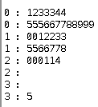
Stemplot

Slide 77
Create a Box Plot
Here are the number of waves Mr. Pines caught for 40 surfing sessions this past summer.
4 | 3 | 35 | 16 | 20 | 15 | 17 | 13 | 18 | 12
20 | 10 | 20 | 11 | 7 | 16 | 13 | 9 | 21 | 17
9 | 15 | 1 | 9 | 2 | 3 | 5 | 8 | 3 | 5
6 | 7 | 8 | 6 | 5 | 21 | 12 | 24 | 2 | 10
Find the 5# Summary

Slide 78
Create a Box Plot
Here are the number of waves Mr. Pines caught for 40 surfing sessions this past summer.
4 | 3 | 35 | 16 | 20 | 15 | 17 | 13 | 18 | 12
20 | 10 | 20 | 11 | 7 | 16 | 13 | 9 | 21 | 17
9 | 15 | 1 | 9 | 2 | 3 | 5 | 8 | 3 | 5
6 | 7 | 8 | 6 | 5 | 21 | 12 | 24 | 2 | 10
Are there outliers?

Slide 79
Create a Box Plot
Here are the number of waves Mr. Pines caught for 40 surfing sessions this past summer.
4 | 3 | 35 | 16 | 20 | 15 | 17 | 13 | 18 | 12
20 | 10 | 20 | 11 | 7 | 16 | 13 | 9 | 21 | 17
9 | 15 | 1 | 9 | 2 | 3 | 5 | 8 | 3 | 5
6 | 7 | 8 | 6 | 5 | 21 | 12 | 24 | 2 | 10
To check for low outlier: Q1-1.5(IQR)……any number lower is considered an outlier

Slide 80
Create a Box Plot
Here are the number of waves Mr. Pines caught for 40 surfing sessions this past summer.
4 | 3 | 35 | 16 | 20 | 15 | 17 | 13 | 18 | 12
20 | 10 | 20 | 11 | 7 | 16 | 13 | 9 | 21 | 17
9 | 15 | 1 | 9 | 2 | 3 | 5 | 8 | 3 | 5
6 | 7 | 8 | 6 | 5 | 21 | 12 | 24 | 2 | 10
To check for high outlier: Q3+1.5(IQR)……any number higher is considered an outlier

Slide 81
Create a Box Plot
Here are the number of waves Mr. Pines caught for 40 surfing sessions this past summer.

Slide 82
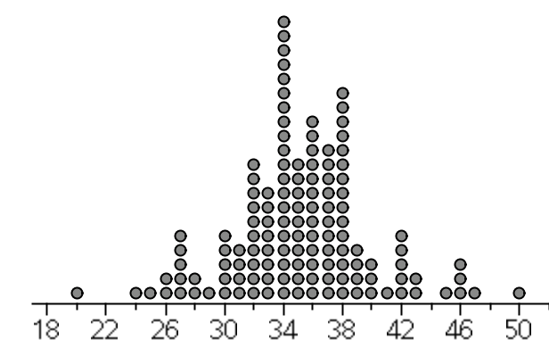
Boxplot
Construct a boxplot for the “guess the age of Mr. Pines data”
n=130

Slide 83
Histogram
Lets make a histogram for the number of minutes of each summer surf session.
40 | 20 | 80 | 45 | 65 | 48 | 48 | 62 | 50 | 48
70 | 49 | 61 | 49 | 50 | 48 | 60 | 47 | 61 | 55
57 | 51 | 45 | 45 | 15 | 15 | 30 | 50 | 45 | 45
40 | 50 | 60 | 45 | 20 | 75 | 45 | 75 | 20 | 60

Slide 84
Histogram
40 | 20 | 80 | 45 | 65 | 48 | 48 | 62 | 50 | 48
70 | 49 | 61 | 49 | 50 | 48 | 60 | 47 | 61 | 55
57 | 51 | 45 | 45 | 15 | 15 | 30 | 50 | 45 | 45
40 | 50 | 60 | 45 | 20 | 75 | 45 | 75 | 20 | 60
We need to choose the x-axis increments, the one you choose may be different than someone else’s.

Slide 85
Histogram
40 | 20 | 80 | 45 | 65 | 48 | 48 | 62 | 50 | 48
70 | 49 | 61 | 49 | 50 | 48 | 60 | 47 | 61 | 55
57 | 51 | 45 | 45 | 15 | 15 | 30 | 50 | 45 | 45
40 | 50 | 60 | 45 | 20 | 75 | 45 | 75 | 20 | 60
Before you start on your histogram, you MUST make a frequency table!

Slide 86
Frequency Table
Range | # of occurences
0-14 min
15-29 min
30-44 min
45-59 min
60-74 min
75-89 min

Slide 87
There are 19 observations in a data set. 5 # Summary…(1,2,4,5,8)
How many observations are less than 4?
5 to 9
HOW?
1,2,2,2,2,4,4,4,4,4,5,5,5,5,5,5,5,5,8

Slide 88
There are 8 observations in a data set. 5 # Summary…(1,2,6,20,21)
Is it possible that there is no observation equal to 6?
Why?
1,2,2,2,10,20,20,21

Slide 89
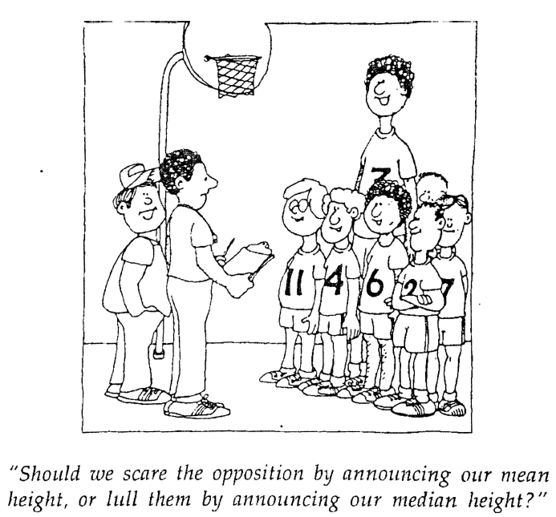

Slide 90
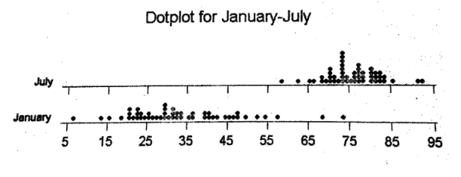
Percentile
What percentile was the day which reached 86 degrees in July?

Slide 91
Standard Deviation
Standard deviation is a measure of spread.
The easiest definition I can give you is that the standard deviation is the average distance the numbers in the set are from the mean.
If all the numbers are the same the standard deviation would be zero.
Standard Deviation is CONSISTENCY!...are the #’s close to each other or very spread out?

Slide 92
Standard Deviation
If the numbers in a set are all very close together(low variability) the standard deviation will be small
If the numbers in the set are very spread out(high variability) the standard deviation will be large.
Standard Deviation is NOT resistant to outliers, an outlier in either direction will make the standard deviation larger.

Slide 93
Standard Deviation

Slide 94
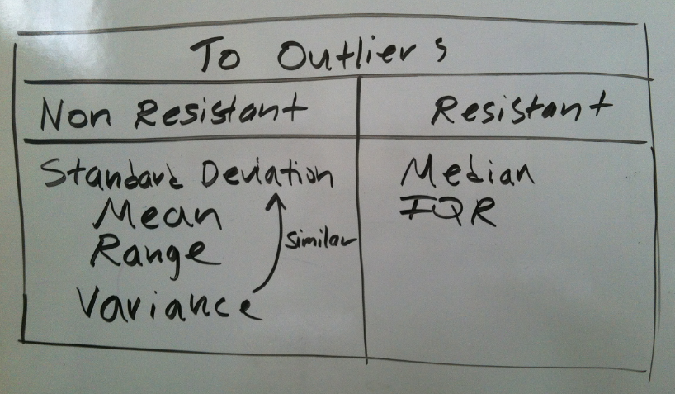
Resistant Vs. Nonresistant

Slide 95
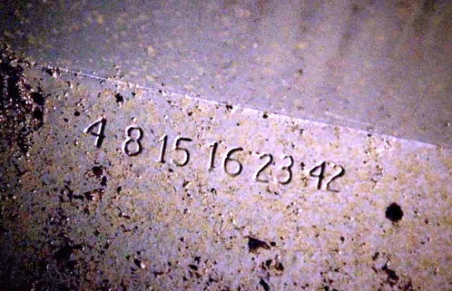
Find the Standard Deviation of “The Numbers”

Slide 96
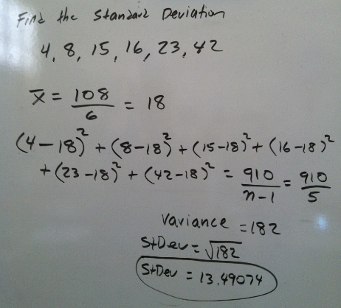

Slide 97
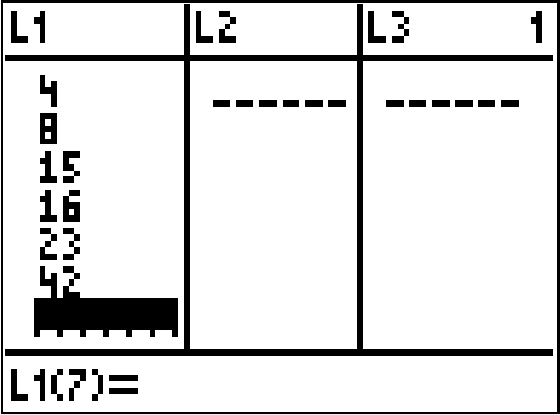
Use your calculator as much as possible
Hit the Stat Button, then hit 1:Edit, then enter the numbers

Slide 98
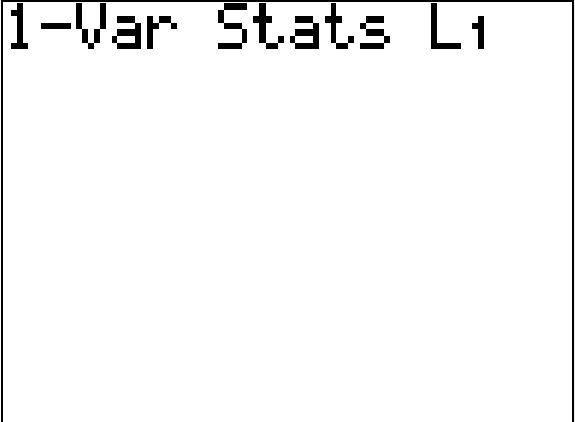
Use your calculator as much as possible
Hit the Stat Button again, then use the right arrow to get to Calc, then hit 1:1-var stats, then hit the 2nd button and then L1(#1 key)
Hit Enter

Slide 99
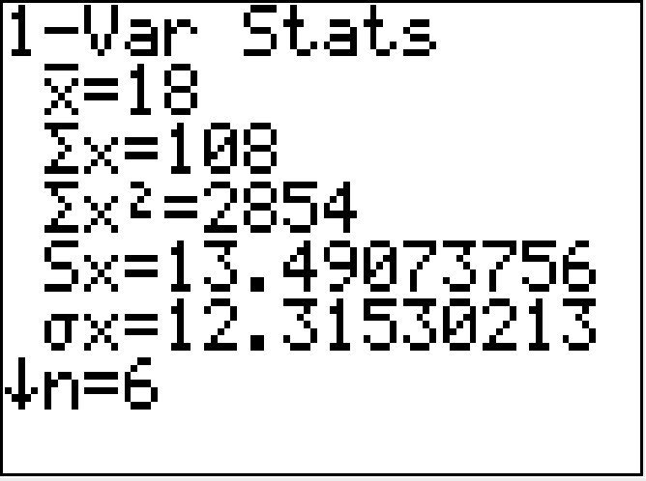
Use your calculator as much as possible
Standard
Deviation

Slide 100
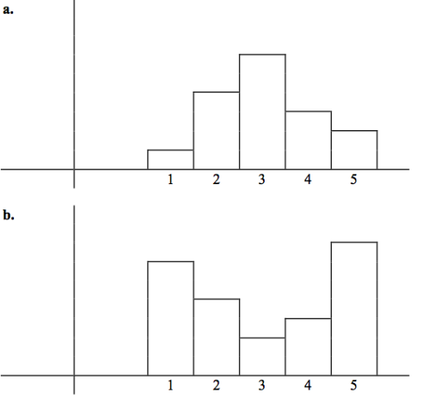
Standard Deviation
Both histograms have the same mean and median. Which one has the smallest standard deviation?

Slide 101
Standard Deviation
Histogram “a” has more data clustered around its center. Which gives it less variability, which results in a SMALLER Standard Deviation.

Slide 102
Standard Deviation
Histogram “b” has more data away from the center. It has two clusters with almost a gap in the middle. Which gives it more variability, which results in a LARGER Standard Deviation.

Slide 103
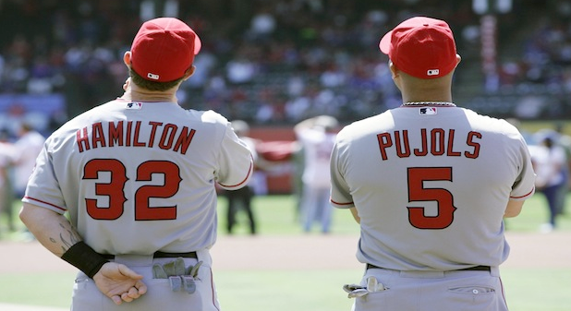
LA Angels 2013 Salaries

Slide 104
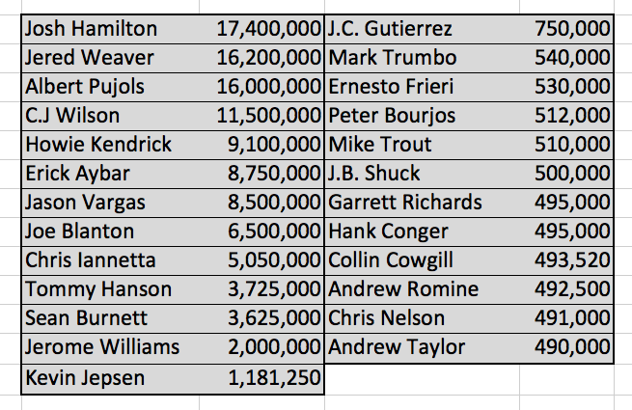

Slide 105
What shape will these salaries form?

Slide 106
If you wanted to convince someone that the LA Angels are overpaid, would you show them the median salary or mean salary? Explain?

Slide 107
Strong Skew to the right, so the mean is greater than the median. The huge salaries pull the mean to the right. The mean is non resistant.

Slide 108
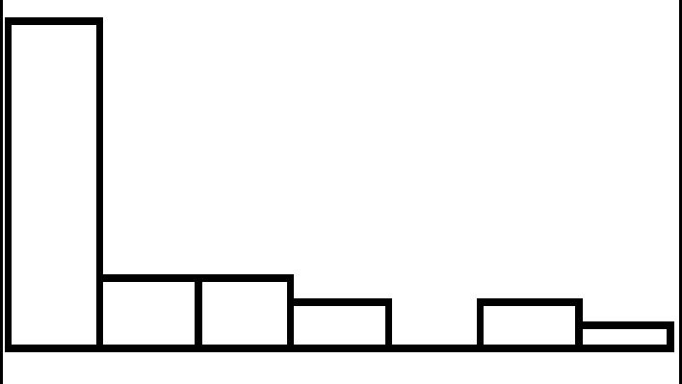
Another view of the shape from a histogram, clearly skewed to the right.

Slide 109
Mean Salary: $4,633,200
Median Salary: $1,181,250

