Slide 1
Chapter 4
Observational Studies & Experimental Design

Slide 2
Rancho Arena
As a group come up with a plan to survey 1,000 guests.
It needs to be detailed, EXPLAIN!!!
You may draw a flow map or diagram.
You cannot just hand the survey to random people, that is not good enough. The survey needs to be distributed randomly.
Everyone’s opinion is important in a survey.
Keep in mind that different types of people may be seated in different areas of the arena.
Be Creative, Best design will earn baseball cards.

Slide 3
Rancho Arena
Who gets the survey?........this is most important…….avoid BIAS!
How do you give the survey?

Slide 4
How many?
One way to determine the number of surveys to each level in the arena is to base it on the % of people in those levels.
There are 15,000 in the arena.
12,000 are in the upper level which is 80%
640 in the luxury suites which is about 4.3%
2,360 on the floor which is about 15.7%
Multiplying 1,000 surveys by those percents give us the following……

Slide 5
How many?
Lets use 80%, 4% and 16% to simplify things.
1,000(.80) = 800 surveys to the upper level.
1,000(.04) = 40 surveys to the luxury suites.
1,000(.16) = 160 surveys to the floor level.

Slide 6
Who gets them?
The Floor Level.

Slide 7
Who gets them?
The Floor Level.
We have 160 surveys to give out.
We cannot give them to people who we think represent the population, which means we cannot use our own judgment.
Typically the floor seating enters in one area at a concert. One method would be to have someone stand at the entrance to the floor seating area and hand a survey to every 14th person who enters. The first person who gets the survey should also be randomly decided.(ex. You roll a die and a 3 shows up….so the 3rd person to pass will get the first survey, then it’s every 14th person until all 160 are gone.

Slide 8
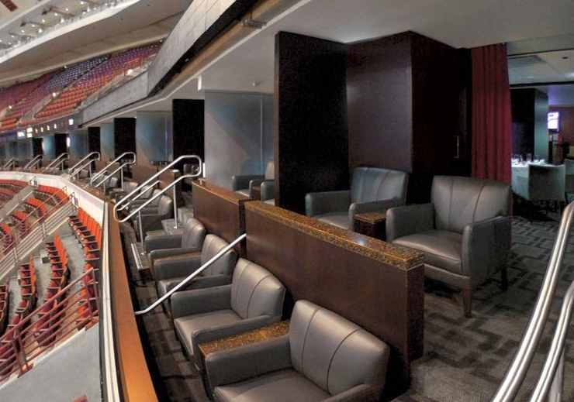
Who gets them?
The Luxury Suites.

Slide 9
Who gets them?
The Luxury Suites.
We have 40 surveys to give out.
The easiest way is to randomly choose four suites and then give EVERYONE in the suite a survey.(This is done so we don’t have to use another random method to decide which people in each suite get a survey)
The most efficient method to randomly choose 4 suites is to place numbered pieces of paper 1 to 64 and place them in a hat. Randomly draw out 4 pieces of paper and all 10 people in those suites get a survey.

Slide 10
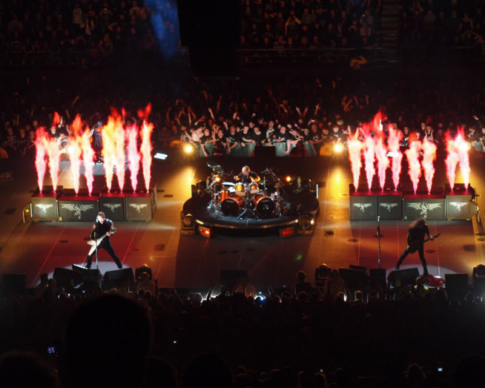
Who gets them?
The Upper Level.

Slide 11
Who gets them?
The Upper Level.
We have 800 surveys to give out.
There are many ways to distribute surveys to the upper levels. Since there are 500 people in each section it will be difficult to hand them out efficiently.
A good method is to have surveys attached to individual seats before the people arrive.(But which seats? This must be decided by a random method)
Most arenas have sections, rows, and then seat #’s.
To make things simple let’s place all 24 section letters on pieces of paper and place in hat. We can draw out 20 of them and decide to place 40 surveys on seats in those sections.(of course the rows and seat #’s in those sections must then be randomly chosen by a similar method…..got it?

Slide 12
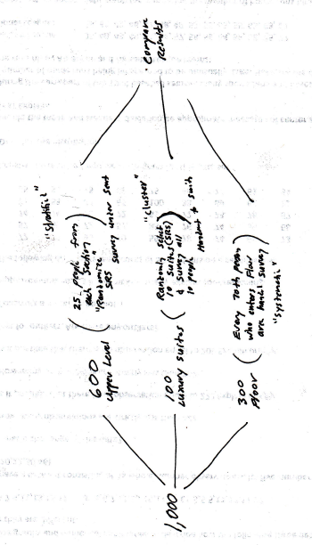

Slide 13
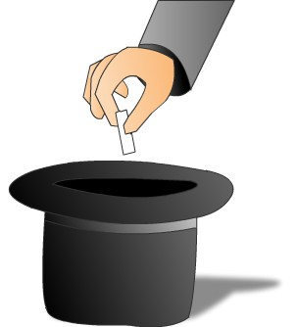
Sampling Design

Slide 14
The entire group of individuals that we want information about is called the population.
A census is an attempt to gather information about every individual member of the population. Problems with census—costs; time needed to complete; sometimes testing can destroy item.
A sample is a part of the population that we actually examine in order to gather information.
The design of a sample refers to the method used to choose the sample from the population.
The design of a study is biased if it systematically favors certain outcomes.

Slide 15
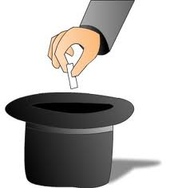
Obtaining a randomly chosen sample refers to the way in which the sample is chosen, not the specific members of the population that happen to end up in the sample.
Simple random sample (SRS)
each member of the population is equally likely to be chosen;
the members of the sample are chosen independently of one other;
every set of n units has an equal chance to be the sample actually selected.
“Classic” method—put names in hat and draw until have desired sample size; more commonly, number names and use random number table or other source of random numbers to select sample.

Slide 16
Systematic sampling—Select every k^{th} element in the population. Easier than random sampling; also guarantees sample is taken from throughout the population—be careful how population is ordered. (i.e. take every 10th student at RAHS; start at randomly selected point—still requires list)
Cluster sampling—divide the population into sections or clusters; randomly select a few of those sections and then choose all members from the selected sections (i.e. randomly select 10 third period classes—survey all students in each class selected—faster way to obtain sample)
Stratified random sampling—select subjects from similar groups called strata (i.e. select SRS from each grade-level at RAHS—9th, 10th, 11th, 12th—in proportion to number of students in each level)

Slide 17
Sources of bias in probability samples:
Under-coverage occurs when some groups in the population are left out of the process of choosing the sample (i.e. telephone survey excludes those without phones).
Response bias occurs when the method of observation tends to produce values that systematically differ from the true value in some way. BAD DESIGN
Non-response bias occurs when individuals chosen for the sample can’t be contacted or refuse to cooperate.

Slide 18
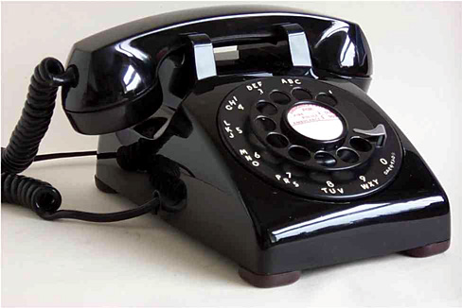
Difficulties with probability sampling—may be no easy way to list all members of a population or to contact some people. Can use: voter registration lists—not everybody is registered; list of all addresses—homeless, multiple people at same address; telephone numbers—unlisted phone numbers, people with multiple numbers are over-represented cell phones

Slide 19
Other sampling techniques (nonprobability—BAD!):
Convenience sampling—easiest way to obtain a sample is to choose it without any random mechanism (Simply uses a sample that is readily available—often biased.
Voluntary sample)—when people participate in a survey by voluntarily responding. People who care enough to respond usually are not representative of the whole population. Not random.
Judgment sampling—a form of convenience sampling where an “expert” selects a sample she/he considers representative. Not random

Slide 20
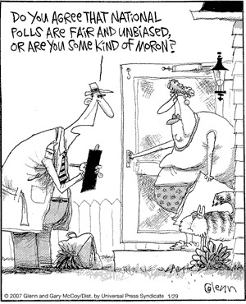
Random sampling is often difficult to do, especially for large populations. (Convenience sampling is easy to do but not very useful—may be representative/ balanced for variables in strata but not for population as a whole.)
The wording of questions is the most important influence on the answers given to a sample survey. Confusing or leading questions can introduce measurement bias. Even minor changes in wording can change the outcome of a survey—pretest survey (often in interview format) to check clarity of questions.

Slide 21
Simple Random Sample (SRS)
A. A sample is a simple random sample (SRS) if it is selected
so that:
each member of the population is equally likely to be chosen;
the members of the sample are chosen independently of one other;
every set of n units has an equal chance to be the sample actually selected.
“Classic” method—put names in hat and draw until have desired sample size; more commonly, number names and use random number table or other source of random numbers to select sample.

Slide 22
Random Digit Table
Use a random digit table to select 5 of the people below. Make sure to assign your digits.
Use line 123 on your random digit table.
Erik | Tammi | Gracie | Julie | Matt | Landry | Tim | Buddy
Lyla | Tyra | Jason | Billy | Luke | J.D. | Mac | Mindy
Brian | Vince | Jess | Becky | Joe | Wade | Santiago | Pam

Slide 23
Use the acronym………………….
D.A.R.E
Make sure to show your method CLEARLY!
D: Digits, which ones are needed?
A: Assign them, what are the digits equivalent to?
R: Repeats? Are repeats allowed? Are any numbers skipped?
E: End…..when will you stop taking digits?

Slide 24
We will be using digits 01-24, we will take 2 digits at a time from line 123 on our random digit table.
Each person is assigned a number starting with Erik(01), Tammi(02)…..Pam(24)
We will ignore repeats and ignore numbers larger than 24.
Once we have 5 different people chosen we will stop.

Slide 25
Sleepy Time
How much sleep do high school students get on a typical school night? An interested student in Mr. Pines AP Stats class designed a survey to find out. This student surveyed the first 160 students to arrive at school on a particular morning. These students reported an average of 7 hours of sleep on the previous night.
What type of sample did the student obtain?
Explain why this sampling method is biased. Is 7 hours probably higher or lower than the true average amount of sleep last night for all students at the school? Why?
CONVENIENCE
Higher, theses students were the first to arrive because they were probably well rested, the other students were probably tired and running late.

Slide 26
Sleepy Time
Mr. Pines suggested that the student redo the survey and this time use a proper sampling method. Keep in mind that there are 1827 students at the school.
c) Explain how the student can use a random digit table to obtain an SRS of 160 students.
d) What would the first 4 students be if line 138 was used on the random digit table?
Use digits 0001 – 1827, each student will be assigned a number between 0001 and 1827, ignore any repeats and digits larger than 1827. Choose a line to start at and take 4 digits at a time until 160 different students are chosen.

Slide 27
Sleepy Time
e) What is a possible consequence of using an SRS for this situation?
f) What would be a better sampling method? Explain.
All students chosen could possibly be the same grade or the sample may exclude a grade.
A statified sample on grade would be effective since it would guarantee that students from each grade level will be included in the survey.

Slide 28
Lincolns Gettysburg Address
Choose 5 words that are good examples of the typical length of the words in Lincoln’s speech.
Find the mean length of these 5 words
We will create a boxplot as a class

Slide 29
Lincolns Gettysburg Address
Use a random digit table to select an SRS of 5 words. Use the line number according to YOUR class number.
Find the mean length of these 5 words
We will create a boxplot as a class

Slide 30
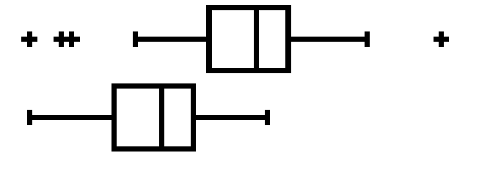
Compare the Samples
per2
True mean = 4.29
Judgment Sample
Simple Random Sample

Slide 31
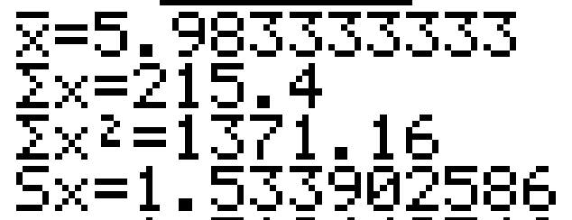
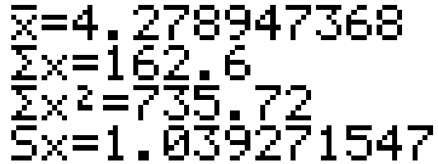
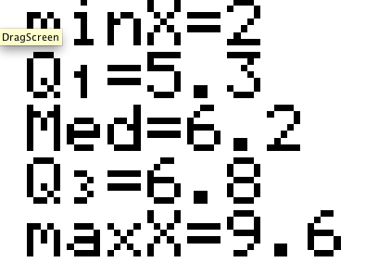
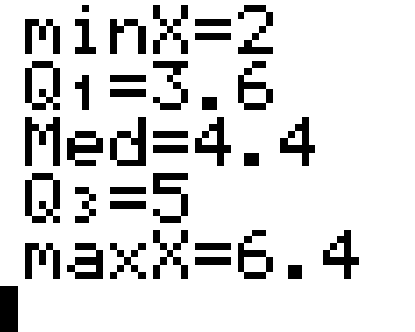
Compare the Samples
per2
Judgment Sample
Simple Random Sample
True mean = 4.29

Slide 32
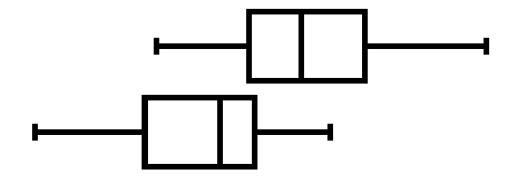
Compare the Samples
per3
True mean = 4.29
Judgment Sample
Simple Random Sample

Slide 33
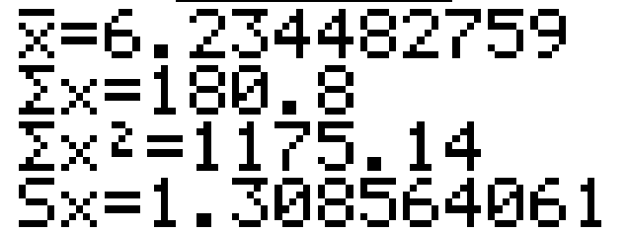
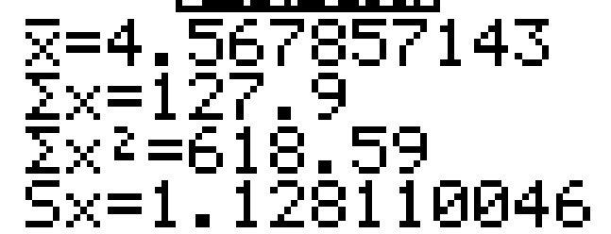
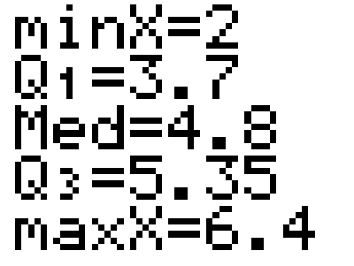
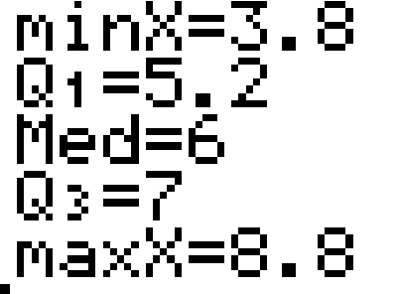
Compare the Samples
per3
Judgment Sample
Simple Random Sample
True mean = 4.29

Slide 34
Compare the Samples
per4
True mean = 4.29
Judgment Sample
Simple Random Sample

Slide 35
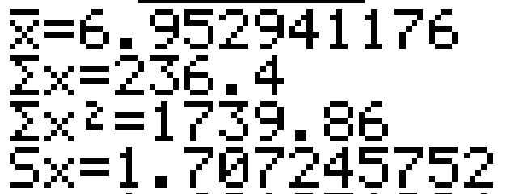
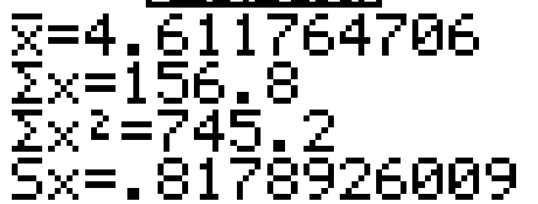
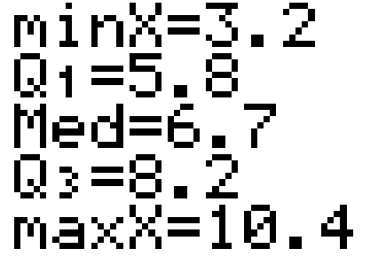
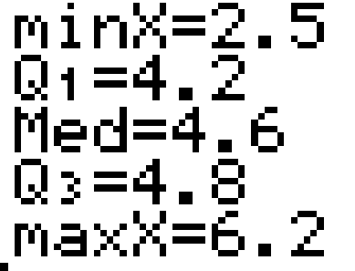
Compare the Samples
per4
Judgment Sample
Simple Random Sample
True mean = 4.29

Slide 36
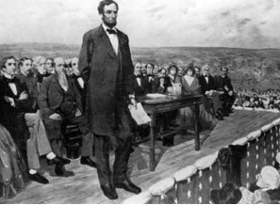
4.29
The true mean length of the words in the Gettysburg Address is.…………….

Slide 37
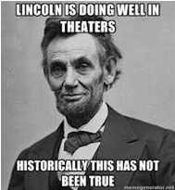

Slide 38
Evaluating Bias in Surveys
Thanks to Mr. Snider

Slide 39
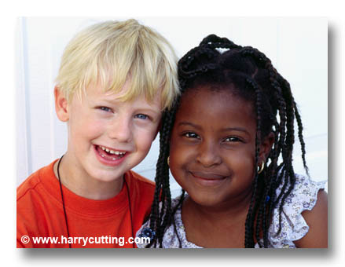
One year after the Detroit race riots of 1967, interviewers asked a sample of black residents in Detroit if they felt they could trust most white people, some white people, or none at all. When the interviewer was white, 35% answered “most”; when the interviewer was black, 7% answered “most”.

Slide 40
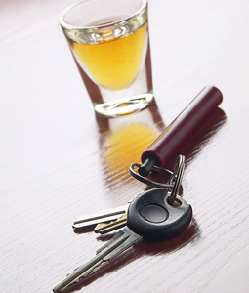
A Gallup poll found that 81% of U.S. parents say they have spoken with their teenagers about the dangers of drinking and driving. Only 64% of the teens remember such a discussion.

Slide 41
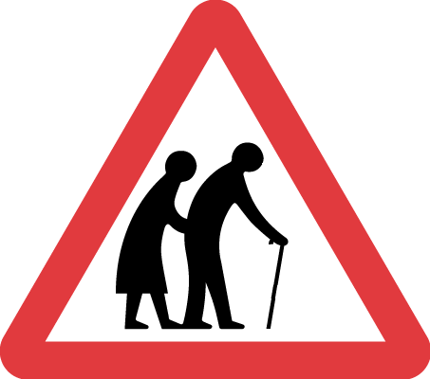
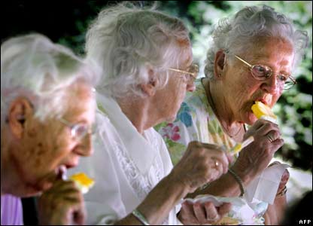
The U.S. census of 1980 states that the 32,194 Americans are 100 years old or older. However, Social Security figures show only 15,258 adults of this advanced age (Los Angeles Times, December 16, 1982).

Slide 42
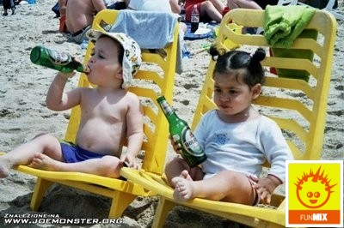
In a 1983 survey of fourth graders (nine-year-olds), Weekly Reader found that 30% felt peer pressure from other children to drink alcoholic beverages (Cincinnati Enquirer, April 22, 1982). The newspaper article did not publish the wording of the question. (Hint: Try to write a question that you are sure nine-year-olds will understand that asks if they feel peer pressure to drink.)

Slide 43
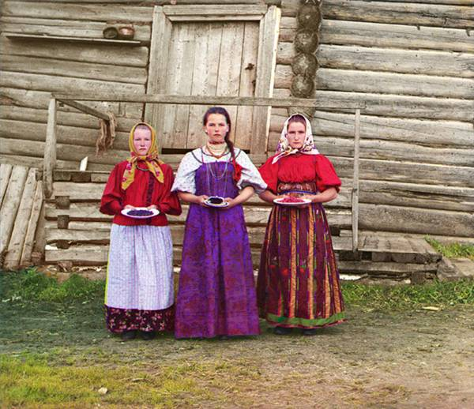
In a census in Russia, 1.4 million more women than men reported that they were married (U.S. News & World Report, August 30, 2006).

Slide 44
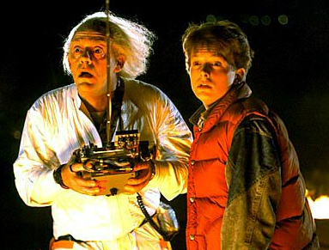
Experimental Design
3 major components of experimental design.
Control
Randomization
Replication

Slide 45
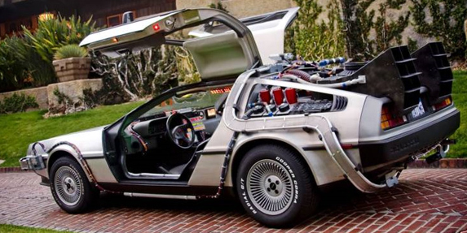
Control
What are we trying to control?
Lurking variables.
Example: To test which tires work or wear best on a car, what things to we have to control?
Tire pressure, weight of car, speed of car, road conditions…the list is endless.

Slide 46
Control--continued
Example 2: New medicine to help with headaches. They want to compare it with the old.
Lurking variables?
Gender, body size, age of participant to name a few.
Methods of control
Direct control---in car example have the exact same car for each type of tire and drive the same speed, with the same road, etc. Tough to do!

Slide 47
Control--continued
500 subjects
Methods of control.
Blocking: You block to control a known lurking variable.
Example: Headache medicine—gender could be a factor. We will separate men and women into 2 blocks
Then half are given new medicine and half are given the old medicine to compare results.
Men
Women
Randomly
assign half
To new medicine
Randomly
Assign half to old
medicine
Randomly
Half to new
medicine
Randomly
Half to old
medicine

Slide 48
Control--continued
Same problem but medicine is for prostate cancer.
Direct control is used in that only men 50-60 are studied.
Blocking is used for more control because they believe that these medicines work differently with various races.
Let’s say there are three medicines being tested (A,B,C) they are randomly assigned after the blocks.
NOTE: BLOCKS ARE NOT RANDOM> YOU CONTROL.

Slide 49
Men age
50-60
in study
Caucasians
Blacks
Asians
Hispanics
A
B
C
A
B
C
A
B
C
A
B
C

Slide 50
Control—Blocks—matched pair
Blocks that are size two are called “matched pair.”
Twins are the best example of a matched pair.
If two people have the same blood pressure.
Sometimes the matched pair is the same person.

Slide 51
Three major designs
1 Group split into two or more groups for your experiment.
Blocks
Matched pair—a form of a block.
The reality is Blocking is used almost every time. Either you have 1 big block, blocks of your choosing, or blocks of size 2 called matched pairs.

Slide 52
Randomization
Concept is treatment groups are randomly assigned.
Randomization, or the theory behind it, is to eliminate bias.
There are many, unlimited ways to randomize.

Slide 53
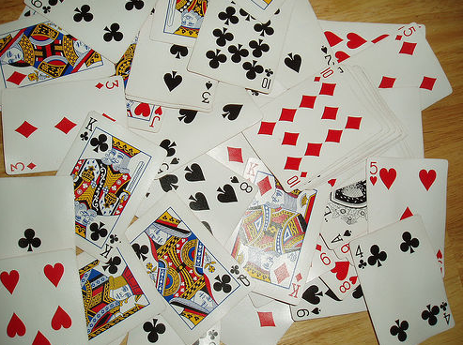
Other ways to randomize
Dice
Names in a hat
Random numbers.
Count 1-3 and put in groups.
Flip coin.

Slide 54
Replication
There are two meanings of replication.
The First is that there are an adequate number of samples in your study.
The next is that similar studies looking for the same relationship done by different parties yield the same result consistently.

Slide 55
Notes
Double blind
The subjects AND the evaluators both do not know the treatments given.
WHY?
Who must know the treatments?
Beware of observational studies that are passed on as experiments—see notes.

Slide 56
Design an Experiment
As a group think of an experiment that could be done at Rancho.
Who would you include in your sample?
How would you get your sample?
Would you use a completely randomized design, matched pairs, or a block design?
Would it need to be a blind experiment? Double Blind?
How many treatments would it have?

Slide 57
BLOCKING
Completely Randomized
Block Design
Matched Pairs

Slide 58
Mr. Pines Surf Wax
Mr. Pines has a brand new surf wax he needs to test out. In order to determine whether his brand of surf wax is worth mass producing he needs to do an experiment comparing it to the current on the market surf wax. In his experiment he has enough money to use 50 subjects. Help Mr. Pines set-up an experiment using a completely randomized design, a block design, and a matched pairs design. He may just choose one of these designs and become a millionaire!

Slide 59
Completely Randomized Design
25 subjects Current Wax
RANDOMIZE
Compare Results
50 subjects
25 subjects Mr. Pines Wax
Place the 50 subjects names in a hat and draw 25 names randomly and place these in the current wax group, the remaining names in the hat will be in Mr. Pines Wax group

Slide 60
Block Design
Some may say the there may be a difference between the effect of wax on short boards and on longboards. This should be accounted for in a block design.
Current Wax
25 Short Board
RANDOMIZE
Mr. Pines Wax
50 subjects
Compare Results
Current Wax
25 Longboard
RANDOMIZE
Mr. Pines Wax
Each board group will randomly take the first 13 peoples names drawn out of a hat and will be placed in the current wax group, the remaining 12 will be in Mr. Pines wax group.

Slide 61
Matched Pair Design
In a matched pairs you can have each subject try both types of wax and compare the results. This can be done if you think that the persons ability or skill may be confounded with the quality of the wax.
Each of the 50 subjects will be their own block. Each subject will use both types of wax for the same amount of time and then compare the results on which performed better. The order for whether they use the current wax or Mr. Pines wax first needs to be randomly selected(a coin flip works well for this). Example..If heads comes up then use the current wax first and then use Mr. Pines wax.

Slide 62
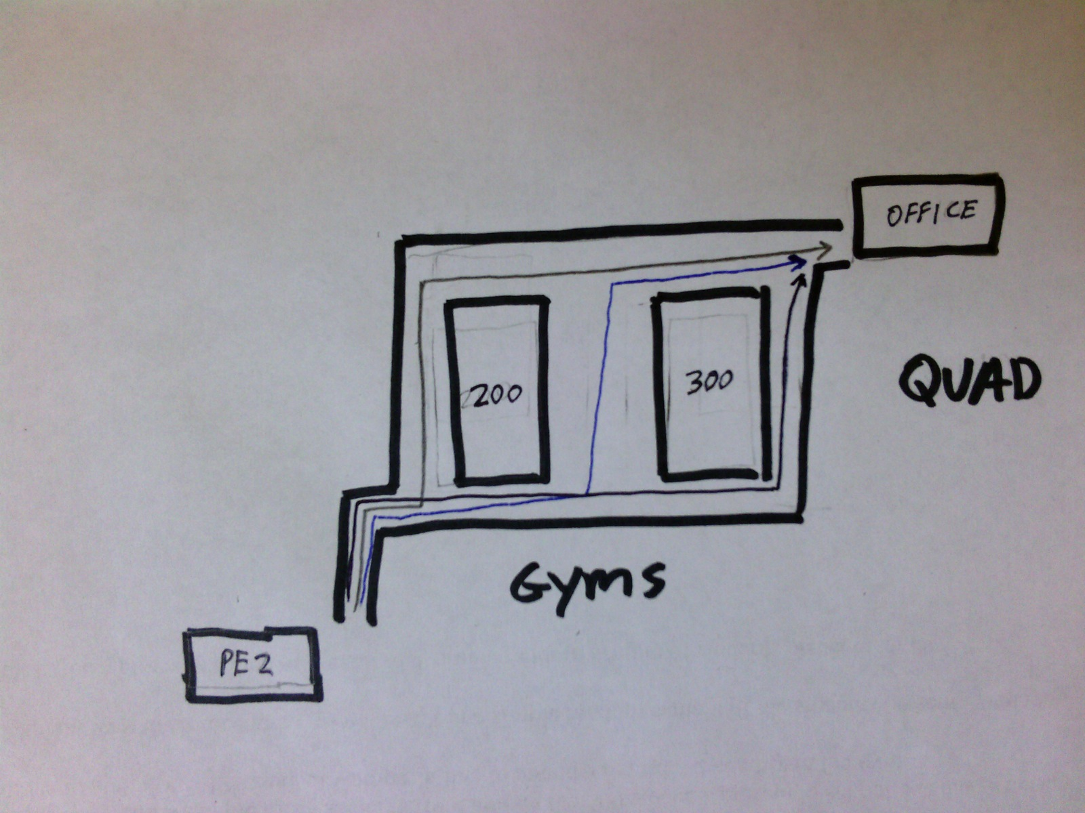
Path to the Office
Mr. Pines takes 3 different paths to get to the office at the end of lunchtime. He often wonders, “which path is the fastest?” He decides he will run an experiment using 120 student volunteers. Can you help him create a well designed experiment? Please☺
He wants you to consider a few different designs.
Do a completely randomized design.
Do a block design?
Could a matched pairs design be done? Explain?
1
2
3

Slide 63
a) Completely Randomized
All 120 students are randomly placed into one of the three treatment groups. Students names will be written on a small sheet of paper and placed in a box. The first 40 names randomly pulled out will be taking path 1, the next 40 students will take path 2, and the remaining 40 students will take path 3. Students will be asked to keep track of their time and walk as they normally would making sure to record their time once they arrive at the office. The average time for the 3 path groups will be calculated and conclusions will be made.

Slide 64
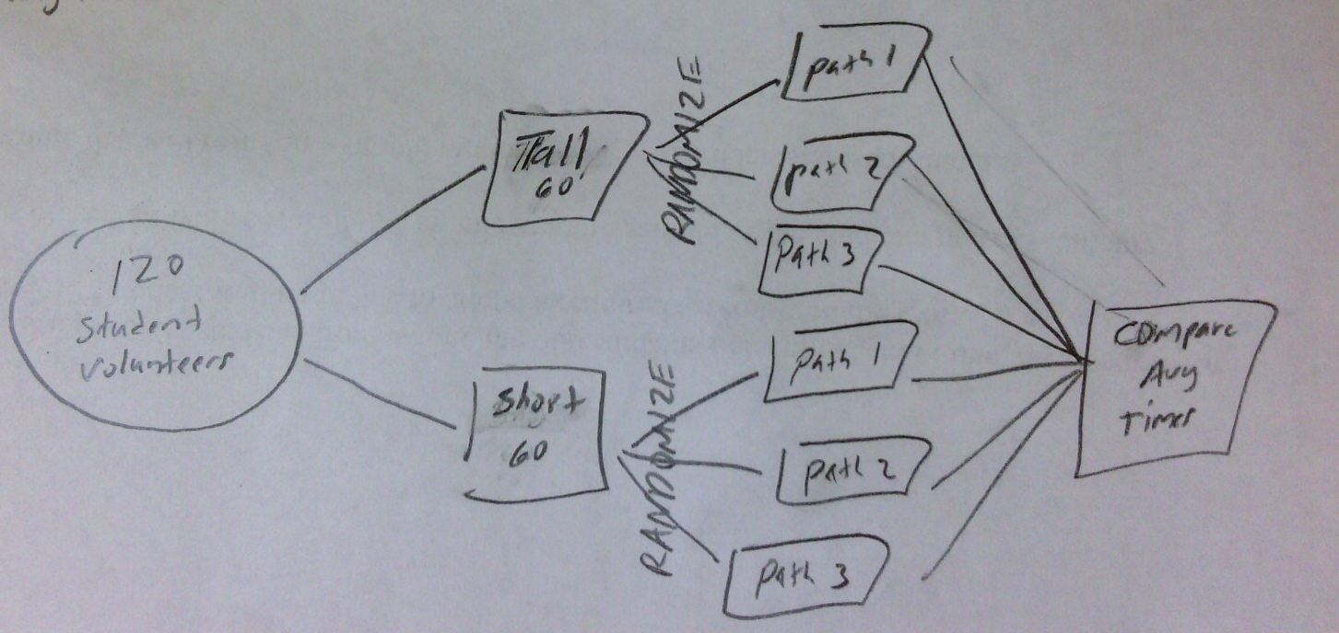
b) Block Design
This design will “block” on the height of students because taller students may take bigger steps and get to the office quicker than shorter students. The 60 tallest students will be placed in a “Tall” group. The 60 shorter students will be placed in a “Short” group.
The 60 students in each group will then have their names placed in a hat, the first 20 students selected will take path 1, the next 20 students will take path 2, and the last 20 students will take path 3.
Students will be asked to keep track of their time and walk as they normally would making sure to record their time once they arrive at the office. The average time for the 6 different groups will be calculated and conclusions will be made.

Slide 65
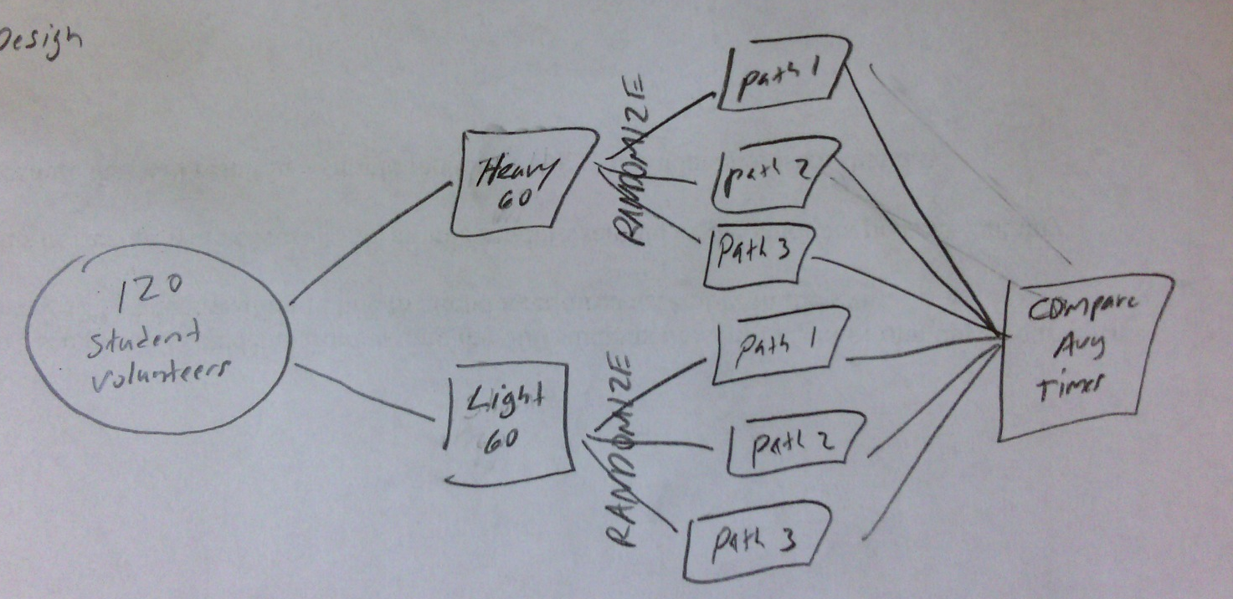
Other ways to block this?
Block on weight

Slide 66
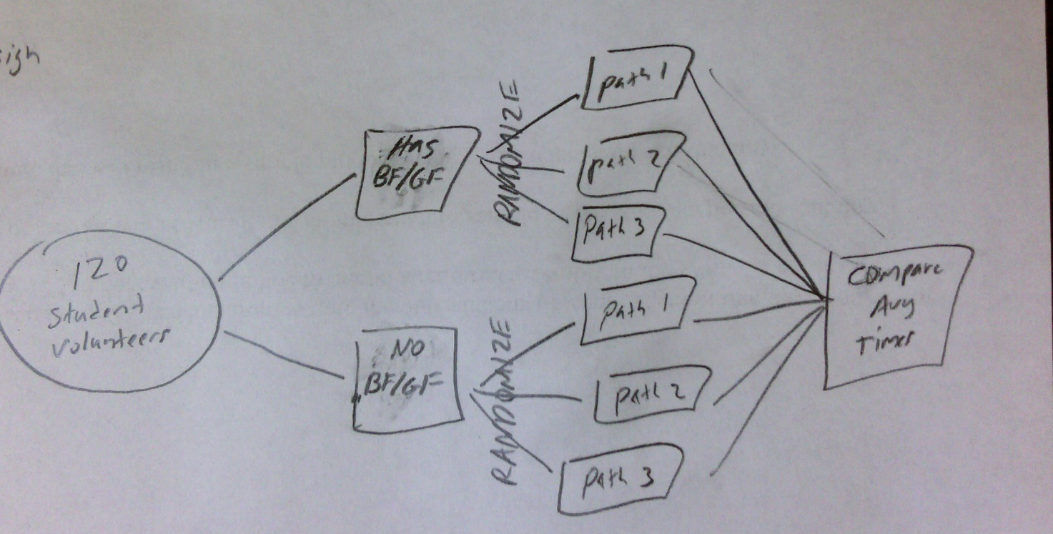
Other ways to block this?
Block on things that slow them down.

Slide 67
c) Matched Pairs?
Matched pairs is usually done with 2 treatments, but it could be done in this situation.
All volunteers would take a different path on 3 different days. The order that they take the paths would be randomly chosen. Three times would be recorded and evaluated at the end.
This method would remove the need for blocking on gender,height, weight, etc. Each volunteers walking style would not interfere with avg times.
Difficulties in this situation might be the experiment might take three times and different days may include lurking variables.

Slide 68
A manufacturer of boots plans to conduct an experiment to compare a new method of waterproofing to the current method. The company recruits 100 volunteers from Seattle, where it rains frequently, to wear the boots as they normally would for 6 months. At the end of 6 months, the boots will be returned to the company to be evaluated for water damage.
(a) Describe a design for this experiment that uses the 100 volunteers. (b) Could your design be double blind? Explain.
2002 #2

Slide 69
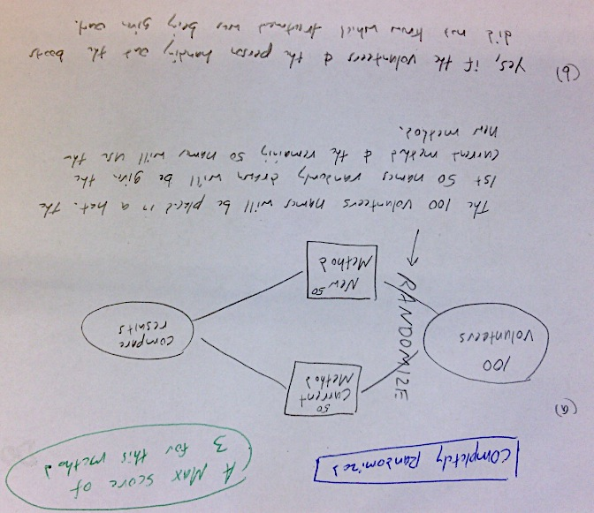

Slide 70
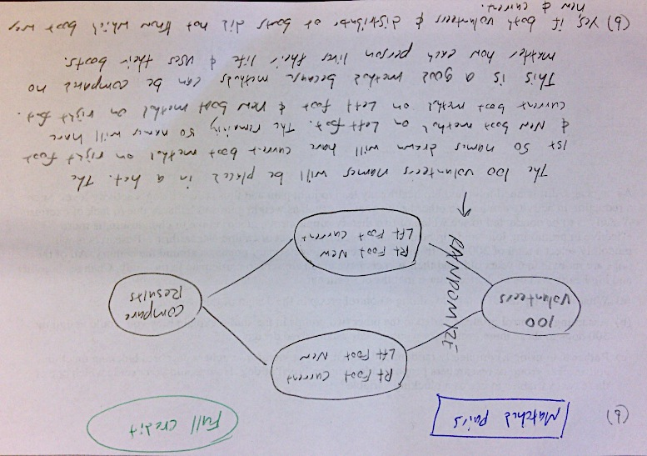

Slide 71
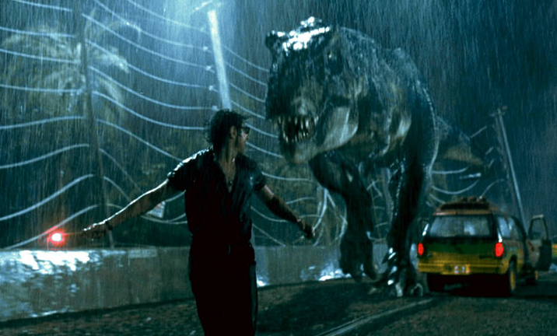
Experimental Units, Subjects, Treatments

Slide 72
Vocabulary of experiments
The objects that on which the experiment is done are the experimental units.
When the units are human beings, they are called subjects.
A specific condition applied to the units is called a treatment.
The explanatory variables in an experiment are often called factors.
Treatments are formed by combining a specific value called a level of each of the factors.

Slide 73
How do commercials effect our view on a certain product? The answer may depend on the length of the commercial and how many times it is repeated. An experimenter used high school students for this experiment. All students watched a 45 minute TV show that included commercials for a new type of cell phone. Some subjects saw a 30-second commercial, and others saw a 90-second version. The same commercial was shown either 1,3,or 5 times during the TV show.
What are the experimental units, factors, levels, and # of treatments?
Experimental Units: the students are subjects
Factors: Length of commercial & # of repetitions
Levels: 2 levels for length(30 or 90) and 3 levels for repetitions(1,3,5)
Treatments: 6 treatments

Slide 74
Subjects
30-second commercial
1 time
5 times
90-second commercial
1 time
3 times
3 times
5 times

Slide 75
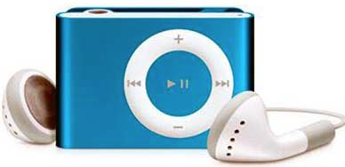
CD vs Digital
Which sounds better?

Slide 76
vs
Mr. Pines always wonders if he should listen to his favorite songs on CD or on his iPod. He decides to run a small experiment to decide which sounds better.
The plan is to listen to a song on CD in his car and give it a rating from 1 to 5(5 being the best sound) He will also listen to the same song in mp3 format on his ipod shuffle and give it the same type of rating.
Comment on the design of his experiment.

Slide 77
vs
Mr. Pines always wonders if he should listen to his favorite songs on CD or on his iPod. He decides to run a small experiment to decide which sounds better.
The plan is to listen to a song on CD in his car and give it a rating from 1 to 5(5 being the best sound) He will also listen to the same song in mp3 format on his ipod shuffle and give it the same type of rating.
The problem with this design is that the Mr. Pines will not know whether the sound quality is due to the song being played from CD/iPod or if it has to do with the quality of his sound system in his car and quality of his Ipod headphones.

Slide 78
vs
Mr. Pines always wonders if he should listen to his favorite songs on CD or on his iPod. He decides to run a small experiment to decide which sounds better.
The plan is to listen to a song on CD in his car and give it a rating from 1 to 5(5 being the best sound) He will also listen to the same song in mp3 format on his ipod shuffle and give it the same type of rating.
This is a common type question, when you cannot determine what is causing the effect it is called CONFOUNDING
In this case the music format is confounded with the speaker system

Slide 79
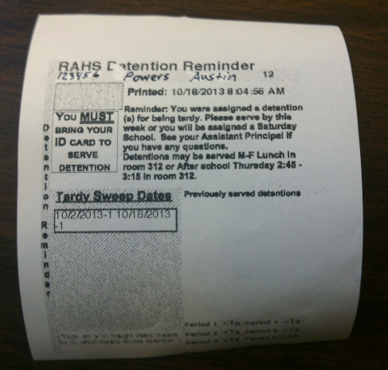
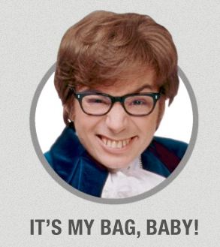
Too Many Tardies

Slide 80
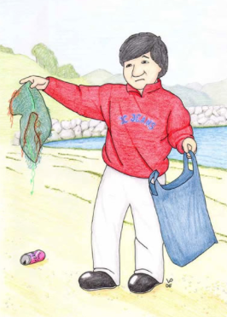
Too Many Tardies
VS.
With the number of tardies becoming a problem at Rancho, the administrators are trying to come up with a tardy policy that works. One idea is to have students who are tardy pick up trash after lunch on the same day that they were tardy.

Slide 81
Too Many Tardies
VS.
An experiment is proposed where students caught being tardy during periods 1,3,5 will get the current “ticket/detention” system.
…students tardy during periods 2,4,6 will have to pick up trash.
After 2 weeks the current system records 265 tardies and the new method records only 31 tardies.
Should Rancho Administrators adopt the new tardy system?

Slide 82
Too Many Tardies
VS.
They should NOT adopt the new method, or at least not yet.
The problem is that periods 1,3,5 are periods where students are frequently tardy. Periods 2,4,6 students are more often on time.
In this situation, the period is CONFOUNDED with method.

Slide 83
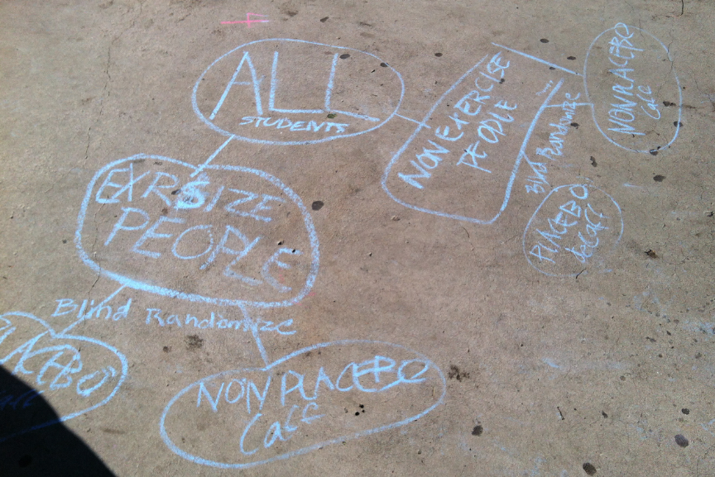
Does Caffeine Increase Your Pulse?

Slide 84
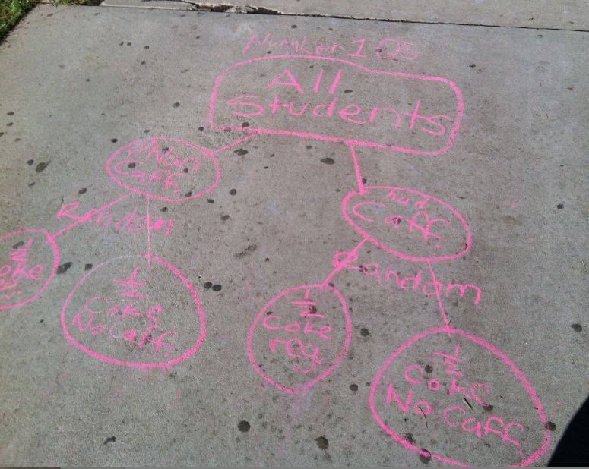
Does Caffeine Increase Your Pulse?

Slide 85
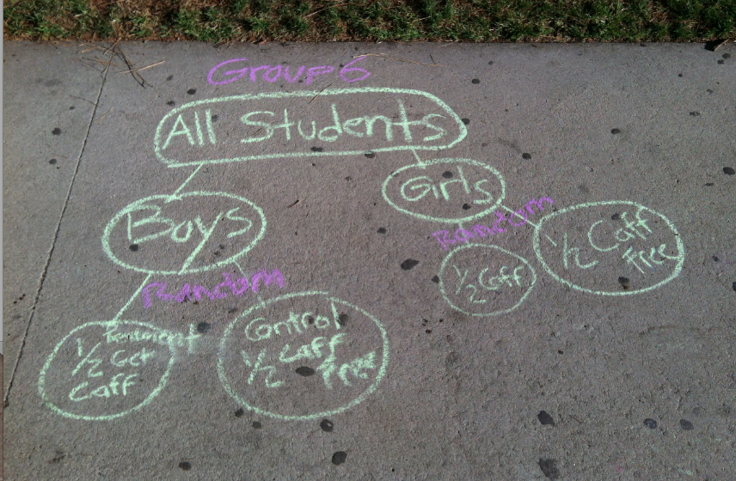
Does Caffeine Increase Your Pulse?

Slide 86
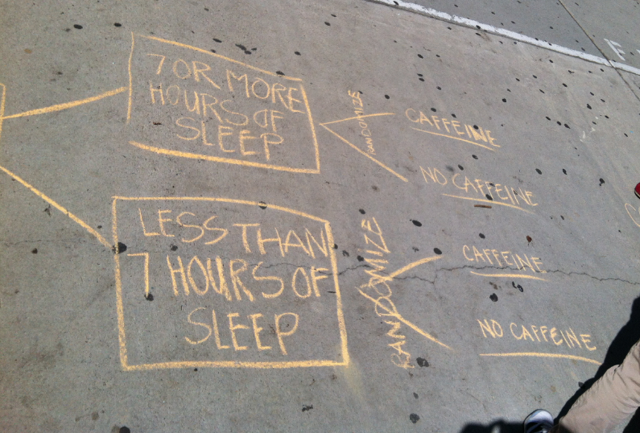
Does Caffeine Increase Your Pulse?

Slide 87
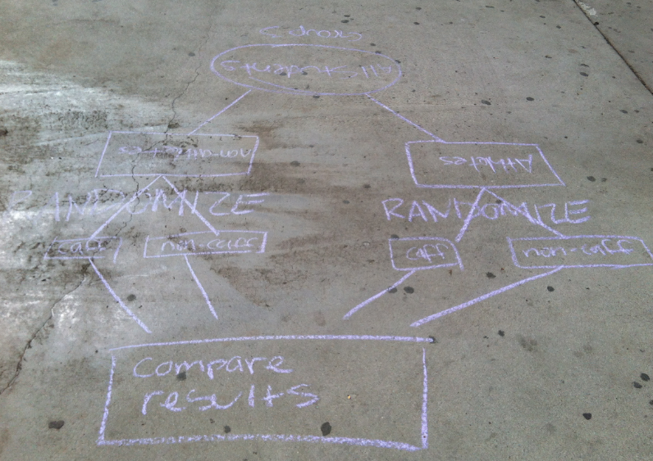
Does Caffeine Increase Your Pulse?

Slide 88
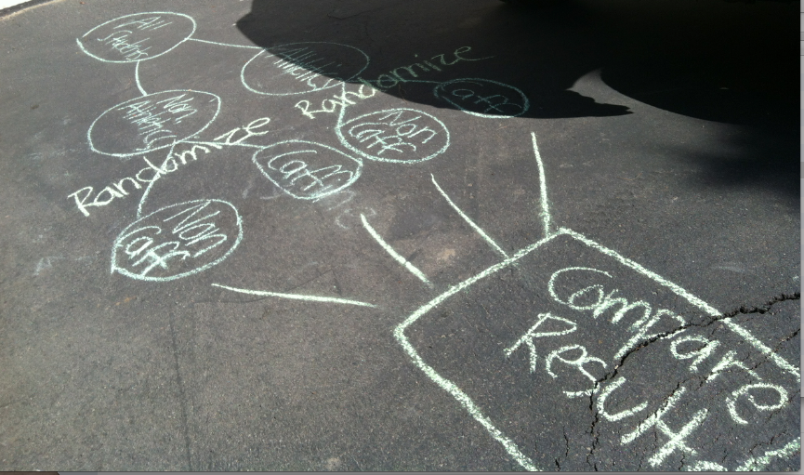
Does Caffeine Increase Your Pulse?

Slide 89
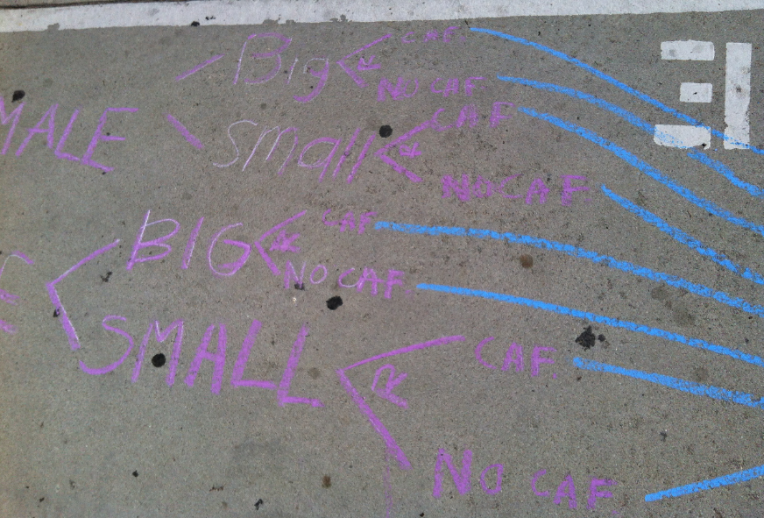
Does Caffeine Increase Your Pulse?

Slide 90
Does Caffeine Increase Your Pulse?
RANDOMIZE
RANDOMIZE

Slide 91
Does Caffeine Increase Your Pulse?

