Slide 1
Chapter 5
Simulation
Conditional Probability
Venn Diagrams
Tree Diagrams

Slide 2
NASCAR Cards and Cereal Boxes
In an attempt to increase sales, a breakfast cereal company decides to offer a NASCAR promotion. Each box of cereal will contain a collectible card featuring one of these NASCAR drivers: Jeff Gordon, Dale Earnhardt Jr, Tony Stewart, Danica Patrick, or Jimmy Johnson. The company says that each of the 5 cards is equally likely to appear in any box of cereal. A NASCAR fan decides to keep buying boxes of cereal until she has all 5 driver’s cards. She is surprised when it takes her 23 boxes to get the full set of cards. Should she be surprised? Design and carry out a simulation to help answer this question.
Explain how you can carry out a simulation to help answer this question.
Run the simulation 7 times.

Slide 3
You must clearly explain your method.
Remember D.A.R.E.
D: Determine the number of digits to be taken at a time
A: Assign your digits.
R: Repeats? Do you allow them or ignore them?
E: Ending rule, when do you stop taking digits?
Explain how you can carry out a simulation to help answer this question.
Run the simulation 7 times.

Slide 4
D: Determine the number of digits to be taken at a time
A: Assign your digits.
R: Repeats? Do you allow them or ignore them?
E: Ending rule, when do you stop taking digits?
The 5 drivers cards are claimed to be equally likely to appear.
The drivers: Jeff Gordon, Dale Earnhardt Jr, Tony Stewart, Danica Patrick, Jimmy Johnson
Go through the D.A.R.E. process using digits 0-9 on your random digit table.
Explain how you can carry out a simulation to help answer this question.
Run the simulation 7 times.

Slide 5
D: Determine the number of digits to be taken at a time
A: Assign your digits.
R: Repeats? Do you allow them or ignore them?
E: Ending rule, when do you stop taking digits?
EXPLAINING YOUR PROCESS(MOST IMPORTANT PART…POINTS!)
We will take 1 digit at a time from the digits 0 – 9 starting at line____ on my random digit table. Digits will be assigned to the drivers in the following way: (0,1, Jeff Gordon) (2,3, Dale Earnhardt Jr) (4,5, Tony Stewart) (6,7, Danica Patrick) (8,9, Jimmy Johnson). Repeat digits will be used and accepted. Stop taking digits once each driver has been selected. Most importantly count the number of digits it took till you had each driver appear, this will simulate the number of cereal boxes it takes till each drivers cards are found.

Slide 6
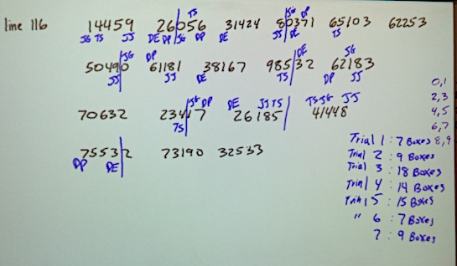
The most we came up with was 18 boxes, it is surprising that it took her 23 boxes.

Slide 7
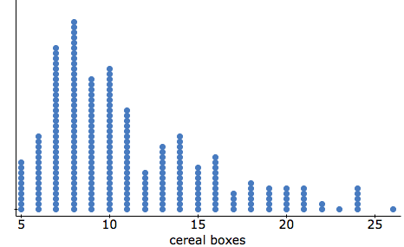
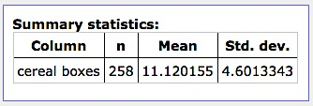
This is 258 trials with only 7 of them having taken 23 boxes or more. A probability of about 3% of the time. Low enough to reject at the 5% level. This shows that it is surprising to take 23 boxes or that maybe the company was incorrect in their claim.

Slide 8
NASCAR Cards and Cereal Boxes
In an attempt to increase sales, a breakfast cereal company decides to offer a NASCAR promotion. Each box of cereal will contain a collectible card featuring one of these NASCAR drivers: Jeff Gordon, Dale Earnhardt Jr, Tony Stewart, Danica Patrick, or Jimmy Johnson. The company says that each of the 5 cards is equally likely to appear in any box of cereal. A NASCAR fan decides to keep buying boxes of cereal until she has all 5 driver’s cards. She is surprised when it takes her 23 boxes to get the full set of cards. Should she be surprised? Design and carry out a simulation to help answer this question.
Explain how you could run this simulation using a deck of cards.
Explain how you could run this simulation using a standard six-sided die.

Slide 9
Simulation with Cards
You have 5 drivers and 52 cards. Choose 2 cards to not use at all.
Assign Cards:
Ace through 10 of spades = Jeff Gordon
Ace through 10 of clubs = Dale Earnhardt Jr
Ace through 10 of hearts = Danica Patrick
Ace through 10 of diamonds = Tony Stewart
All face cards = Jimmy Johnson
Remove Jack of spades and Jack of clubs.
Shuffle cards well and flip cards over until 5 different drivers are selected. Keep track of the number of cards dealt, these equal a box of cereal.

Slide 10
Simulation with a 6-sided die
You have 5 drivers and 6 sides of a die.
Assign Cards:
Rolling a 1 = Jeff Gordon
Rolling a 2 = Dale Earnhardt Jr
Rolling a 3 = Danica Patrick
Rolling a 4 = Tony Stewart
Rolling a 5 = Jimmy Johnson
If a 6 is rolled we will ignore it and NOT count as a cereal box..
We will keep rolling until each driver is selected and we will count each roll except for 6’s as cereal boxes purchased.

Slide 11
Twitter at Rancho
According to a recent survey on campus, 73% of Rancho students claim that they use twitter regularly.
How likely would it be to find 4 or more students that DO NOT use twitter in a random sample of 10 students?
Describe how you would use a random digit table to simulate this.
Run your simulation 8 times.
99154 70392 79230 91058 92210 70439 08629 73299 01696 30913
12835 60006 78314 96569 67532 68144 28944 26687 49634 88274
42036 16052 09827 21725 89404 63870 33212 74379 71355 32281
86004 14817 46965 63606 87422 63593 92501 80995 98607 16439

Slide 12
Twitter at Rancho
According to a recent survey on campus, 63% of Rancho students claim that they use twitter regularly.
How likely would it be to find 4 or more students that DO NOT use twitter in a random sample of 10 students?
Describe how you would use a random digit table to simulate this.
Run your simulation 8 times.
99154 70392 79230 91058 92210 70439 08629 73299 01696 30913
12835 60006 78314 96569 67532 68144 28944 26687 49634 88274
42036 16052 09827 21725 89404 63870 33212 74379 71355 32281
86004 14817 46965 63606 87422 63593 92501 80995 98607 16439

Slide 13
Twitter at Rancho
According to a recent survey on campus, 67% of Rancho students claim that they use twitter regularly.
How likely would it be to find 4 or more students that DO NOT use twitter in a random sample of 10 students?
Describe how you would use a random digit table to simulate this.
Run your simulation 8 times.
99154 70392 79230 91058 92210 70439 08629 73299 01696 30913
12835 60006 78314 96569 67532 68144 28944 26687 49634 88274
42036 16052 09827 21725 89404 63870 33212 74379 71355 32281
86004 14817 46965 63606 87422 63593 92501 80995 98607 16439

Slide 14
Conditional Probability Formulas

Slide 15
Conditional Probability Formulas

Slide 16
Independent Events
If 2 events A and B have no effect on each other then they are independent.
If A and B are independent then:

Slide 17
Mutually Exclusive
Mutually Exclusive events mean that A and B cannot both happen.
Events cannot be Independent and Mutually Exclusive

Slide 18
MySpace Vs Facebook
A recent survey suggests that 85% of college students have posted a profile on Facebook, 54% use MySpace regularly, and 42% do both. Suppose we select a college student at random.
(a) Construct a Venn Diagram to represent this setting.
(b) There are 20 million college students, make a two-way table for this chance process.
(c) Consider the event that a randomly selected college student has posted a profile on at least one of these two sites. Write this event in symbolic form using the two events of interest that you chose in (a).
(d) Find the probability of the event described in (c). Explain your method.

Slide 19
Instagram Vs Twitter
A recent survey suggests that 92% of college students have a twitter account, 74% use Instagram regularly, and 68% do both. Suppose we select a college student at random.
(a) Construct a Venn Diagram to represent this setting.
(b) There are 24 million college students, make a two-way table for this chance process.
(c) Consider the event that a randomly selected college student has posted a profile on at least one of these two sites. Write this event in symbolic form using the two events of interest that you chose in (a).
(d) Find the probability of the event described in (c). Explain your method.

Slide 20
Live on Campus & Have a Car
A recent survey suggests that 61% of college students at a certain college live on campus, 38% have a car, and 22% do both. Suppose we select a college student at random.
(a) Construct a Venn Diagram to represent this setting.
(b) There are 24 thousand college students at this school, make a two-way table for this chance process.
(c) Consider the event that a randomly selected college student lives on campus or has a car or both. Write this event in symbolic form using the two events of interest that you chose in (a).
(d) Find the probability of the event described in (c). Explain your method.
(e) Are living on campus and having a car independent? Mutually exclusive?
(f) What is the probability that someone lives on campus given they have a car?
(g) What is the probability that someone has a car given they live on campus?

Slide 21
Venn Diagrams
Very Nice!
They are pretty cool if you think about it.

Slide 22
Mr. Pines and his father Mr. Pines go to the beach together many mornings during the year. If the waves are good they will go surfing. If the waves are bad they do not surf.

Slide 23
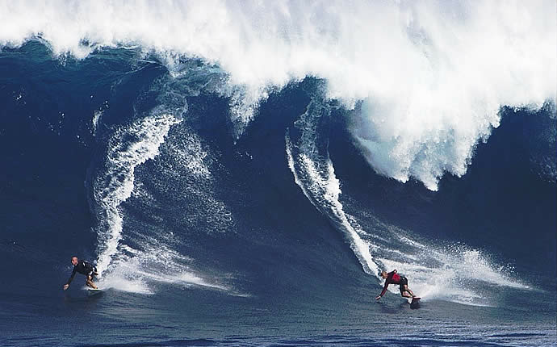
GOOD WAVES

Slide 24
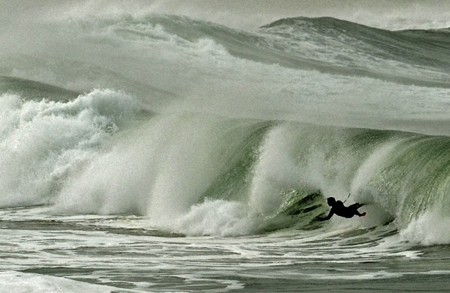
BAD WAVES

Slide 25
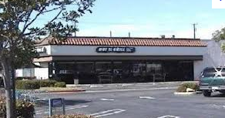
Sometimes they eat breakfast after they surf. Sometimes they surf and don’t eat. Sometimes they eat and don’t surf, and sometimes they just go home without surfing or eating.

Slide 26
It is estimated that they actually go surfing about 71% of the time that they go to the beach, eat breakfast 79% of the time that they go to the beach, and 63% of the time they do both. Suppose we select a randomly chosen trip to the beach:
(a) Construct a Venn Diagram to represent this setting.

Slide 27
SURF
BREAKFAST
SURFED
BREAKFAST
.63
.08
.16
SURF ONLY
BOTH
BREAKFAST ONLY
.13
NEITHER

Slide 28
The two of them have gone to the beach about 1,040 times in the past 8 years. Make a two-way table for this setting.
BREAKFAST
BOTH
YES
NO
SURF ONLY
SURFED
YES
NO
1,040
BREAKFAST ONLY
NEITHER

Slide 29
You need to take the percentage for each square times the total
BREAKFAST
BOTH
YES
NO
SURF ONLY
(.63)(1040) = 655.2
(.08)(1040) = 83.2
738.4
SURFED
YES
(.16)(1040) =166.4
(.13)(1040) = 135.2
301.6
NO
1,040
822.23
218.4
BREAKFAST ONLY
NEITHER

Slide 30
What is the probability that Mr. Pines and his father either surf or eat breakfast on a randomly chosen trip to the beach?
Since this is an “or” type problem use the formula below.
Let P(A) = surfing and P(B) = eat breakfast, refer back to the venn diagram for the probabilities

Slide 31
If they surfed, what is the probability that they ate breakfast too?
Rephrase this as:
What is the probability that they ate breakfast GIVEN they surfed.

Slide 32
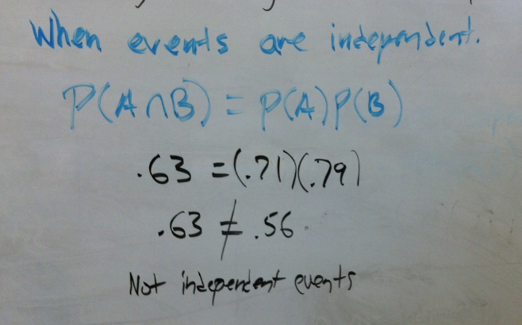
Are surfing and eating breakfast independent?

Slide 33
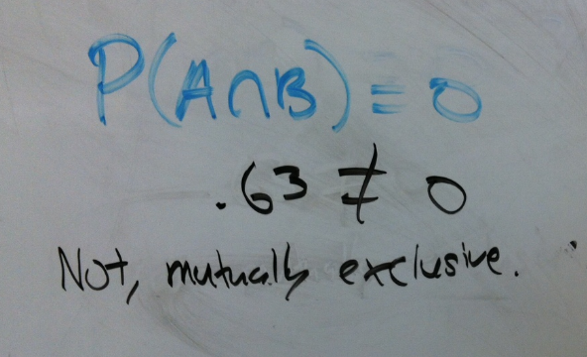
Are surfing and eating breakfast mutually exclusive?

Slide 34
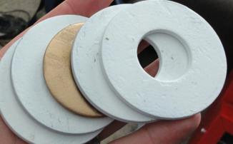
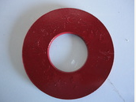
Mr. Pines Washers

Slide 35
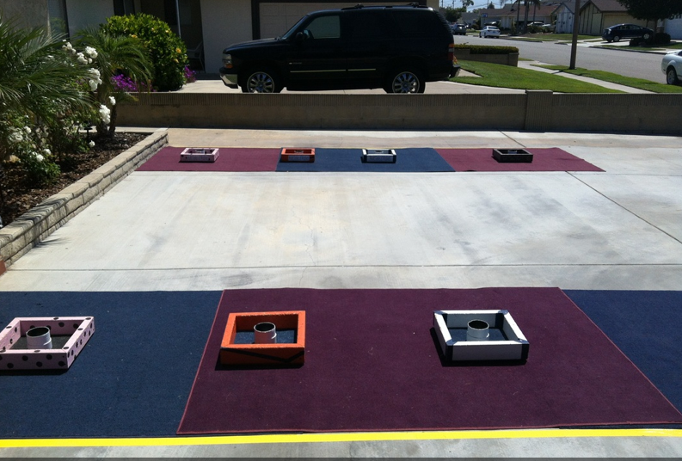
Mr. Pines needs many 1” steel washers for his World Series of Washers tournaments. In the past few years he has bought hundreds of washers from various hardware stores that sell them

Slide 36
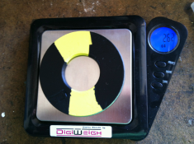
All washers that Mr. Pines buy are weighed. If they are too heavy or too light he classifies them as defective and does not use them in his tournaments. He estimates that 1 out of 200 washers are defective.
However the scale is only 99.3% accurate in determining if washers are defective or ok to use.

Slide 37
You need to draw a tree diagram.
Washers ok
Classified ok
Classified defective
Washers defective
Classified defective
All Washers
Classified ok
.995
.993
.007
.993
.005
.007

Slide 38
Mr. Pines Washers
1. What is the probability that a randomly selected washer is classified as defective by Mr. Pines.
Washers ok
Classified ok
Classified defective
Washers defective
Classified defective
All Washers
Classified ok
.993
.995
.007
.993
.005
.007
There are two branches that lead to a defective washer
(.995)(.007) + (.005)(.993) = .01193

Slide 39
Mr. Pines Washers
2. If a randomly selected washer is classified as defective, what is the probability that the washer is actually defective?
Washers ok
Classified ok
Classified defective
Washers defective
Classified defective
All Washers
Classified ok
.993
.995
.007
.005
.993
.007
This time we want only the actually defective branch on the numerator and all the ways to get a defective on the denominator

Slide 40
THE HIV PROBLEM
It has been estimated that in the United States, 1 out of 250 people are infected with HIV.
Currently the test for determining if someone is infected with HIV is 99.5% accurate.
What is the probability that a randomly selected person tests positive for HIV?
If a randomly selected person tests positive for HIV what is the probability that they are really infected?

Slide 41
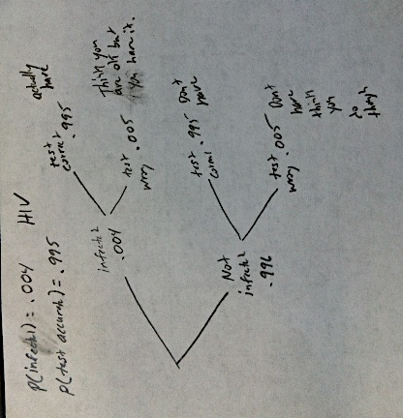

Slide 42
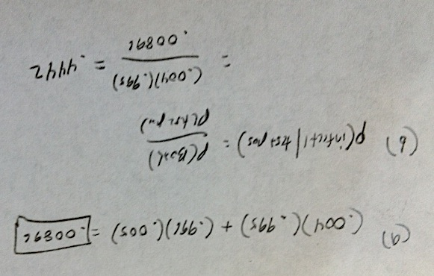

Slide 43
Tree Diagram
prob cards #39,9,34

Slide 44
Guessing on a Test
Over time, a student analyzes her ability to guess correctly after narrowing down multiple choice answers in a 5-selection question. She discovers that if she narrows her answer set to 2 or 3 choices, her probability of getting the right answer is 0.8, but is she still has 4 or 5 choices left, her probability of choosing correctly decreases drastically to 0.1.
Assuming that in general she can narrow her choices to 2 or 3 choices 70% of the time.
For the following questions assume the girl always guesses.
What is the probability that she will answer the question correctly?
What is the probability that she narrowed her choice to 2 to 3 choices given she got the question wrong?

Slide 45
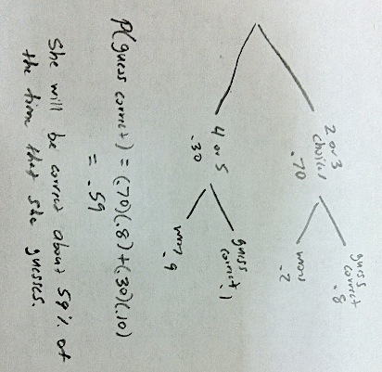
Guessing on a Test

Slide 46
Guessing on a Test

Slide 47
A basketball player at Rancho has probability 0.80 of making a free throw. Explain how you would use each of the following to simulate one free throw by this player.
Assign digits 1,2,3,4 to be a free throw made and digit 5 to be a missed free throw, ignore a 6. Roll the die one time.

Slide 48
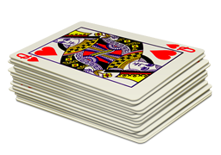
A basketball player at Rancho has probability 0.80 of making a free throw. Explain how you would use each of the following to simulate one free throw by this player.
There are many ways to do this. Pick a method that uses most the cards and is quick and easy to do. Assign all cards A-8 as a free throw made and 9,10 as free throws missed. Remove all face cards. Shuffle the deck and draw one card randomly.

Slide 49
A basketball player at Rancho has probability 0.80 of making a free throw. Explain how you would use each of the following to simulate one free throw by this player.
Random Digit Table
Assign digits 1-8 as free throws made and digits 9,0 as a free throw missed.

