Slide 1
Super mega baseball
Linear Regression HR vs Ego

Slide 2
This is a baseball game for PS4, XBOX1, and Steam..(whatever that is). One night I was bored and browsing the Playstation Store and came across this cartoon looking game that was only like $15. The video demo looked decent and I had some money left over from a gift card so I bought it.

Slide 3
Long story short…..I’ve been playing it for about 6 months and haven’t played any other game since. BEST GAME EVER…..definitely my BIASED point of view.
Linear Regression HR vs Ego

Slide 4
Super mega baseball
The interesting thing about this game that makes it different from other games is the difficulty setting(called EGO LEVEL) can be set from 0(super easy) up to 99(they say impossible). Most games just have easy, medium, hard options.
Linear Regression HR vs Ego

Slide 5
Super mega baseball
So I am curious if there is a linear relationship between EGO LEVEL and the # OF HOMERUNS(I can hit per game)
Basically at a low EGO LEVEL I can hit lots of Homeruns, at a high EGO LEVEL I cannot hit very many Homeruns(sometimes I cannot even hit the ball)
The next few slides show some video clips of the difference in EGO LEVEL
Linear Regression HR vs Ego

Slide 6
At a low ego setting the ball is pitched slowly and it is easy to hit a HR.

Slide 7
The Ego level goes up, the ball is pitched faster, but a homerun can still be hit.
Ego 72

Slide 8
Sometimes at a high Ego level hitting the ball seems impossible.
Ego 90

Slide 9
At times it gets frustrating……

Slide 10
But even at the max Ego level of 99, it is possible to hit a HR.
Ego 99

Slide 11
Data Collection
A random sample of 13 games was taken recording the ego level and the number of homeruns hit in each game.
Ego HR
99 2
95 1
99 0
90 5
90 1
90 0
86 7
87 4
65 7
64 9
55 12
50 14
39 17

Slide 12
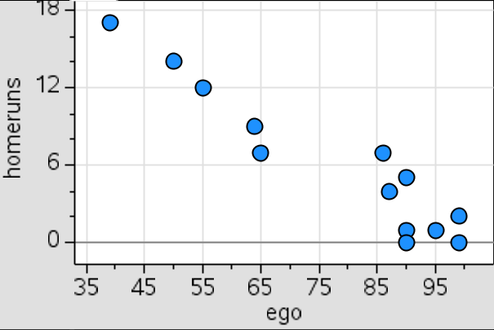
HR’s(per game) vs Ego Level
The first look at the scatterplot shows a fairly linear pattern trending in a negative direction

Slide 13
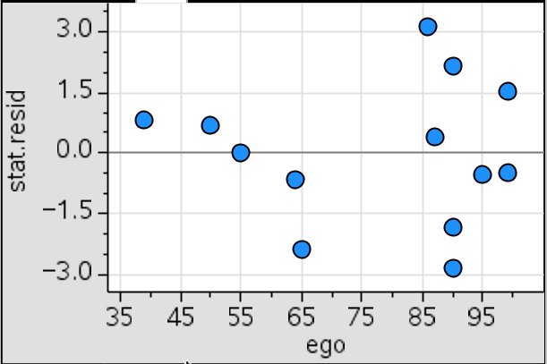
Residual vs Ego Level
A linear model is a good fit since this residual plot is randomly scattered

Slide 14
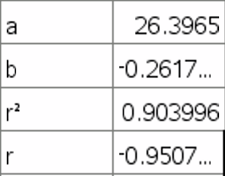
Regression Statistics
Predicted Homeruns per game = 26.3965 – 0.2617(Ego Level)

Slide 15
Interpret the slope
b = -.2617
For every 1 unit increase in the Ego level, our model predicts an average decrease of about -.2617 in the number of homeruns hit per game.

Slide 16
Interpret the y-intercept
a = 26.3965
At an Ego level set at Zero our model predicts about 26 homeruns hit per game.

Slide 17
Interpret the correlation coefficient
r = -.9507
There is a strong negative linear association between Ego level and the number of homeruns hit in a game.

Slide 18
Interpret the coefficient of determination
R² = .9040
90.4% of the variation in homeruns hit per game can be explained by the approximate linear relationship with the Ego level.

Slide 19
The End…High Fives for everyone!

