Slide 1
Team Type Problem
Seinfeld Racing Team

Slide 2
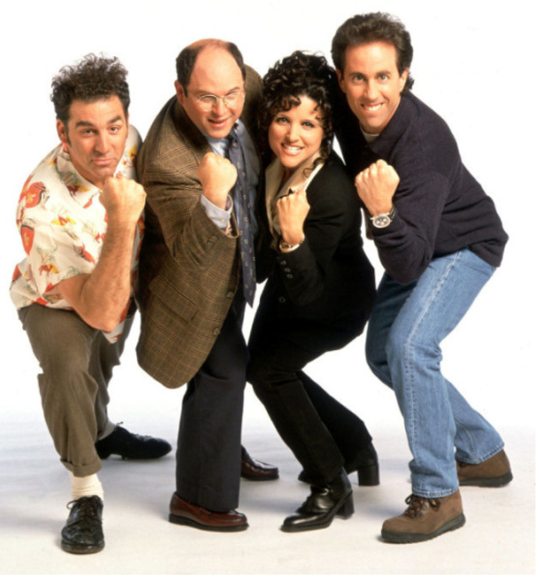
The Seinfeld Four are going to run a relay race.

Slide 3
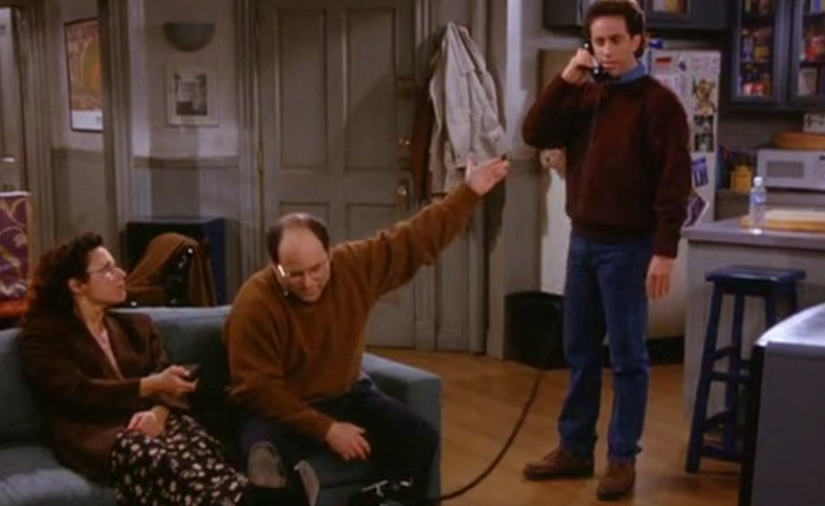
The only problem with their running team is………
I choose not to run!

Slide 4
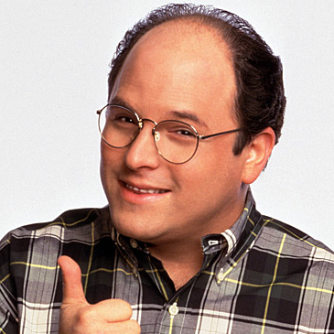
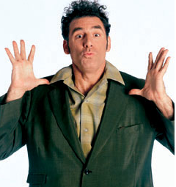
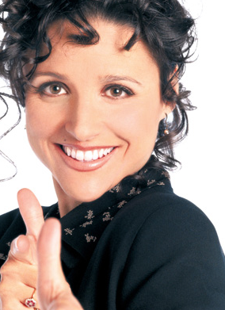
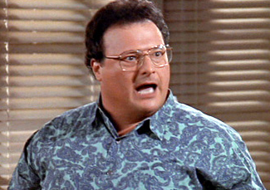
Their individual times follow a Normal Distribution.
GEORGE
KRAMER
N(12.3, 2.9)
N(11.2, 4.2)
And our alternate
ELAINE
NEWMAN
N(10.2, 2.6)
N(17.3, 1.8)

Slide 5
The combined times of our racers also follow a Normal Distribution
This statement must be on your papers on an FRQ.
Team Combined Mean
μ_{team} = 12.3 + 11.2 + 10.2 + 17.3 = 51 seconds
Team Standard Deviation
σ_{team} = √ 2.9² + 4.2² + 2.6² + 1.8² = 6.00417 seconds
Team Time N(51, 6.00417)

Slide 6
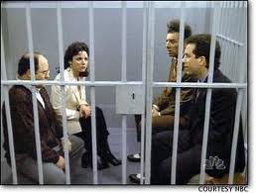
What is the probability that the Seinfeld Racing Team can beat their goal of 48 seconds?

Slide 7
What is the probability that the Seinfeld Racing Team can beat their goal of 48 seconds?
P( X < 48)?
Use the most interesting formula in the world!
P(Z < -.50)

Slide 8
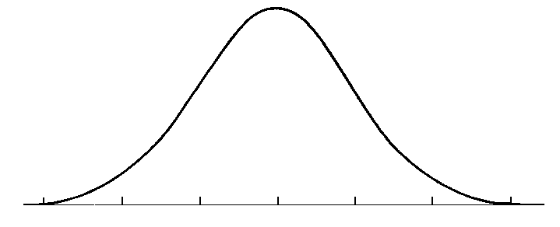
What is the probability that the Seinfeld Racing Team can beat their goal of 48 seconds?
P(Z<-.50)
Use normalcdf(-1000, -.50)
μ
P = .3085
The probability of the Seinfeld Racing Team beating their goal of 48 seconds is about .3085

